Slide 1
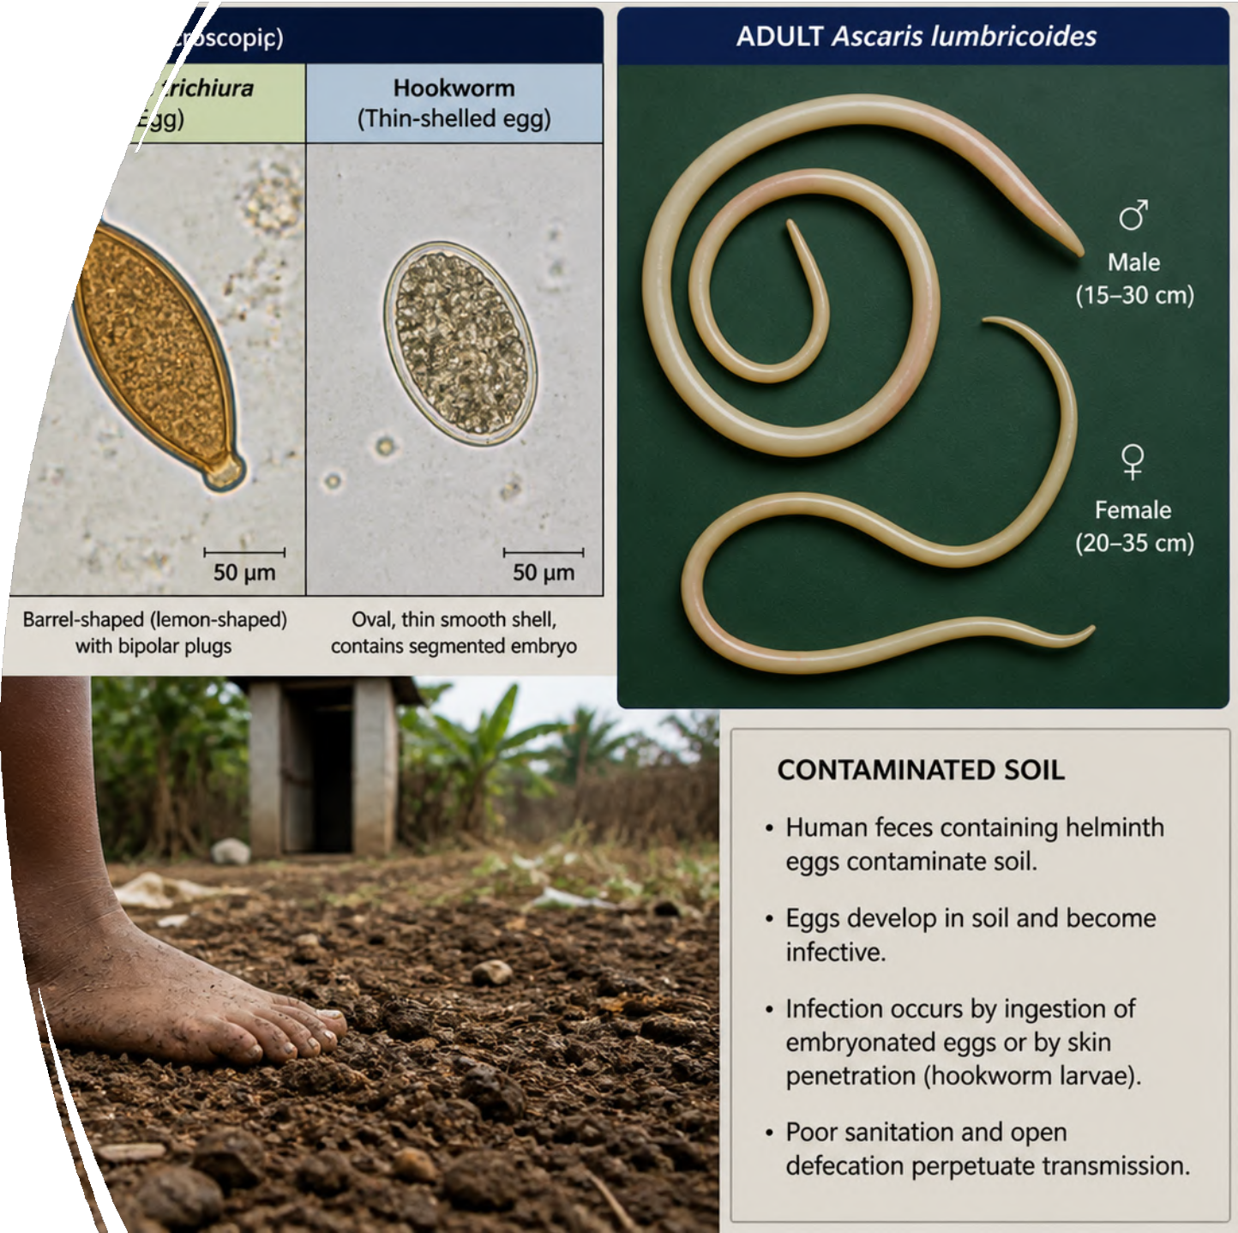
Lecture 6: Intestinal Infections with Parasites – Part 2
Prof. Hazem Aqel
Basic Medical Sciences College pf Medicine
Al-Balqa Applied University

Slide 2
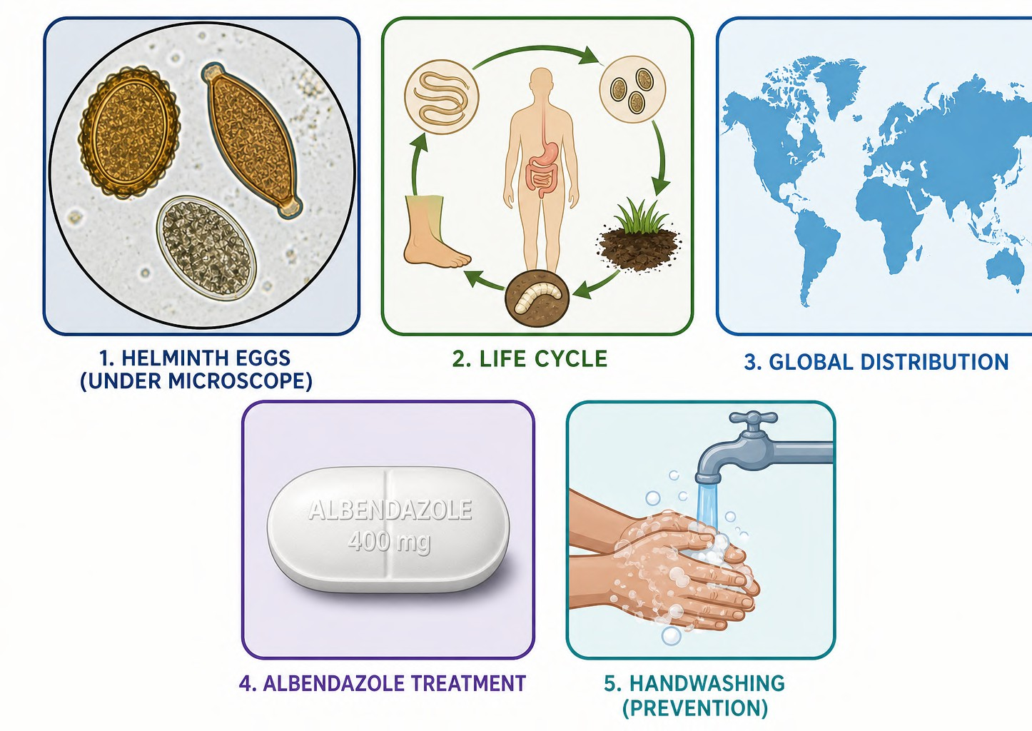
Learning Objectives
•
Describe the microbiological features (morphology, eggs, life cycles) of major soil-transmitted and other intestinal helminths.
Explain pathogenesis, including larval migration, mechanical damage, and nutritional impact in the GIT.
Compare global and Jordan-specific epidemiology, noting declining trends in STH.
Select diagnostic methods (stool concentration, egg identification) and interpret findings.
Outline treatment, prevention (WASH + deworming), and public health control strategies.
•
•
•
•

Slide 3
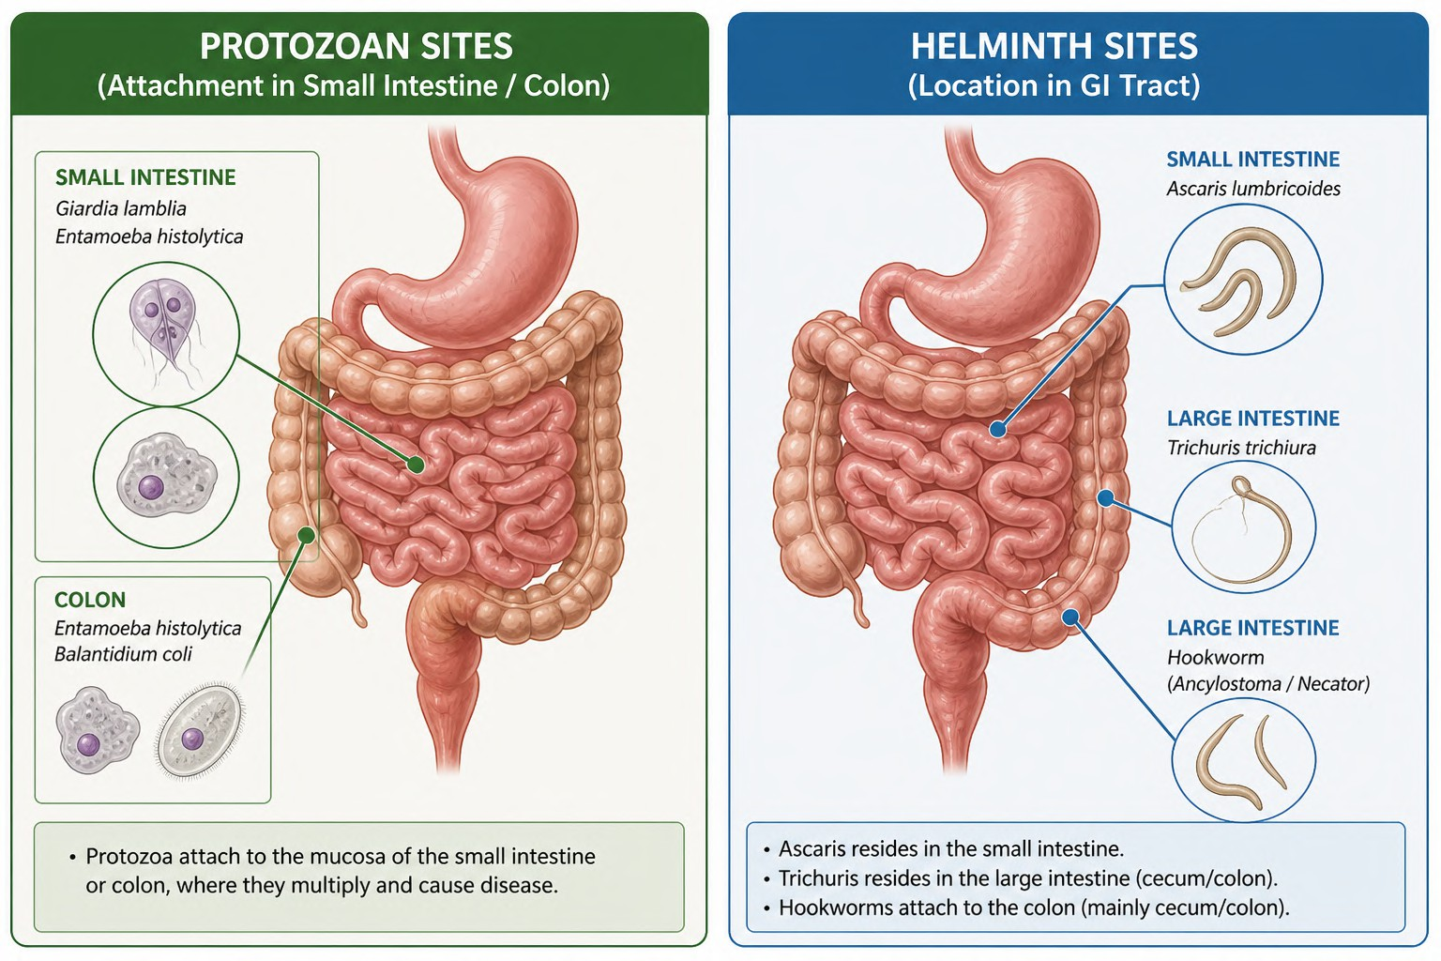
Overview – Linking Part 1 to Part 2
•
Part 1 focused on protozoa (Giardia, Entamoeba,
Cryptosporidium) → mainly fecal-oral cysts, watery/chronic diarrhea
Part 2: Helminths — larger, multicellular; eggs/larvae in soil or direct transmission
Syndromes: Asymptomatic light infections → heavy burden causes malnutrition, anemia, intestinal obstruction, growth delay
Transmission: Soil contamination (STH), autoinfection, food/undercooked meat
Unique digestive microbiology angle: Helminths often cause chronic low-grade inflammation/malabsorption without acute invasion like Entamoeba
•
•
•
•

Slide 4
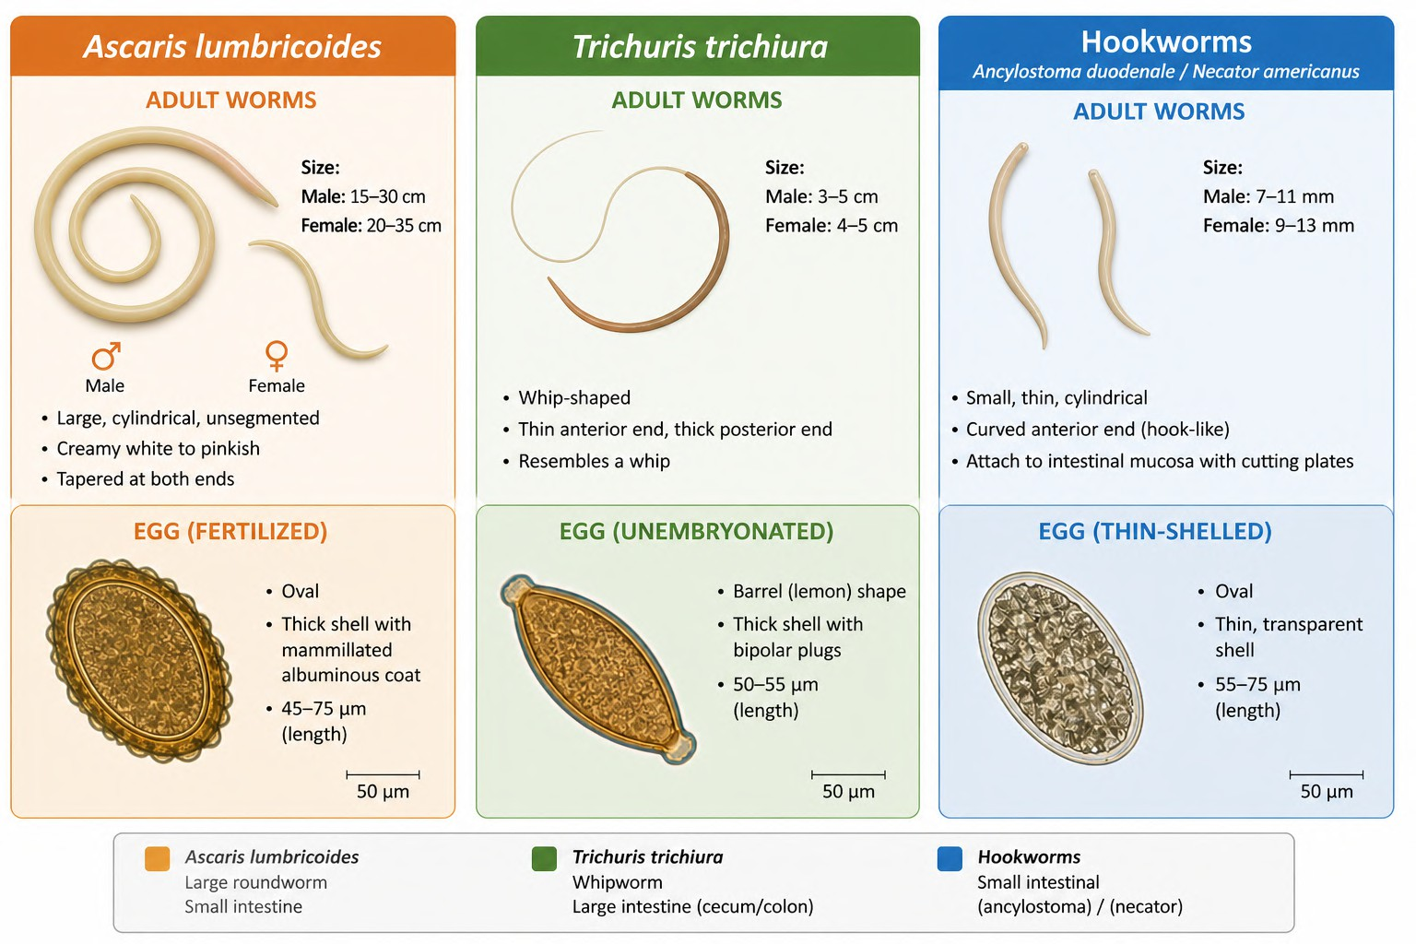
Soil-Transmitted Helminths (STH) – Quick Reference
Ascaris lumbricoides (roundworm) — largest, most common
Trichuris trichiura (whipworm)
Hookworms (Ancylostoma duodenale / Necator americanus)
Global burden: ~1.5 billion infected (24% world population); children most affected
Contrast with Part 1: No cysts; eggs embryonate in soil; no person-to-person direct spread (except H. nana)

Slide 5
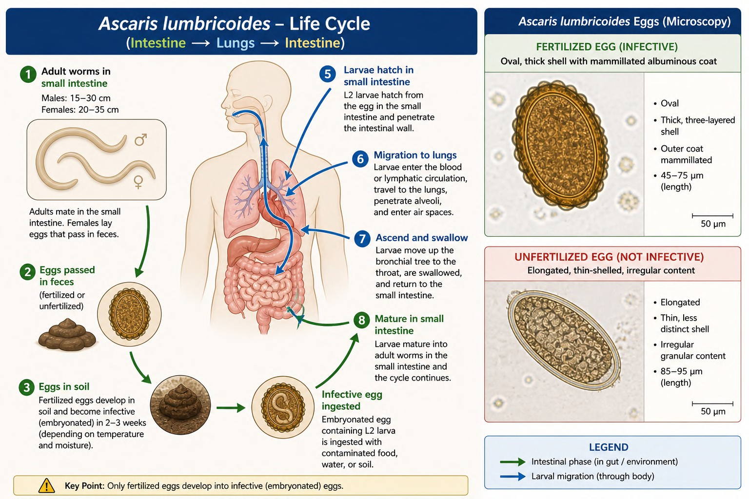
Ascaris lumbricoides – Microbiology & Life Cycle
•
Nematode; adult females up to 35 cm, males 15–30 cm; fertile eggs (thick
mammillated shell, 45–75 µm)
•
Life cycle: Ingestion of embryonated eggs
* larvae hatch in small intestine →
penetrate mucosa → migrate via
blood/lungs (cough/swallow) → mature in jejunum (2–3 months)
High egg output (up to 200,000/day/female); eggs highly resistant in soil
Microbiological highlight: Larval pulmonary migration phase (Löffler syndrome possible)
•
•

Slide 6
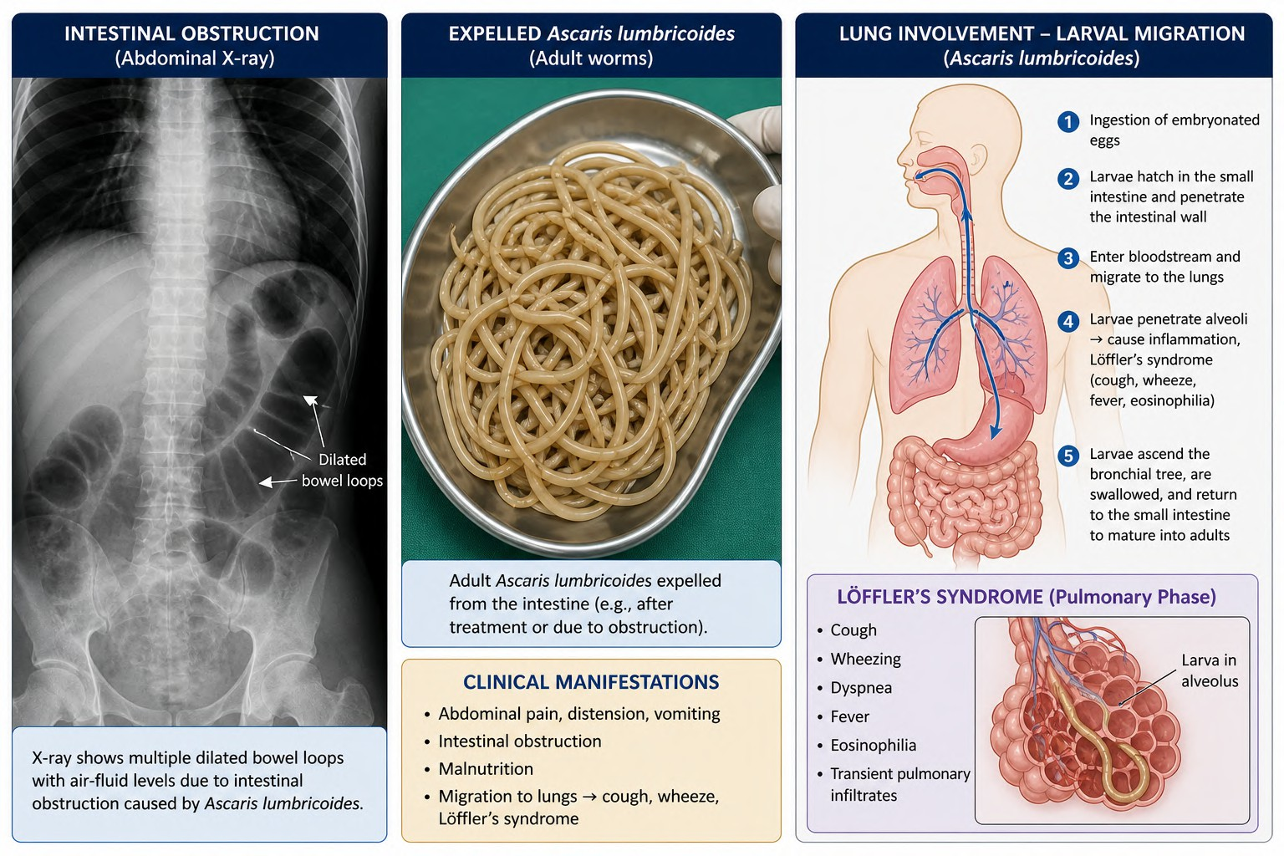
Ascaris – Pathogenesis & Clinical Features
Pathogenesis: Mechanical obstruction (heavy load), nutrient competition (malabsorption of proteins/fats), larval migration (eosinophilia, pneumonitis)
Symptoms: Often asymptomatic; heavy infection → abdominal pain, distension, malnutrition, growth stunting, rare bowel obstruction or biliary ascariasis
Common in children; eosinophilia during migration phase

Slide 7
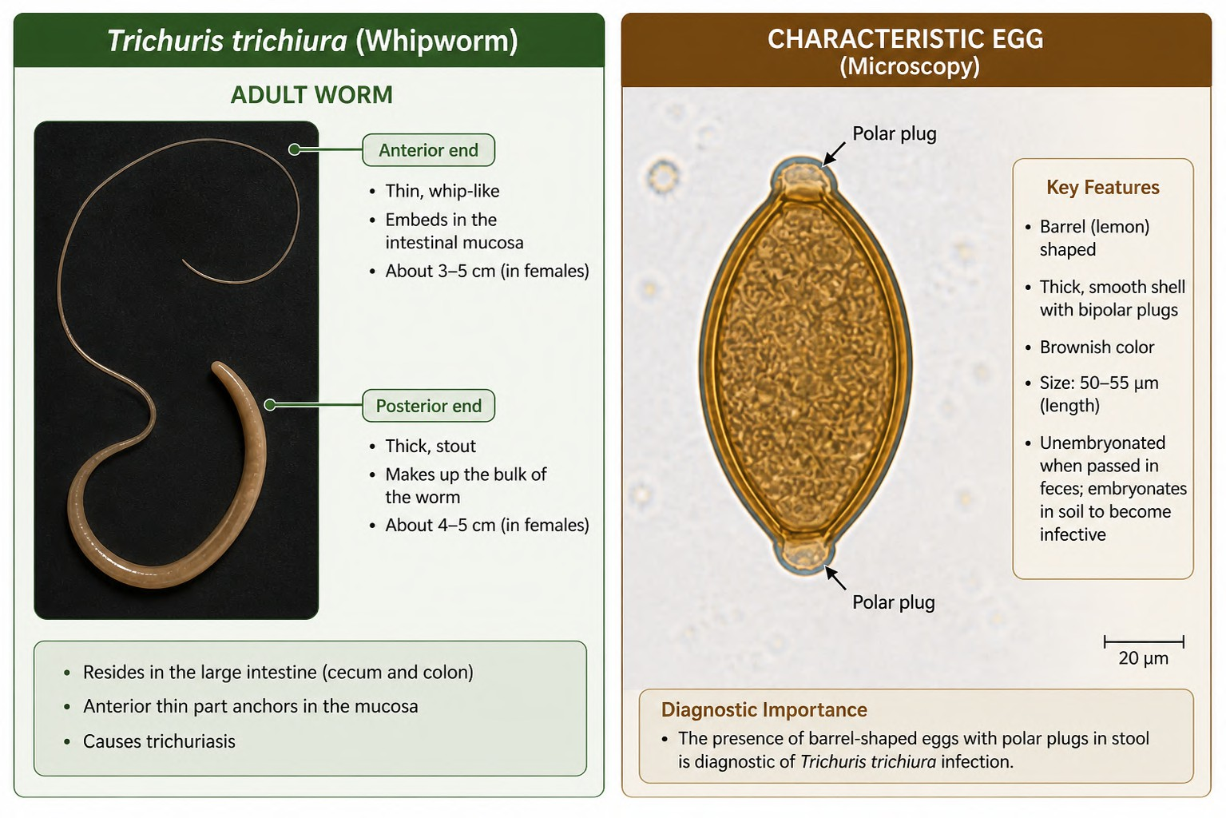
Trichuris trichiura – Microbiology & Life Cycle
Whipworm; adults 3–5 cm (thread-
like anterior embeds in mucosa)
Eggs: Barrel-shaped with polar plugs (50 × 20 µm), embryonate in soil
Life cycle: Ingestion of eggs → hatch in small intestine → larvae mature in cecum/colon (no systemic migration)
Heavy infections cause chronic colitis-like picture

Slide 8
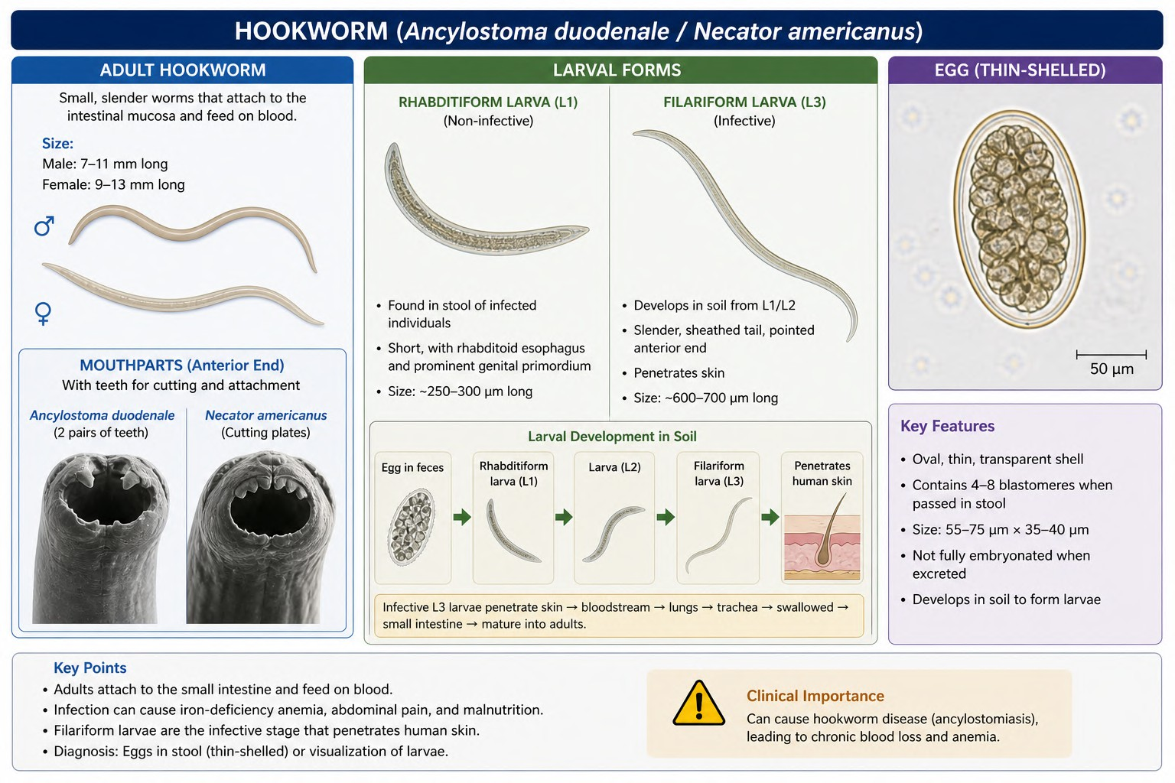
Hookworms – Microbiology & Life Cycle
Ancylostoma duodenale & Necator americanus; adults ~1 cm, buccal capsule with teeth/plates
Eggs: Thin-shelled, oval (60 × 40 µm), embryonate quickly in soil
Life cycle: Filariform larvae penetrate skin (ground itch) → lungs
* swallowed → attach to small intestine mucosa, suck blood
Key feature: Chronic blood loss (0.03–0.2 ml/worm/day)

Slide 9
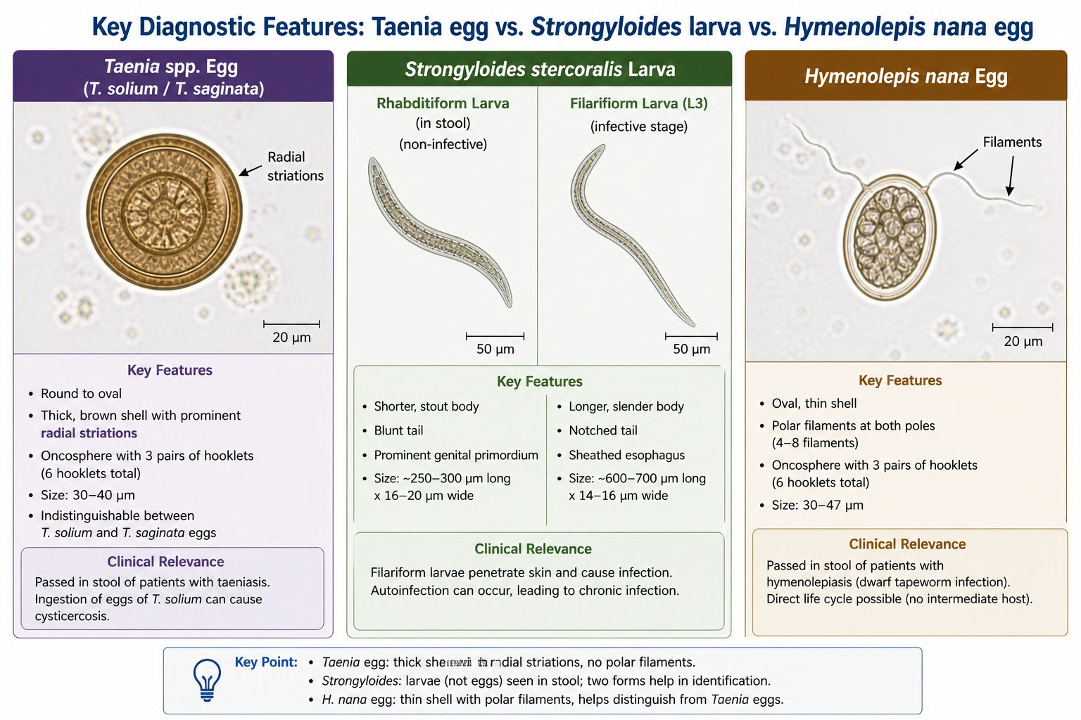
Other Intestinal Helminths in Part 2
Taenia spp. (beef/pork tapeworm): Proglottids/eggs; cysticercosis risk with T. solium
Strongyloides stercoralis: Autoinfection cycle (rhabditiform → filariform larvae); hyperinfection in immunocompromised
Hymenolepis nana (from Part 1 review): Direct cycle, polar filaments in eggs
Enterobius vermicularis (pinworm): Perianal eggs, autoinfection

Slide 10
Pathogenesis Comparison – Helminths vs. Protozoa
STH: Nutritional drain (Ascaris), blood loss (hookworm), mucosal
embedding (Trichuris) → anemia, protein-energy malnutrition, cognitive
impact
Heavy burden complications: Obstruction (Ascaris), rectal prolapse (Trichuris), severe anemia
Immune response: Eosinophilia common; chronic infections modulate immunity
Synergy with Part 1: Co-infections (e.g., Giardia + Ascaris) worsen malnutrition

Slide 11
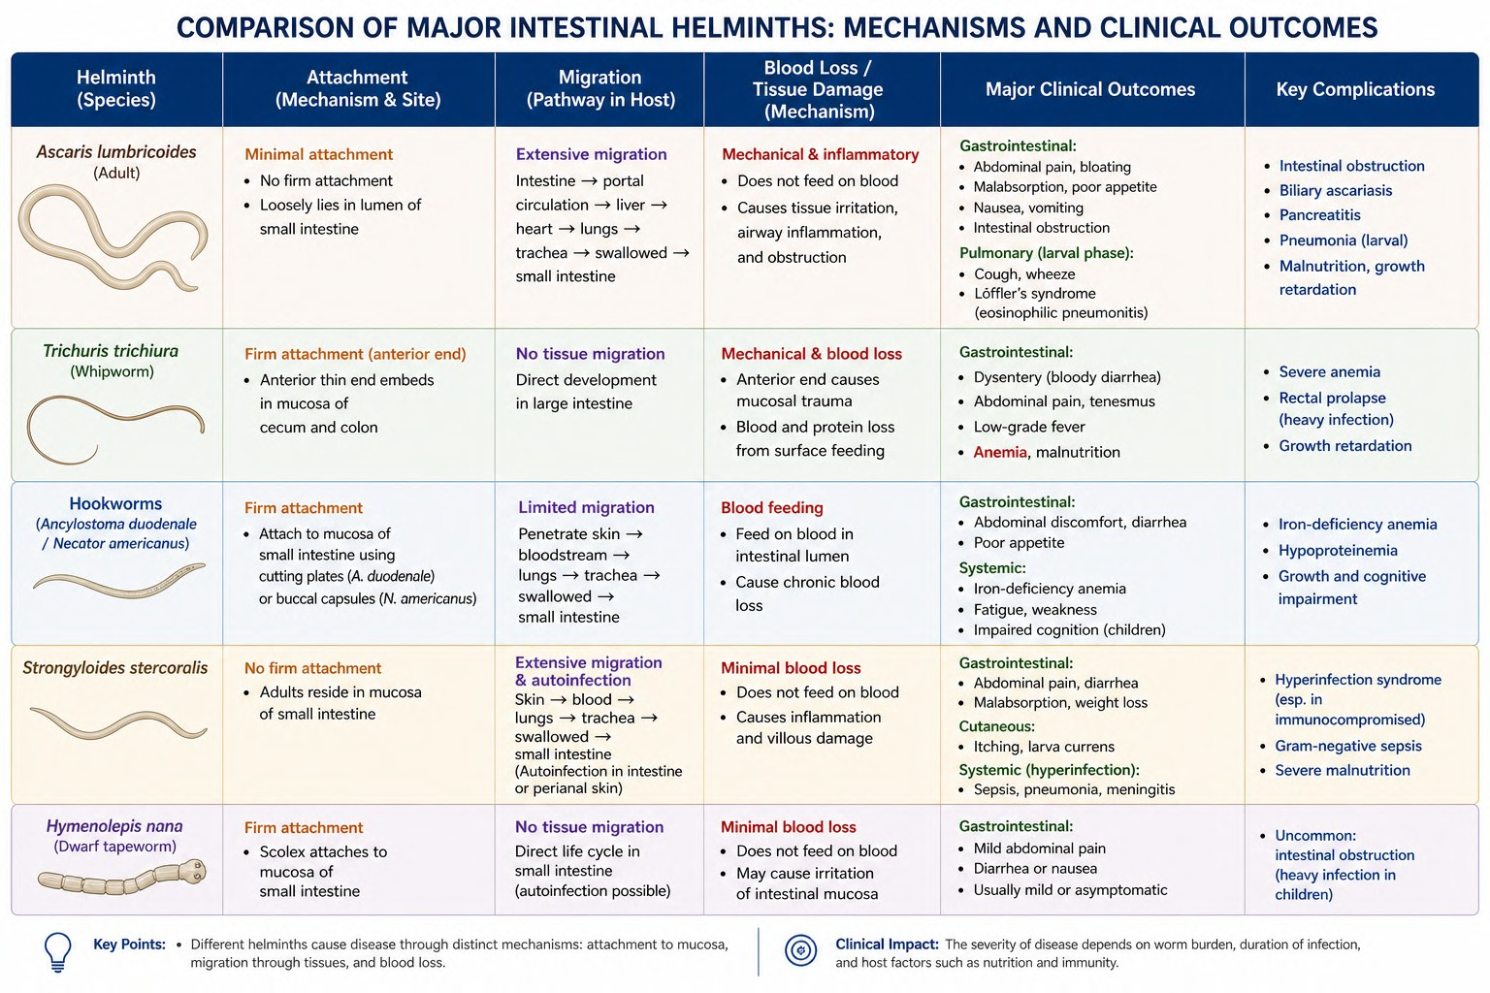

Slide 12
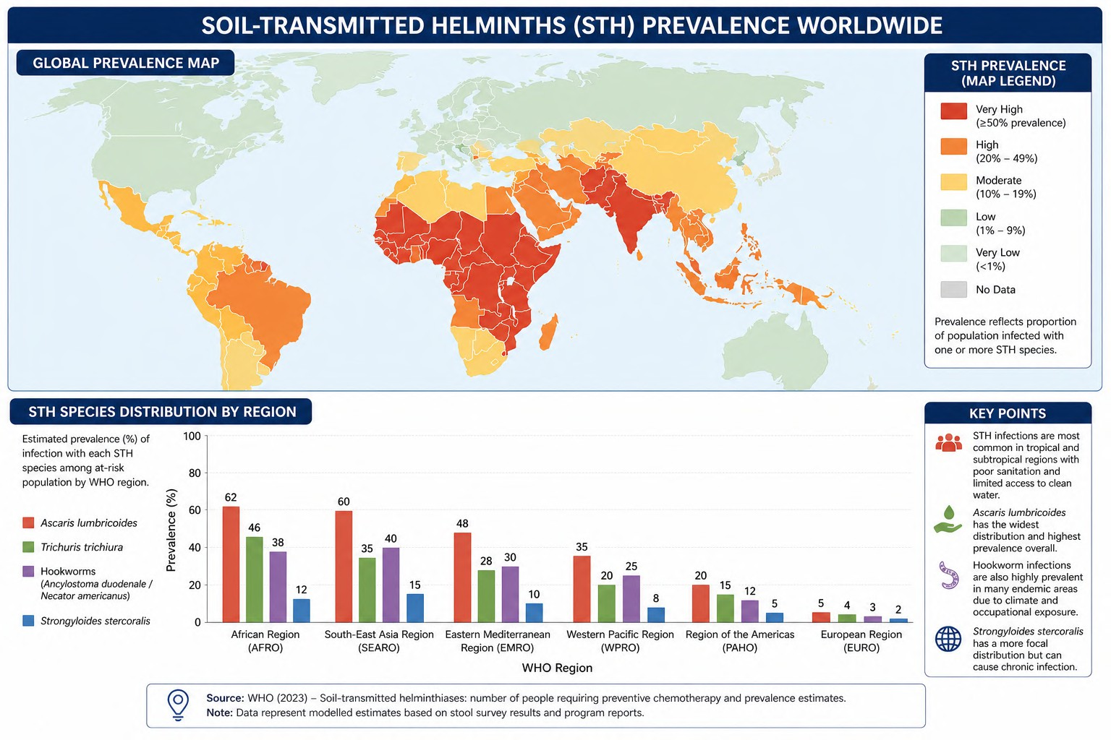
Global Epidemiology
STH affect ~1.5 billion people (24% global population); highest burden in sub-Saharan Africa, Asia, Latin America
Ascaris: ~800+ million; Trichuris & hookworms hundreds of millions
Declining trends with MDA (mass drug administration), but hotspots persist; children 5–15 years most affected
Morbidity: 1.38 million DALYs; impacts growth, education, productivity in endemic areas

Slide 13
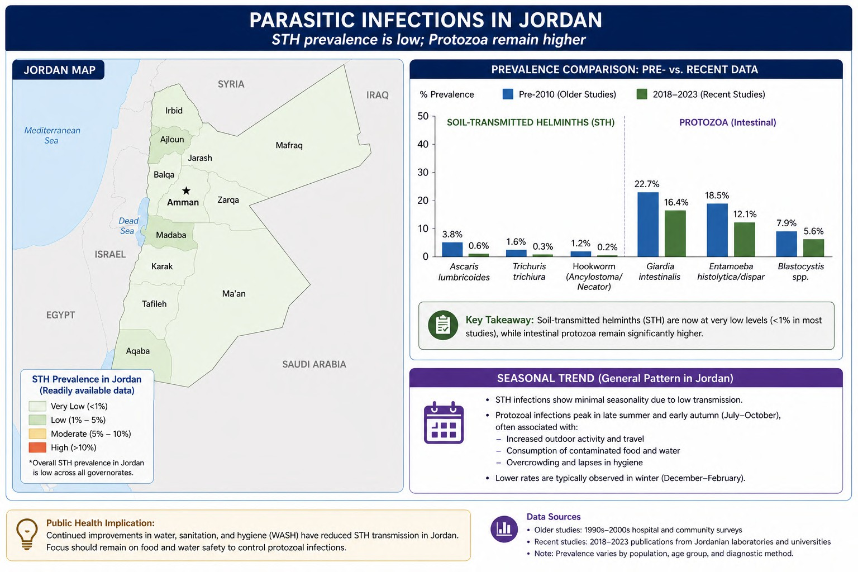
Epidemiology in Jordan – Local Relevance
•
Overall intestinal parasites historically high (up to
44% in northern hospitals, Giardia/Entamoeba dominant); STH much lower
Ascaris lumbricoides, Trichuris, hookworm, and Hymenolepis nana reported at low rates (<1–5% in older studies); recent data show declining trends in helminths (e.g., H. nana and hookworm decreasing)
Protozoa (Giardia, Entamoeba) remain more prevalent; STH rare due to improved sanitation, deworming, and urban/rural differences
Jordan pearl: Focus on vulnerable groups (children in rural areas, refugees); summer peaks for some parasites; continued surveillance needed despite low STH burden
•
•
•

Slide 14
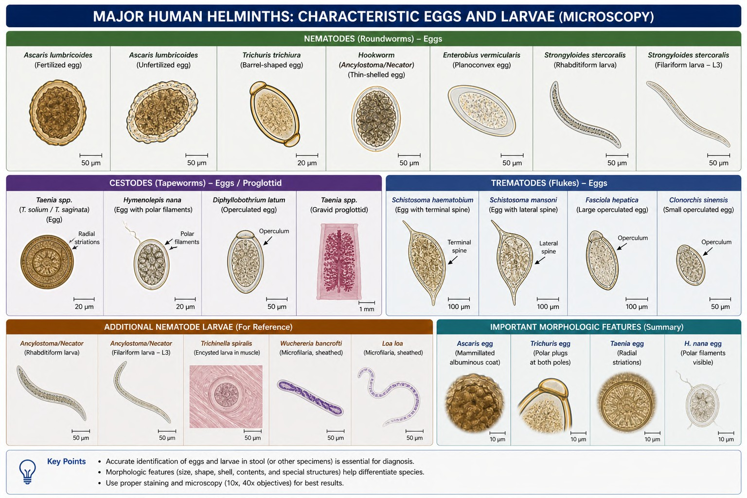
Diagnosis – Microbiological Focus
Stool examination: Direct wet mount + concentration techniques (formol-
ether) for eggs/larvae
Key morphology: Ascaris (mammillated), Trichuris (polar plugs), hookworm (thin-shelled)
Scotch tape test for Enterobius; Baermann technique or agar plate for Strongyloides
Eosinophilia clue; serology/PCR in complex cases (Strongyloides, cysticercosis)

Slide 15
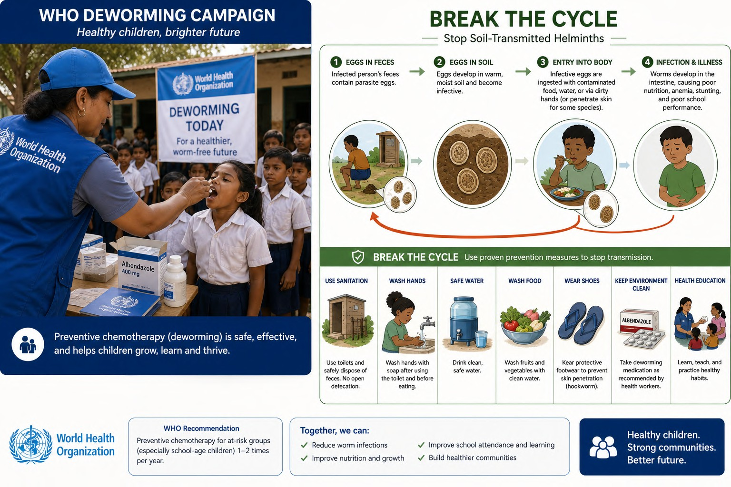
Treatment & Prevention
Single-dose albendazole or mebendazole highly effective for STH (WHO MDA programs)
Ivermectin for Strongyloides; praziquantel for Taenia
Prevention: WASH (water, sanitation, hygiene), shoe-wearing, handwashing, safe food, periodic deworming
Public health: Integration with school health programs; monitoring resistance

Slide 16
Summary, Key Takeaways & Clinical Integration
Key Takeaways (boxed):
  STH microbiology: Egg identification & life cycles critical for diagnosis
  Global: Massive burden reduced by MDA; Jordan: STH low but protozoa co-circulate
  Pathogenesis: Nutritional & mechanical damage in heavy infections
  Management: Albendazole + WASH; prevention more impactful than treatment alone
Quick Poll + Briefcase (e.g., child with failure to thrive + eosinophilia in endemic setting)
Link to Part 1: Combined approach for mixed infections common in practice

Slide 17
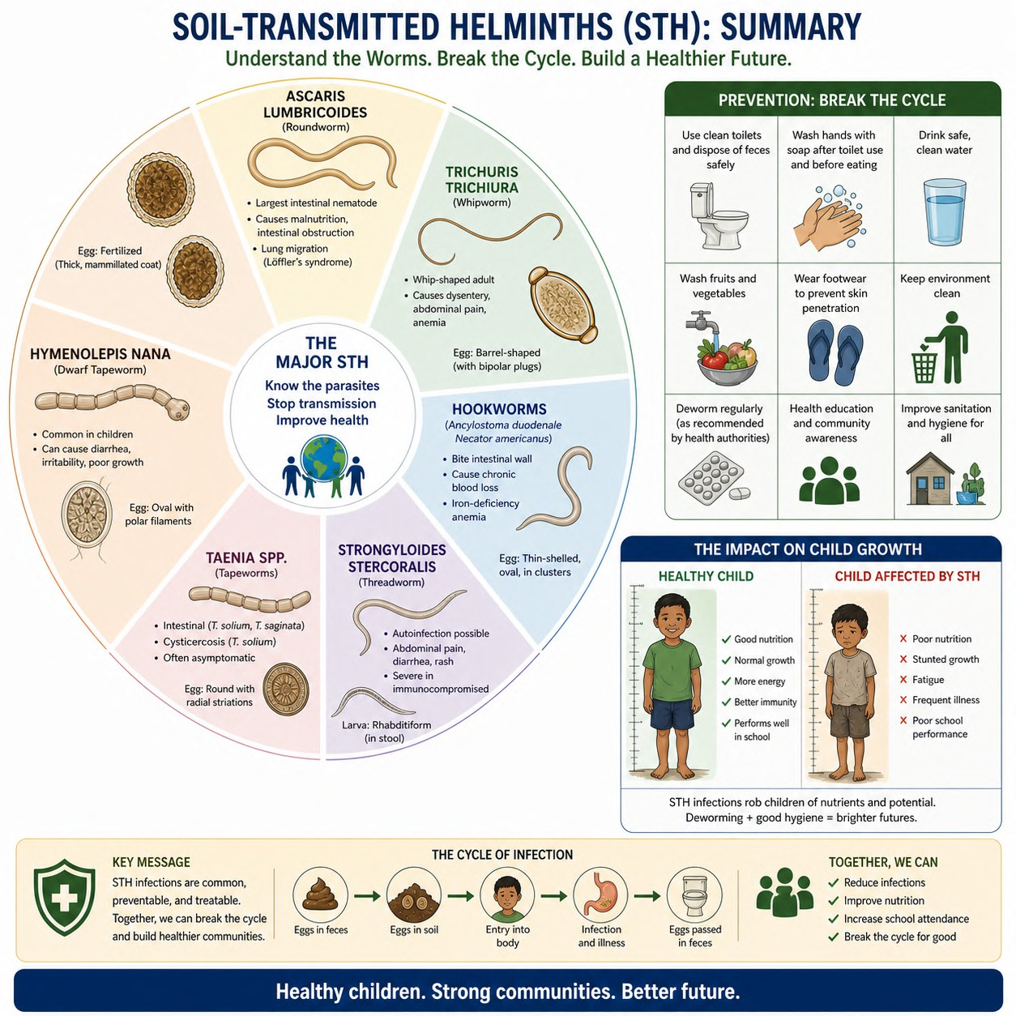

Slide 18
ANY QUESTIONS???
THANK YOU

