Slide 1
ANS

Slide 2
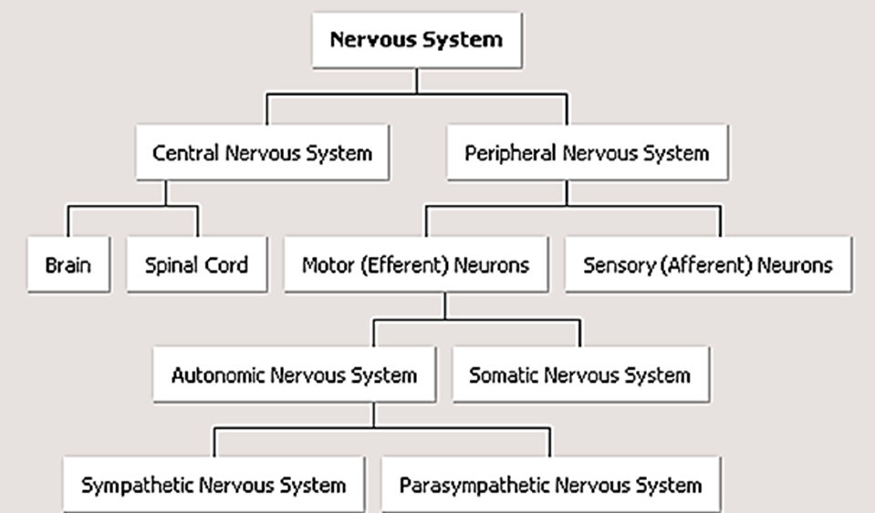

Slide 3
General Information
Autonomic nervous system is a set of pathways to and from the central nervous system (CNS) that innervates and regulates smooth muscle, cardiac muscle, and glands.
Autonomic nervous system plays a major role in homeostasis but also controls non-homeostatic organs such as the reproductive system.
Autonomic nervous system output to many visceral organs is continuous (tonic). Unlike the somatic nervous system, who’s out-put to skeletal muscle is phasic and undergoes periods of repose;
Autonomic nervous system activity changes in anticipation of demands.
Autonomic nervous system output is coordinated with somatic activity to provide supportive visceral function (e.g. blood flow)
One of the most striking characteristics of the auto­nomic nervous system is the rapidity and intensity with which it can change visceral functions. For instance, within 3 to 5 seconds it can increase the heart rate to twice normal,
Autonomic nervous system has three divisions: sympathetic, parasympathetic, and enteric.
About 75 percent of all parasympa­thetic nerve fibers are in the vagus nerves (cranial nerve X)

Slide 4
Organization of The ANS
 | Parasympathetic | Sympathetic
General Characteristics | limited ramification (1:1) discreteمنفصل discharge affects specific effector system, individually anabolic in nature | intense ramification تشعب(1:20), very diffuse, generalize action Catabolic in nature (expenditure in nature)
Location of the ganglia | located in or near the effector organs | located in the para-vertebral chain.
Origin of the pre-ganglionic neurons | Originate in the nuclei of cranial nerves III, VII, IX, and X; and in spinal cord segments S2-S4, or the cranio-sacral region. Long and myelinated | Originate in spinal cord segments T1-L3, or the thoraco-lumbar region and are Short and myelinated
Postganglionic neurons characteristics | short and un-mylinated | long and un-mylinated

Slide 5
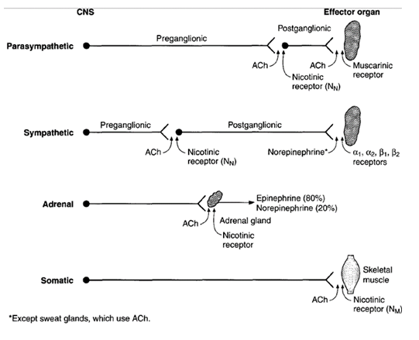

Slide 6
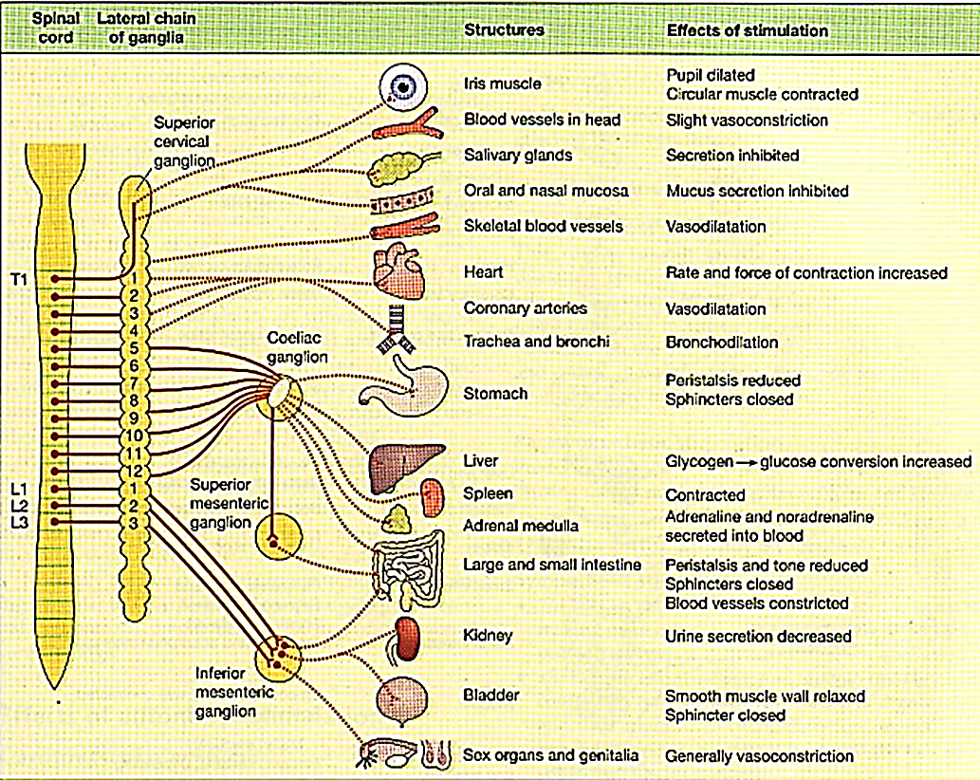

Slide 7
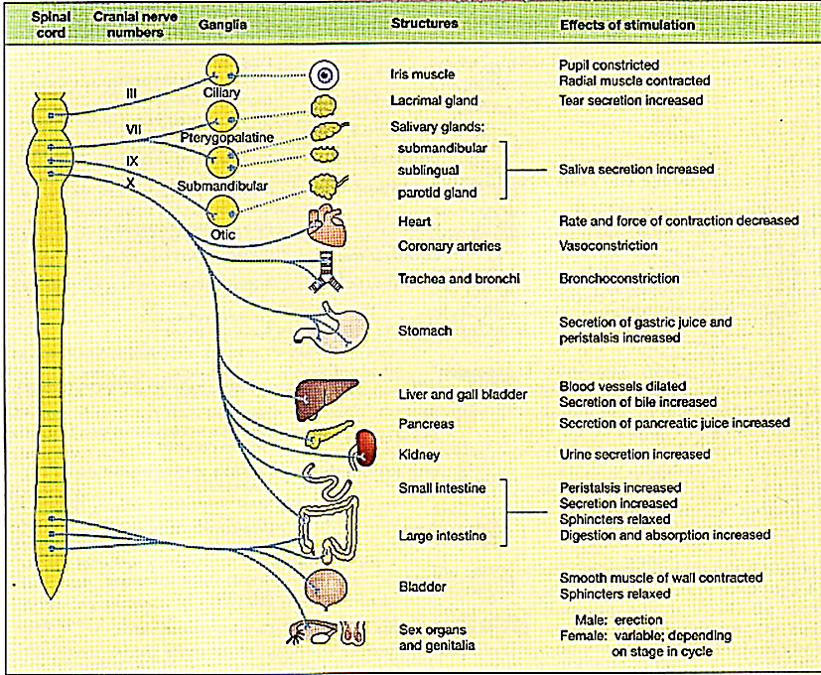

Slide 8
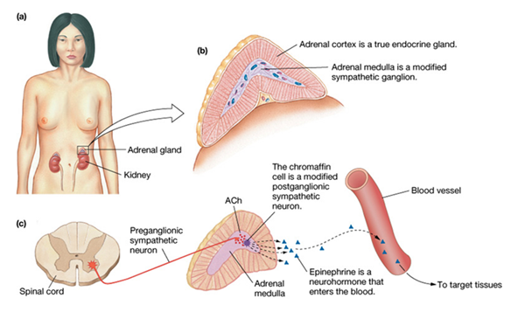

Slide 9
Sympathetic fibers which do not synapse in the thoracic and upper lumber para-vertebral ganglia of the sympathetic chain leave the ganglia and synapse with post-ganglionic neurons in other ganglia as followings:
1. Cervical ganglia: These receive extensions of the sympathetic trunk from T1 to T7. Their post-ganglionic fibers distribute themselves to structures in the head, neck and upper limbs.
2. Collateral ganglia (Coeliac and mesenteric): They are found in the abdomen and pelvis and their post-ganglionic fibers supply the abdominal viscera down to the proximal part of the colon.
3. Sacral ganglia: These receive a caudal extension of the sympathetic trunk from lower thoracic and upper lumber segments. Their post-ganglionic fibers are distributed to the distal colon, pelvic organs and lower limb.
The adrenal medulla is essentially a sympathetic ganglion in which the post-ganglionic cells have lost their axons and secrete nor-epinephrine, epinephrine, and some dopamine directly into the blood-stream.
There is usually no acetylcholine in the circulation
Pre-ganglionic fibers synapse directly on chromaffin cells in the adrenal medulla.
The chromaffin cells secrete epinephrine (80%) and nor-epinephrine (20%) into the blood and these two hormones in turn are carried in the blood to all tissues of the body.

Slide 10
The circulating epinephrine and nor-epinephrine have almost the same effects on the different organs as the effects caused by direct sympathetic stimulation except:
The circulating epinephrine and nor-epinephrine effects last 5 to 10 times as long as sympathetic stimulation
because both these hormones are removed from the blood slowly over period of 1 to 3 minutes
The circulating epinephrine and nor-epinephrine are able to stimulate structures in the body that are not innervated by direct sympathetic fibers.
The dual mechanism of sympathetic stimulation and circulating epinephrine and nor-epinephrine provides a safety factor, with one mechanism substituting for the other if it is missing.
Pheochromocytoma is a tumor of the adrenal medulla that secretes excessive amounts of catecholamine and is associated with increased excretion of 3-methoxy-4-hydroxymandelic acid (VMA).

Slide 11
In most situations, the sympathetic and parasympathetic act “synergistically”مؤازرة
This functional synergy is particularly evident in reflex effects exerted on heart by baroreceptors.
Excitation of the baro-receptors when the arterial blood pressure rises, decrease the heart rate and contractility of the heart; this is brought about by an increase in the activity of parasympathetic fibers to the heart, accompanied by decrease in sympathetic activity.
In many organs receiving both sympathetic and parasympathetic innervation, the parasympathetic effect predominates under physiological conditions- these include the urinary bladder and some exocrine glands.
There are also organs with only sympathetic or only parasympathetic innervation. Almost all blood vessels, spleen some exocrine glands and smooth musculature of hair follicles receive only sympathetic innervation.
Neurotransmitters of the ANS
Adrenergic neurons release nor-epinephrine as the neurotransmitter.
Cholinergic neurons, whether in the sympathetic or parasympathetic nervous system, release acetylcholine (ACh) as the neurotransmitter.
Non-adrenergic, non-cholinergic neurons include some post-ganglionic parasympathetic neurons of the gastrointestinal tract, which release substance P, vaso-active intestinal peptide (VIP), or nitric oxide (NO).

Slide 12
Generally :
The neurons that are cholinergic are:
All pre-ganglionic neurons.
The anatomically parasympathetic post-ganglionic neurons.
The anatomically sympathetic post-ganglionic neurons which innervate sweat glands.
The anatomically sympathetic neurons which end on blood vessels in skeletal muscles and produce vaso-dilation when stimulated.
The remaining post-ganglionic sympathetic neurons are nor-adrenergic

Slide 13
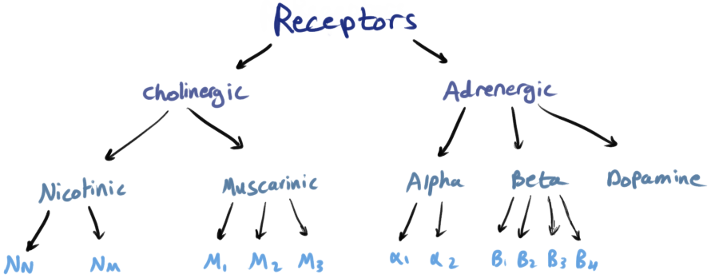
ANS Receptors

Slide 14
Adrenergic Receptors
Adrenergic Receptors has 4 Ligands :
Nor-adrenaline, the transmitter substance release by post-ganglionic sympathetic release.
Adrenaline, a hormone secreted along with nor-adrenaline by adrenal medulla.
Dopamine, the metabolic precursor of nor-adrenaline and adrenaline, which functions as a neuro-transmitter in its own right in brain, and possible also in the periphery.
Isoprenaline, a synaptic derivative of nor-adrenaline that is not found in the body.
Adrenergic receptors are classified into α and β subtypes, and these subtypes differ in their potency to the ligands (agonists) :
α Noradrenalin > adrenaline > isoprenaline
β Isoprenaline > adrenaline > noradrenalin
The basic adrenergic receptor structure is 7 trans-membrane domains (serpentine receptor)

Slide 15
Remember :
Gαs-coupled receptors:
Gαs interacts with adenylyl cyclase (AC).
⇒
adenylyl cyclase catalyzes the production of cAMP from ATP;
⇒
cAMP activates protein kinase A,
Gαi-coupled receptors:
Gαi interacts with adenylyl cyclase (AC).
⇒
adenylyl cyclase is inhibited
⇒
the production of cAMP is inhibited too

Slide 16
Gαq-coupled receptors:
Gαq interacts with phospholipase C
⇒
increase in (IP3) levels
⇒
Increase in intracellular [Ca₂⁺].

Slide 17
Type | Locations | Effect | Sensitivity | Mechanism of action | Notes
άl Receptors | vascular smooth muscle of the skin the gastrointestinal (GI) bladder sphincters the radial muscle of the iris | Excitation | Equally sensitive to nor-epinephrine and epinephrine | Gq protein | nor-epinephrine must be present in high enough concentrations to activate ά1 receptors.
ά2 Receptors | presynaptic nerve terminals platelets fat cells walls of the GI tract | Inhibition | --------------------------------------------------------------------------------------------- | Gi protein | ------------------------------------------------------------------------------------------
β1 Receptors | sinoatrial (SA) node atrioventricular (AV) node ventricular muscle of the heart. | Excitation | sensitive to both nor-epinephrine and epinephrine, and are more sensitive than the άl receptors. | Gs protein | ------------------------------------------------------------------------------------------
β2 Receptors | vascular smooth muscle of skeletal muscle bronchial smooth muscle the walls of the GI tract and bladder | Inhibition and relaxation | more sensitive to epinephrine than to nor-epinephrine | Gs protein | ------------------------------------------------------------------------------------------

Slide 18
Type | Locations | Effect | Sensitivity | Mechanism of action | Notes
β3 Receptors | --------------------------------------------------------------------------------------------------------------------- | ------------------------------------ | --------------------------------------------------------------------------------------------- | --------------------------------------------------------------- | may be involved in regulating the metabolism of fatty acids, and could be the site of anti-obesity drugs in the future
β4 Receptors | --------------------------------------------------------------------------------------------------------------------- | ------------------------------------ | --------------------------------------------------------------------------------------------- | --------------------------------------------------------------- | Not discovered function

Slide 19
Cholinergic Receptors
Acetylcholine is secreted by neurons in many areas of the nervous system but speciﬁcally by :
(1) the terminals of the large pyramidal cells from the motor cortex,
(2) several different types of neurons in the basal ganglia,
(3) the motor neurons that innervate the skeletal muscles,
(4) the preganglionic neurons of the autonomic nervous system,
(5) the postganglionic neurons of the parasympathetic nervous system, and
(6) some of the postganglionic neurons of the sympathetic nervous system (sweat glands, and blood vessels
in skeletal muscles .. and they produce vaso-dilation when stimulated.)
In most instances, acetylcholine has an excitatory effect; however, it is known to have inhibitory effects at some peripheral parasympathetic nerve endings, such as inhibition of the heart by the vagus nerves

Slide 20
Nicotinic Cholinergic Receptors
Reason for this name
this type of receptors are known as nicotinic, because these types of receptors stimulated by nicotine which mimics the action of Ach but having more affinity than Ach.
Types and Location
(N_{N}) : found in the autonomic ganglia of the sympathetic and parasympathetic nervous systems, and in the adrenal medulla
❖ (N_{M}) : found in the neuromuscular junction
Activation and Blocking
They are activated by ACh or nicotine, and are blocked by ganglionic blockers (e.g., hexamethonium) in the autonomic ganglia, but not at the neuromuscular junction … These actions are not blocked by atropine
Effect
They produce Activation (Excitation)
Mechanism of Action
ACh binds to ά subunits of the nicotinic Ach receptor. The nicotinic ACh receptors are also ion channels for Na⁺ and K⁺.

Slide 21
Subunits
Nicotinic cholinergic receptors are made up of five sub-units that form a central channel which, when the receptor is activated, permits the passage of Na and other cations. The sub-units are (2 ά, β, δ, γ)
Muscarinic Cholinergic Receptors
Reason for this name
The substance known as muscarine from mushroom (amatina muscaria) is activating these type of receptors, so named as muscarinic receptors.
Types and Location
❶ The M1 muscarinic receptors are located in the neural system.
❷ The M2 muscarinic receptors are located in the heart,
❸The M3 muscarinic receptors are located in :
the smooth muscles of the blood vessels causing vasodilation,
the lungs causing bronchoconstriction
smooth muscles of the gastrointestinal tract (GIT), which help in increasing intestinal motility and dilating sphincters many glands that help to stimulate secretion
in salivary gland and other glands of the body.

Slide 22
Activation and Blocking
They are activated by ACh and muscarine, and are blocked by atropine.
Effects
They are inhibitory in the heart (e.g., decreased heart rate, decreased conduction velocity in AV node).
And are excitatory in smooth muscle and glands (e.g., increased GI motility, increased secretion).
Subunits
Muscarinic receptors are G-protein coupled receptors (GPCRs also known as seven-trans-membrane domain receptors, serpentine receptor) which adrenergic receptor is one of its type
Mechanism of Action
Heart SA node: Gi protein, inhibition of adenylate cyclase, which leads to opening of K⁺ channels, slowing of the rate of spontaneous depolarization, and decreased heart rate.
Smooth muscle and glands: G_{q} protein, stimulation of phospholipase C, and increase in IP3 and intracellular [Ca₂⁺].

Slide 23
Areas of brain which are concerned with autonomic regulation
(1) Some of voluntary reflexes like the voiding of urine and defecation are controlled by cortical centers.
(2) Hypothalamus: Posterior hypothalamus regulate sympathetic function, anterior hypothalamus regulate
parasympathetic function though there is overlapping in distribution of hypothalamus nuclei
(3) Autonomic centers in brainstem
(4) Center in the cranial nerve nuclei and spinal cord
(5) The limbic system along with the hypothalamus produce the autonomic responses that accompany
states and activity such as: Feeding and drinking behavior, sexual behavior and fear and rage reaction
Medulla
Vasomotor center
Respiratory center
Swallowing, coughing, and vomiting centers
Pons
Pneumotaxic center
Midbrain
Micturition center

Slide 24
Transmission in Sympathetic Ganglia
The responses produced in post-ganglionic neurons by stimulation of their pre-ganglionic innervations include the following:
Fast excitatory post-synaptic potential: rapid depolarization that generate action potentials.
Slow inhibitory post-synaptic potential: a prolonged inhibitory depolarization that generate action potentials.
Slow excitatory post-synaptic potential: a prolonged excitatory depolarization that generate action potentials.
Late slow excitatory post-synaptic potential: It is very prolonged, lasting minutes rather than milliseconds
Cholinergic Discharge
In general way, the functions promoted by activity in the cholinergic division of the autonomic nervous system are those concerned with vegetative aspects of day-today living.
For example, cholinergic action favors digestion and absorption of food by increasing the activity of the intestinal musculature, increase gastric secretion, and relaxation of the pyloric sphincter.
For this reason, and contrast it with the “catabolic” nor-adrenergic division, the cholinergic division is sometimes called the “anabolic nervous system”.

Slide 25
Nor-Adrenergic Discharge
The nor-adrenergic division discharge as a unit in emergency situation. The effects of this discharge are of considerable value in preparing the individual to cope with the emergency, although it is important to avoid the teleological fallacy in the statement that is the system discharge in order to do this.
For example, nor-adrenergic discharge:
Relaxes accommodation and dilates the pupils (letting more light into the eye).
Accelerates the heart-beat and raise the blood pressure (providing better perfusion of the vital organs and muscles).
Constricts the blood vessels of the skin (which limits bleeding from wound).
Lower thresholds in the reticular formation (reinforcing the alert, aroused state)
Elevate plasma glucose and fatty acids level (supplying more energy).
On the basis of effects like these, Cannon called the emergency-induced discharge of the nor-adrenergic nervous system the “preparation for fight or flight”.

Slide 26
The emphasis on mass discharge in stressful situation should not obscure the fact that the nor-adrenergic autonomic fibers also sub-serve other functions.
For example, tonic nor-adrenergic discharge to the arterioles maintains arterial pressure, and variations in this tonic discharge are the mechanism by which carotid sinus feed-back regulation of blood pressure is affected
In addition, sympathetic discharge is decreased in fasting animals and increased when fasting animals are re-fed.
These changes may explain the decrease in blood pressure and metabolic rate produced by fasting and the opposite changes produced by feeding.

Slide 27
Sympathetic and Parasympathetic Tone
Normally, the sympathetic and parasympathetic systems are continually active
The value of tone is that it allows a single nervous system to both increase and decrease the activity of a stimulated organ.
For instance, sympathetic tone nor­mally keeps almost all the systemic arterioles constricted to about one-half their maximum diameter.
By increasing the degree of sympathetic stimulation above normal, these vessels can be constricted even more; conversely, by decreasing the stimulation below normal, the arterioles can be dilated.
Tone Caused by Basal Secretion of Epinephrine and Norepinephrine by the Adrenal Medullae.
The normal resting rate of secretion by the adrenal medullae is about 0.2 μg/kg/min of epinephrine and about 0.05 μg/kg/min of norepinephrine.
These quantities are considerable—indeed, enough to maintain the blood pressure almost normal even if all direct sympathetic pathways to the cardiovascular system are removed.

Slide 28
Effect of Loss of Sympathetic or Parasympathetic Tone After Denervation
Immediately after a sympathetic or parasympathetic nerve is cut, the innervated organ loses its tone.
In the case of the blood vessels, for instance, cutting the sympathetic nerves results immediately in almost maximal vasodilatation within 5 to 30 seconds.
However, over minutes to days, “intrinsic tone” in the smooth muscle of the vessels increased.
Increased tone caused by increased muscle contractile force that is not the result of sympathetic stimulation but chemical adaptation in smooth muscle fibers themselves.
During the first week or so after a sympathetic or parasympathetic nerve is destroyed, the innervated organ become more sensitive to injected nor-adrenaline or acetylcholine. This phenomenon is called “denervation super-sensitivity”.
The cause of denervation super-sensitivity is only partially known. Part of the answer is that the number of receptors in post-synaptic membrane of the effectors cells increases when nor-adrenaline or acetylcholine is no longer release in the synapses “up-regulation”.
Therefore, when a dose of the hormone is now injected into the circulation, the effectors reactions are vastly increased.
For instance, loss of parasympathetic tone to the heart after cardiac vagotomy increases the heart rate to 160 beats/min in a dog, and this rate will still be partially elevated 6 months later.

