Slide 1
Vascular physiology
Lecture 7
By Dr. Asem Alkhalaileh

Slide 2
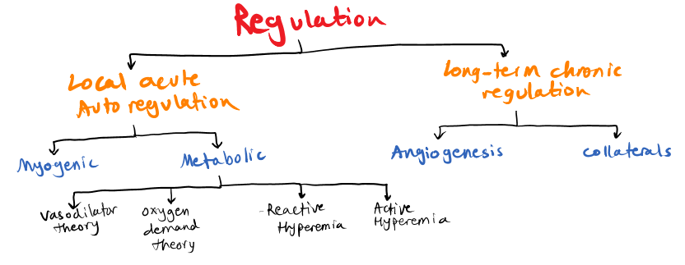

Slide 3
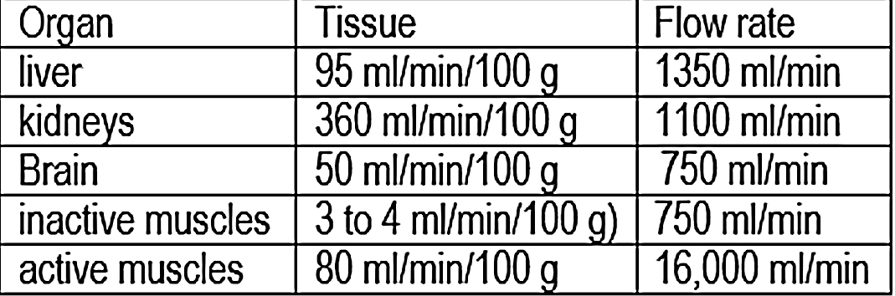
Control of cardiovascular system:
Local control of blood flow in response to tissue needs
Variations in Blood Flow in Different Tissues
and Organs. Example:
Total blood flow of 1350 ml/min in the liver, which is 95 ml/min/100 g of liver tissue.
The extremely large blood flow through the kidneys (1100 ml/min (360 ml/min/100 g) Brain (50 ml/min/100 g)
Conversely, most surprising is the low blood flow to all the inactive muscles of the body (only a total of 750 ml/min) even though the muscles constitute be­tween 30 and 40 percent of the total body mass.
In the resting state, the metabolic activity of the muscles is very low, as is the blood flow (only 3 to 4 ml/min/100 g). Yet, dur­ing heavy exercise, muscle metabolic activity can increase more than 60-fold and the blood flow as much as 20-fold, increasing to as high as 16,000 ml/min in the body’s total muscle vascular bed (or 80 ml/min/100 g of muscle).
The blood flow to each tissue usually is regulated at the minimal level that will supply the tissue’s requirements no more, no less

Slide 4
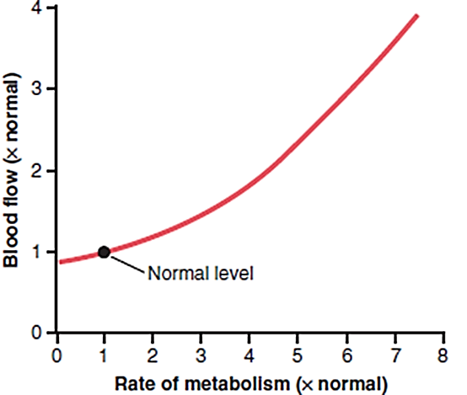
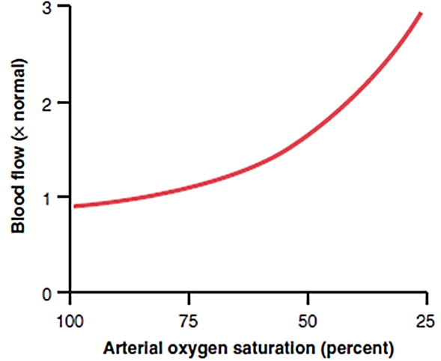
Acute control is achieved by rapid changes in local vasodilation or vasoconstriction of the arterioles, met-ar­terioles, and pre-capillary sphincters that occur within seconds to minutes to provide very rapid maintenance of appropriate local tissue blood flow.
Factors related to acute control of local blood flow:
A. Increases in tissue metabolism increase tissue blood flow
An increase in metabolism up to 8 times normal increases the blood flow acutely about 4 folds.
B. Reduced Oxygen Availability Increases Tissue Blood Flow.
One of the most necessary of the metabolic nutri­ents is oxygen.
Some cause for decrease in tissue oxygen:
(1) at a high altitude at the top of a high mountain,
(2) in pneumonia,
(3) in carbon monoxide poisoning (which poisons the ability of hemo­globin to transport oxygen), or
(4) in cyanide poisoning (which poisons the ability of the tissues to use oxygen),
Whenever the availability of oxygen to the tissues decreases, the blood flow through the tissues increases markedly.

Slide 5
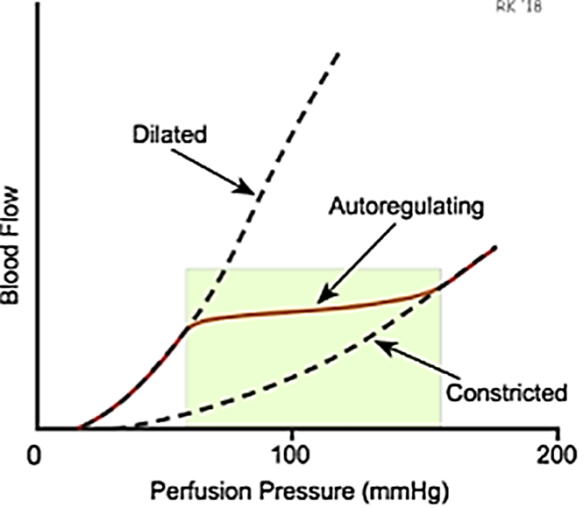
Auto-regulation:
The capacity of tissues to regulate their own blood flow is referred to as (auto-regulation).
Most vascular beds have an intrinsic capacity to compensate for moderate changes in perfusion pressure by changes in vascular resistance, so that blood remains relatively constant.
Autoregulation is well developed in the kidney, but it has been observed in the mesentery, skeletal muscle, brain, liver, and myocardium.
Autoregulation is defined as the intrinsic ability of an organ to maintain a constant blood flow despite changes in perfusion pressure (arterial minus venous pressure).
Autoregulatory response occurs in the absence of neural and hormonal influences, although these influences can modify the response
Autoregulatory response, if perfusion pressure is decreased to an organ (e.g., by partially occluding the arterial supply to the organ), blood flow initially falls, then returns toward normal levels over the next few minutes.
If an organ is subjected to an experimental study in which perfusion pressure is both increased and decreased over a wide range of pressures, the autoregulatory responses in which flow changes relatively little despite a large change in perfusion pressure.

Slide 6
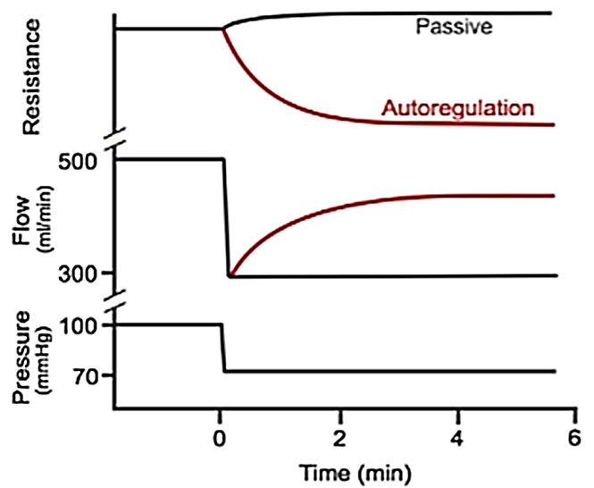
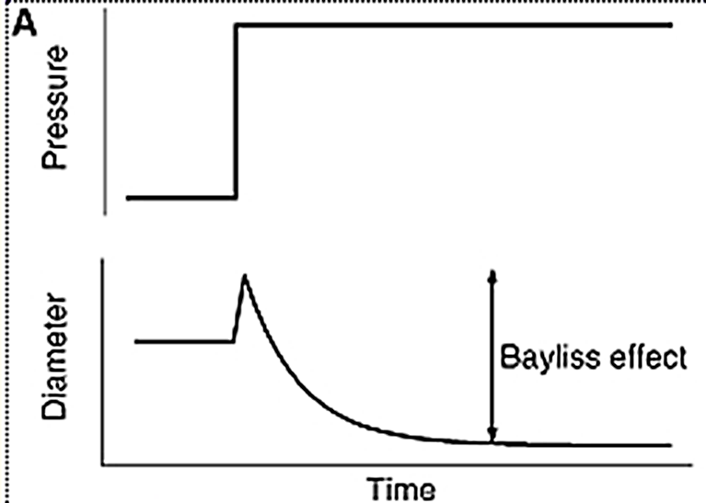
Different organs display varying degrees of autoregulatory
excellent autoregulation the renal, cerebral, and coronary circulations
moderate autoregulation the skeletal muscle and splanchnic circulations
little or no autoregulatory the cutaneous circulation
Autoregulation is important to keep constant blood flow
during changes in blood pressure and
when a distributing artery to an organ becomes narrowed
(e.g., atherosclerotic narrowing of lumen, vasospasm,
or partial occlusion with a thrombus)
The possible explanation of acute autoregulation mechanism:
(1) The metabolic theory
(2) Endothelium theory:
Endothelium may secret vasodilator
or vasoconstrictor chemicals
(3) The myogenic theory
The myogenic theory based on the observation that sudden stretch of small blood vessels causes the smooth muscle of the vessel wall to contract (the Bayliss effect). Therefore, it proposed that when high arterial pressure stretches the vessel, this in turn causes reactive vascular constriction that reduces blood flow nearly back to normal. Conversely, at low pressures, the degree of stretch of the vessel is less, so that the smooth muscle relaxes, reducing vascular resistance and helping to return flow toward normal.

Slide 7
The mechanisms by which tissue blood flow are not fully understood, but two main theories have been proposed:
I. Metabolic theory of auto-regulation:
1. Vasodilator Theory for Acute Local Blood Flow Regulation (Possible Special Role of Adenosine):
According to the vasodilator theory,
↑the rate of metabolism or ↓the availability of oxygen or some other nutrients to a tissue,
⬇
↑the rate of formation of vasodilator substances in the tissue cells.
⬇
The vasodilator substances then are believed to diffuse through the tissues to the pre-capillary sphincters, met-arterioles, and arterioles to cause dilation.
Some of the different vasodilator substances that have been suggested are adenosine, carbon dioxide, adenosine phosphate com­pounds, histamine, potassium ions, and hydrogen ions.
Each has its own vasodilator
①skin and brain: increase in CO₂
②Skeletal muscle: K and lactate
③heart: adenosine
④injured tissue: histamine

Slide 8
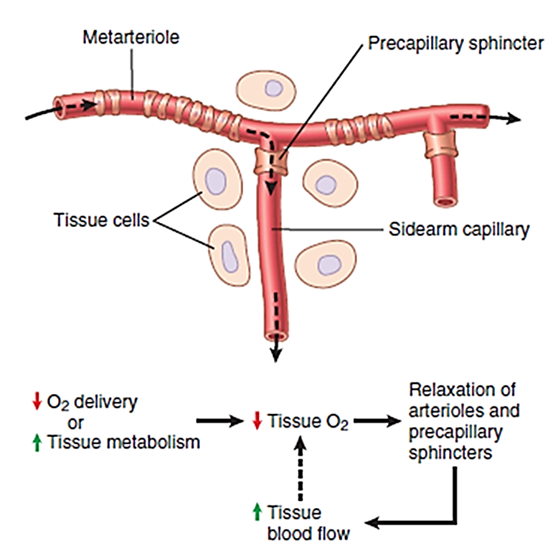
Vasodilator substances may be released from the tissue in response to oxygen deficiency
Many physiologists believe that adenosine is an impor­tant local vasodilator for controlling local blood flow. For example, minute quantities of adenosine are released from heart muscle cells when coronary blood flow becomes too little, and this release of adenosine causes enough local vasodilation in the heart to return coronary blood flow to normal.
the heart becomes more active than normal
⬇
the heart’s metabolism increases an extra amount
⬇
causes increased utilization of oxygen
⬇
(1) decreased oxygen concentration in the heart muscle cells
⬇
(2) conse­quent degradation of adenosine triphosphate (ATP)
⬇
(3) increases the release of adenosine.
⬇
adenosine leaks out of the heart muscle cells
⬇
coronary vasodilation,
⬇
providing increased coronary blood flow to supply the increased nutrient demands of the active heart.

Slide 9
2. Oxygen Demand Theory (or the nutrient demand theory) for Local Blood Flow Control.
The explanation of this theory:
Oxygen is one of the metabolic nutrients required to cause vascular muscle contraction (with other nutrients required as well). Therefore, in the absence of adequate oxygen, it is reasonable to believe that the blood vessels would relax and therefore dilate.
increased utilization of oxygen in the tissues as a result of increased metabolism theoretically could decrease the availability of oxygen to the smooth muscle fibers in the local blood vessels, and this decreased availability, too, would cause local vasodilation.
Possible Role of Other Nutrients besides Oxygen in Control of Local Blood Flow.
Under special conditions, it has been shown that lack of other substances can cause local tissue vasodilation:
◆ glucose
❖ amino acids or fatty acids,
⬥ vitamin deficiency disease beriberi, in which the patient has deficiencies of the vitamin B substances thiamine, niacin, and riboflavin.

Slide 10
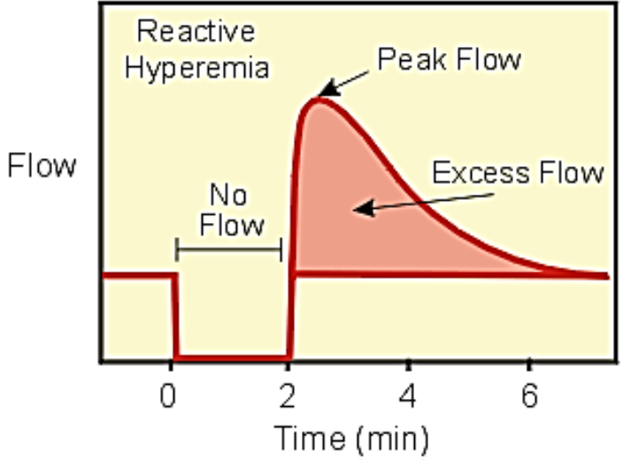
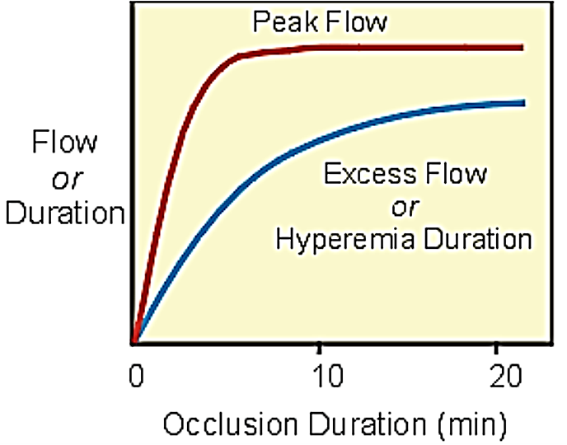
“3. Reactive Hyperemia”
Reactive hyperemia is the transient increase in organ blood flow that occurs following a brief period of ischemia (e.g., arterial occlusion).
The hyperemia occurs because during the period of occlusion ► tissue hypoxia ►buildup vasodilator metabolites ► dilate arterioles + decrease vascular resistance.
Then when perfusion pressure is restored (i.e., occlusion released), flow becomes elevated (i.e., hyperemia occur, hyperemia means high flow) because of the reduced vascular resistance. During the hyperemia, the tissue becomes reoxygenated and vasodilator metabolites are washed out of the tissue. This causes the resistance vessels to regain their normal vascular tone thereby returning flow to control.
Factors affecting reactive hyperemia:
The longer the period of occlusion, the greater the metabolic stimulus for vasodilation leading to increases in peak reactive hyperemia and duration of hyperemia.
Depending upon the organ, maximal vasodilation as indicated by peak flow, may occur following less than one minute (e.g., coronary circulation) of complete arterial occlusion, or
may require several minutes of occlusion (gastrointestinal circulation).

Slide 11
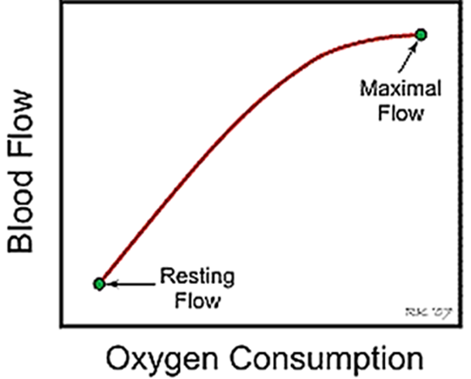
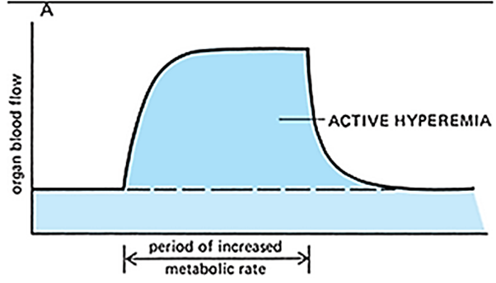
“4. Active Hyperemia”
Hypoxia mean Decreased tissue pO₂ resulting from
reduced oxygen supply or
increased oxygen demand.
Hypoxia-induced vasodilation may be
direct (inadequate O₂ to sustain smooth muscle contraction) or
indirect via the production of vasodilator metabolites.
Active hyperemia is the increase in organ blood flow (hyperemia) that is associated with increased metabolic activity of an organ or tissue.
When any tissue becomes highly active, such as
an exercising muscle,
a gastrointestinal gland during a hyper-secretory period,
or even the brain during increased mental activity,
the rate of blood flow through the tissue increases.

Slide 12
The increase in local metabolism
▼
the cells to release large quantities of vasodi­lator substances
▼
dilation of local blood vessels
▼
increased local blood flow. In this way, the active tissue receives the additional nutrients required to sustain its new level of function.
The magnitude of active hyperemia responses differ among organs because of the relative changes in metabolic activity from rest and their vasodilatory capacity.
Active hyperemia can result in up to a 50-fold increase in muscle blood flow with maximal exercise,
whereas cerebral blood flow may only increase 2-fold with increased neuronal activity.
Active hyperemia may be due to a combination of
tissue hypoxia and
generation of vasodilator metabolites

Slide 13
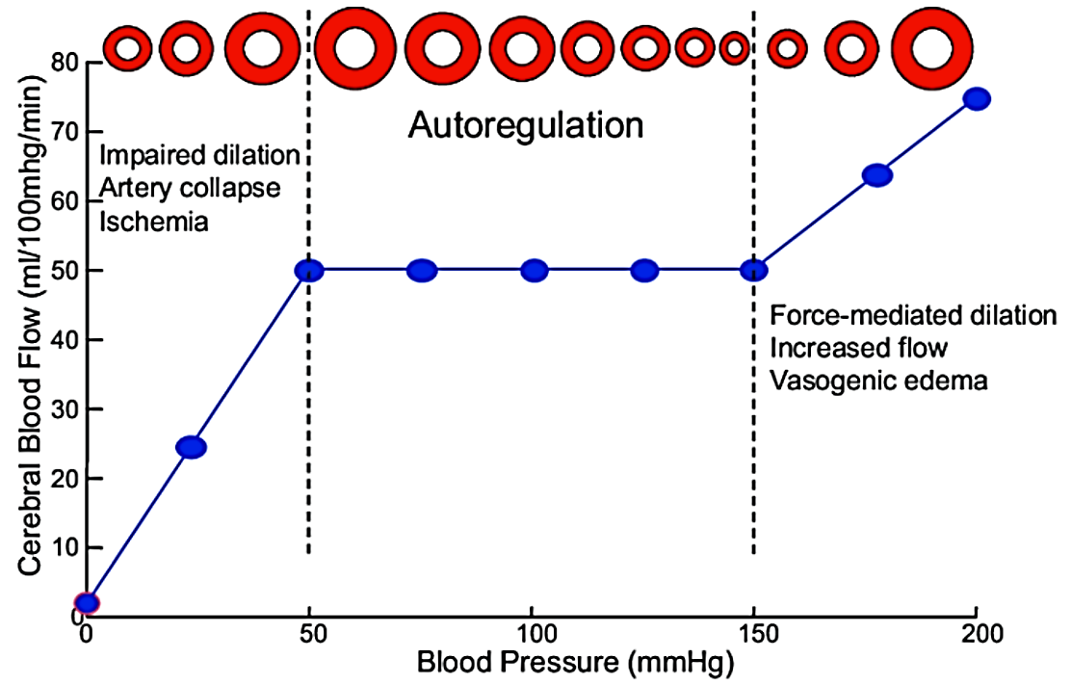
The myogenic mechanism
 is inherent to vascular smooth muscle
 can occur in the absence of neural or
hor­monal influences.
is most pronounced in arterioles
but can observed in arteries, venules,
veins, and even lymphatic vessels.
 is appears to be important in preventing
excessive stretching of blood vessels
when blood pressure is increased
 may play a role in autoregulation of
blood flow and in reactive hyperemia.
 has not been clearly identified in all vascular beds, but it has been noted in the splanchnic and renal circulations and may be present to a small degree in skeletal muscle.
Myogenic contraction initiated by
The increased intraluminal pressure ►the activation of non-selective cation channels in the plasma membrane of the smooth muscle cells, ►membrane depolarization ► open voltage-gated L-type Ca²⁺ channels ►Ca²⁺ influx ►smooth muscle contraction

Slide 14
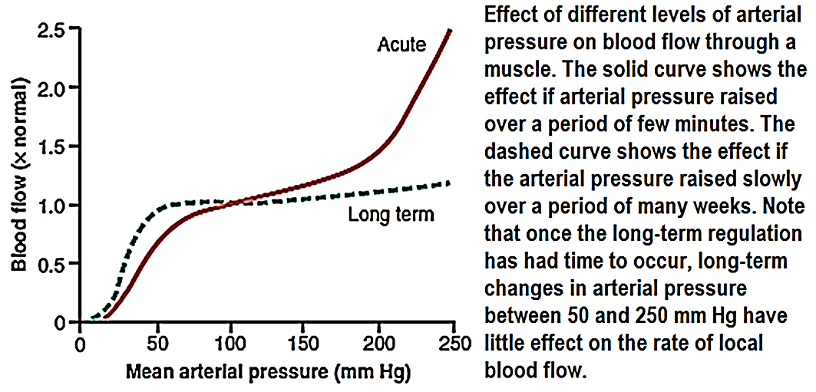
(2) Long-term control
Long-term control means slow, controlled changes in flow over a period of days, weeks, or even months.
Long-term control changes provide even better control of the flow in proportion to the needs of the tissues.
Long-term control changes come about because of an increase or decrease in the physical sizes and numbers of blood vessels supplying the tissues.
Most of the mechanisms for acute local blood flow regulation, even after full activation of these acute mechanisms, the blood flow usually adjusted only about three quarters of the way to the exact additional require­ments of the tissues.
Long-term control regula­tion gives a far more complete control of blood flow. For instance, in the aforementioned example, if the arterial pressure remains at 150 mm Hg indefinitely, within a few weeks the blood flow through the
tissues gradually approaches almost exactly
the normal flow level and
the local blood flow remain more stable with changes
in blood pressure between 50 to 250 mmHg.
Long-term regulation of blood flow is especially
important when the metabolic demands of a
tissue change. Thus, if a tissue becomes
chronically overactive and therefore requires
increased quantities of oxygen and other
nutrients, the arterioles and capillary vessels usually
increase in both number and size within a few weeks
to match the needs of the tissue, unless the circulatory
system has become pathological or too old to respond.

Slide 15
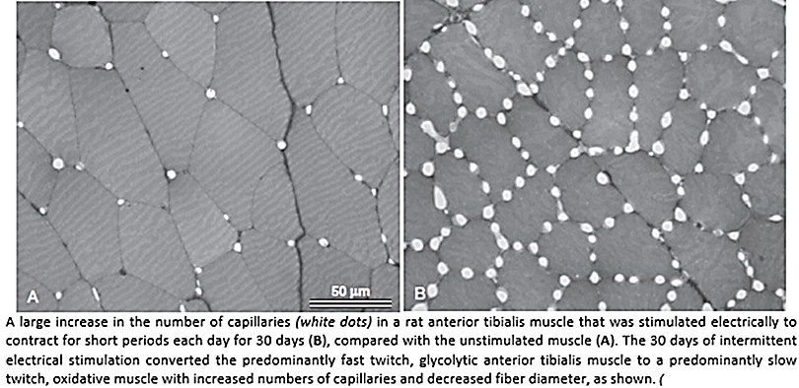
Factors control long-term blood flow:
I. Vascularity
An especially valuable characteristic of long-term vascular control is that vascu­larity.
For instance, if the metabolism in a tissue is increase for a prolonged period, vascularity increases in size and number, a process gen­erally called angiogenesis; if the metabolism decreased, vascularity decreases
During heavy exercise the need for whole
body blood flow often increases to six to
eight times the resting blood flow. This great
excess of flow may not be required for more
than a few minutes each day. Nevertheless,
even this short need can cause enough
angiogenic factors formed by the muscles to
increase their vascularity as required.
Were it not for this capability, every time
a person attempted heavy exercise, the muscles would fail to receive the required nutrients, especially the required oxygen, and thus the muscles simply would fail to contract.

Slide 16
However, after extra vascularity does develop, the extra blood vessels normally remain mainly vasocon­stricted, opening to allow extra flow only when appropri­ate local stimuli such as a lack of oxygen, nerve vasodilatory stimuli, or other stimuli call forth the required extra flow.
The actual physical reconstruction of the tissue vas­culature
 occurs to meet the needs of the tissues.
 occurs rapidly in new growth tissue, such as in scar tissue and cancerous tissue
occurs much more slowly in old, well-established tissues.
● occurs within a few days in the neonate
occurs as long as months in the elderly person.
Furthermore, the final degree of response is much better in younger than in older tissues;
the neonate vascularity will adjust to match almost exactly the needs of the tissue for blood flow
the older tissues vascularity frequently lags far behind the needs of the tissues

Slide 17
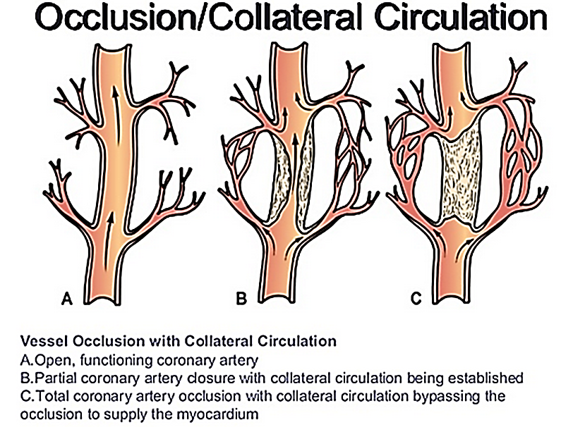
II. Collateral Circulation
In most tissues of the body, when an artery or a vein is blocked, a new vascular channel usually develops around the blockage and allows at least partial resupply of blood to the affected tissue.
The collateral vessels continue to grow for many months
The collateral vessels usually forming multiple small collat­eral channels rather than one single large vessel.
Under resting conditions, the blood flow may return to nearly normal, but the new channels seldom become large enough to supply the blood flow needed during strenuous tissue activity.
The development of collateral vessels follows the usual principles of both acute and long-term local blood flow control, the acute control being rapid metabolic dilation, followed chronically by growth and enlargement of new vessels over a period of weeks and months.

Slide 18
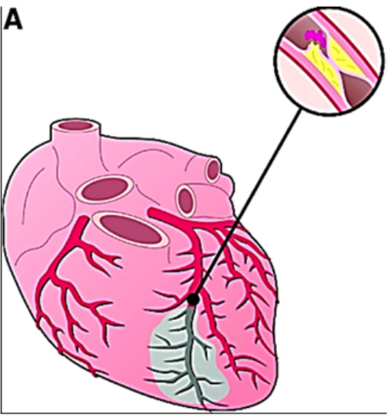
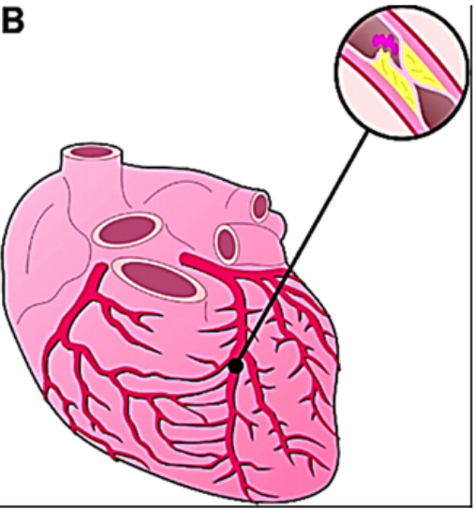
An important example of the development of collateral blood vessels occurs after thrombosis of one of the coronary arteries. By the age of 60 years, most people have experienced closure or at least partial occlusion of at least one of the smaller branch coronary vessels, but they are not aware of it because collateral blood vessels have developed rapidly enough to prevent myocardial damage. When collateral blood vessels are unable to develop quickly enough to maintain blood flow because of the rapidity or severity of the coronary insufficiency, serious heart attacks occur.
Role of Oxygen in Long-Term Regulation
Oxygen is important not only for acute control of local blood flow but also for long-term control. One example of this is increased vascularity in tissues of animals that live at high altitudes, where the atmospheric oxygen is low.
In premature human babies punted into oxygen tents for therapeutic purposes, the excess oxygen causes almost immediate cessation of new vascular growth in the retina of the premature baby’s eyes and even causes degeneration of some of the small vessels that already have formed. When the infant is taken out of the oxygen tent, explosive overgrowth of new vessels then occurs to make up for the sudden decrease in available oxygen. Indeed, often so much overgrowth occurs that the retinal vessels grow out from the retina into the eye’s vitreous humor, eventually causing blindness, a condition called retrolental fibroplasia or Retinopathy of prematurity.

Slide 19
Blood flow regulation in skeletal muscle at rest and during exercise
Strenuous exercise is one of the most stressful conditions that the normal circulatory system faces because there is such a large mass of skeletal muscle in the body, all of it requiring large amounts of blood flow.
Also, the cardiac output often must increase to four to five time normal in the non-athlete, or to six to seven times normal in the well-trained athlete, to satisfy the metabolic needs of the exercising muscles.
Rate of blood flow through the muscle
During rest, blood flow through skeletal muscle averages 3 to 4 ml/min/100 g of muscle.
During extreme exercise in the well-conditioned athlete, this blood flow can increase 25- to 50-fold, rising to 100 to 200 ml/min/100 g of muscle.
Peak blood flows as high as 400 ml/min/100 g of muscle have been reported in thigh muscles of endurance-trained athletesالرياضين المدربين على التحمل.

Slide 20
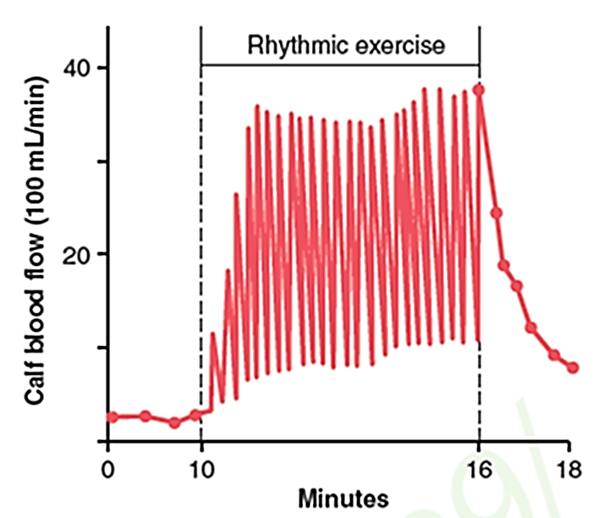
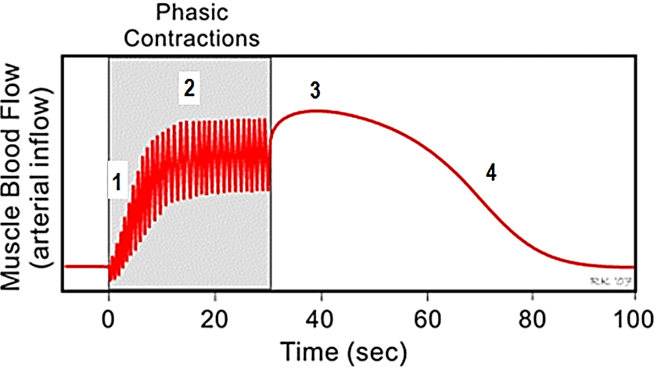
Muscle during exercise
The outflow in the vein increase during contraction and decrease during relaxation
The arterial inflow decrease during contraction and increase during relaxation
1. After just a couple of seconds, mean and peak flows begin to increase (active hyperemia)
2. Blood flow during Muscle Contractions
After 15-20 seconds, the increased flow will reach a steady state that is determined by
the force and frequency of contraction, and
the metabolic demands of the tissue.
Blood flow to contracting skeletal muscle is highly pulsatile (The flow increases and decreases with each muscle contraction)
The cause of the lower flow during the muscle contraction phase
of exercise is compression of the blood vessels by the contracted muscle.
During strong tetanic contraction, which causes sustained compression
of the blood vessels, the blood flow can be almost stopped, but this also
causes rapid weakening of the contraction
3. When contractions cease, blood flow may transiently increase because
of the loss of compressive forces, and then over the next minute or so the
flow will return to control.
4. At the end of the contractions, the blood flow remains very high for a
few seconds but then returns toward normal during the next few minutes

Slide 21
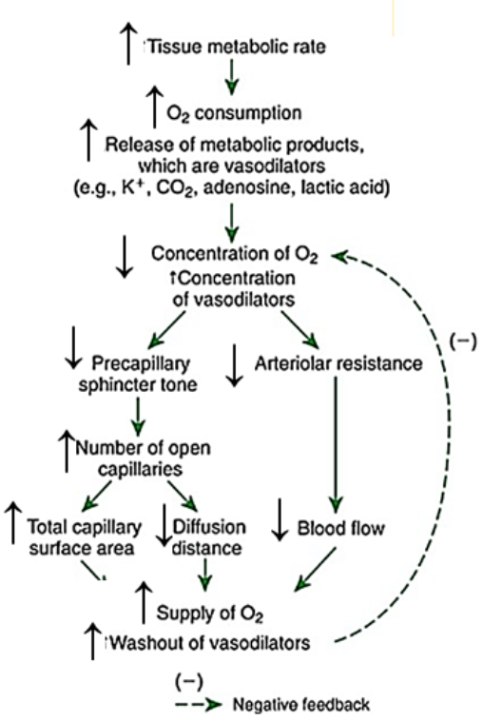
Vasodilation & Increased blood flow in muscle capillaries during exercise
Vasodilation of the arterial tree ►increased blood flow
Increase nutrient to the tissues per unit time.
increases micro-vessel hematocrit and RBC ► increased oxygen delivery to the active muscles.
Increase functional capillary density (or number of perfused capillaries)
functional capillary density is the relative number of open capillaries in a specific volume of tissue ►
a. diminishes the distance that oxygen and other nutrients must diffuse from the capillaries to the contracting muscle fibers and
b. sometimes contributes 2-3 folds increased capillary surface area through which oxygen and nutrients can diffuse from the blood to the tissues.
Perfused capillary density is proportional to
oxygen consumption in red muscles
lactate production in white muscle.

Slide 22
Under resting conditions, oxygen extraction ranges between 20% and 40%.
During heavy exercise, approximately 70–80% of the oxygen delivered to the active muscles may be extracted.
oxygen extraction the difference between the arterial and venous concentrations of oxygen
Control of blood flow in skeletal muscle
I. Humeral Control of Muscle Blood Flow
The tremendous increase in muscle blood flow that occurs during skeletal muscle activity
is caused mainly by:
Vasodilator substances acting directly on the muscle arterioles to cause dilation or
Reduction of oxygen in the muscle tissues.
Vasodilator substances include
(1) potassium ions
(2) adenosine triphosphate (ATP),
(3) lactic acid
(4) carbon dioxide.

Slide 23
II Sympathetic Vasoconstrictor Nerves
The sympathetic vasoconstrictor nerve fibers secrete norepinephrine at their nerve endings ►decrease blood flow through resting tissues to as little as one-half to one-third normal when maximally activated. This vasoconstriction is of physiologic importance in attenuating decreases of arterial pressure in circulatory shock and during other periods of stress when it may even be necessary to increase blood pressure.
The medullae of the two adrenal glands also secrete large amounts of norepinephrine and epinephrine into the circulating blood during strenuous exercise.
The circulating norepinephrine acts on alpha adrenergic receptors in the muscle vessels to cause a vasoconstrictor
The circulating epinephrine acts on beta adrenergic receptors in the muscle vessels to cause a vasodilation
Norepinephrine acting on alpha-receptors causes vasoconstriction effect is strong in the skin, digestive tract, and kidneys. In these organs, normal blood flow greatly surpassesيفوق that required to keep the tissues alive. Instead, most of the blood flow serves specific physiological functions in the organs. By contrast, such vasoconstriction does not occur in the brain or heart, where blood flow serves to keep the cells in these vital organs alive and healthy.

Slide 24
Note:
1. The effect of local (or humeral) and neural control are not equal at different tissues some the neural control is dominant (as skin) and other the local control is dominant (like heart and brain)
2. Skeletal muscle and skin do not receive parasympathetic nerve
3. Sympathetic stimulation which work through nor-epinephrine cause’s vasoconstriction to skeletal blood vessels but also to other vessels this will help to shift blood from organ does not need blood to organs needs it
4. Sympathetic stimulation also causes vein constriction (but with less extent than arteries because it possess less smooth muscle). Vein constriction help to return blood to arterial tree.
5. During rest; the neural effect is more prominent than local effect on skeletal muscle blood vessels,
During exercise both local effect (due to accumulation of metabolites) causing vasodilation and neural causing vasoconstriction affect the muscle blood vessel.
The local effect is more prominent than neural effect on skeletal muscle blood vessels and end result is vasodilation
6. Sympathetic stimulation also stimulate adrenal medulla to secret epinephrine and norepinephrine.

Slide 25
Thank you!
As you shine on your medical journey, remember that the pursuit of knowledge and the practice of compassion are intertwined.
Never lose sight of the fact that medicine is not just a profession, it is a lifelong commitment to the well-being of others, but don’t lose yourself while doing that!
وتذكروا قوله تعالى: «فَأَمَّا الزَّبَدُ فَيَذْهَبُ جُفَاءً ۖ وَأَمَّا مَا يَنفَعُ النَّاسَ فَيَمْكُثُ فِي الْأَرْضِ»

