Slide 1
Vascular physiology Lecture 6
By Dr. Asem Alkhalaileh

Slide 2
Concept 1: Edema

Slide 3
Edema (oedema)
Edema refers to the presence of excess fluid in the body tissues.
Intracellular Edema
Three conditions are especially prone to cause intracellular swelling:
(1) Lack of adequate nutrition to the cells and Depression of the metabolic systems of the tissues:
For example, when blood flow to a tissue is decreased,
▼
the delivery of oxygen and nutrients is reduced.
▼
If the blood flow becomes too low to maintain normal tissue metabolism,
▼
the cell membrane ionic pumps become depressed( ATP and Na-K ATPase).
▼
When this occurs, sodium ions that normally leak into the interior of the cell can no longer be pumped out of the cells, and
▼
the excess sodium ions inside the cells cause osmosis of water into the cells.
Sometimes this can increase intracellular volume of a tissue area (even of an entire ischemic leg, for example) to two to three times normal. When this occurs, it is usually a مقدمةprelude to death of the tissue.

Slide 4
(2)Intracellular edema can occur in inflamed tissues:
Inflammation
▼
has a direct effect on the cell membranes to increase their permeability,
▼
allowing sodium and other ions to diffuse into the interior of the cell,
▼
with subsequent osmosis of water into the cells.
(3) Hyponatremia
Hyponatremia caused by:
Absolute Hyponatremia: normal water but low sodium in extracellular fluid.
Relative (or dilution) Hyponatremia: excess water but normal sodium in extracellular fluid.
When there is Hyponatremia, the water moves from compartment of low concentration of solute (extracellular) to the compartment with high concentration of solute (intracellular) causing swelling of the cell.
Example brain edemas.

Slide 5
Extracellular Edema
Extracellular fluid edema occurs when there is excess fluid accumulation in the extracellular spaces.
There are two general causes of extracellular edema:
(1) excessive capillary fluid filtration ►Abnormal leakage of fluid from the plasma to the interstitial spaces across the capillaries, is the most common clinical cause of interstitial fluid accumulation
(2) Failure of the lymphatic to return fluid from the interstitium back into the blood.
Lymphatic Blockage Causes Edema (lymphoedema and lymphatic edema)
When lymphatic blockage occurs, edema can become especially severe because
plasma proteins that leak into the interstitium have no other way to be removed► The rise in protein concentration ►raises the colloid osmotic pressure of the interstitial fluid, which draws even more fluid out of the capillaries.
The most common causes of lymphedema include:
Cancer. If cancer cells block lymph vessels, lymphedema may result. For instance, a tumor growing near a lymph node or lymph vessel could enlarge enough to block the flow of the lymph fluid.
Radiation treatment for cancer. Radiation can cause scarring and inflammation of lymph nodes or lymph vessels.
Surgery. In cancer surgery, lymph nodes are often removed to see if the disease has spread. However, this doesn't always result in lymphedema.
Parasites. In developing countries in the tropics, the most common cause of lymphedema is infection with Elephantiasis or filariasis clog the lymph nodes.

Slide 6
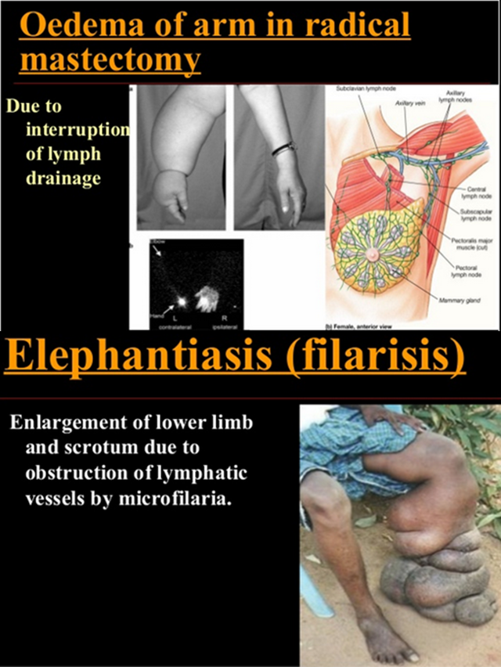

Slide 7
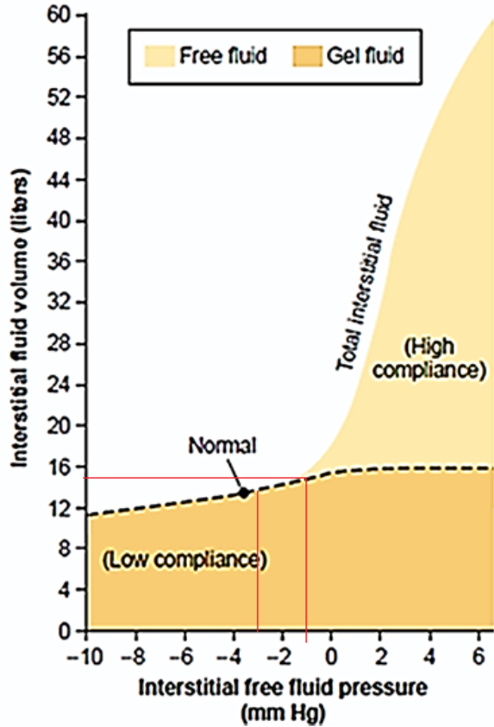
Safety Factors That Normally Prevent Edema
The reason the abnormality must be severe is that three major safety factors prevent excessive fluid accumulation in the interstitial spaces:
(1) Low compliance of the interstitium when interstitial fluid pressure is in the negative pressure range,
(2) The ability of lymph flow to increase 10-to 50-fold, and
(3) “Wash-down” of interstitial fluid protein concentration, which reduces interstitial fluid colloid osmotic pressure as capillary filtration increases. وكأنها 3 خطوات متتالية الخطوة الاولى تؤدي الى الثانية ثم الاولى والثانية تؤدي الى الثالثة
(1) Safety factor caused by low compliance of the interstitium when interstitial fluid pressure is in the negative pressure range
In most loose subcutaneous tissues of the body is slightly less than atmospheric pressure, averaging about –3 mm Hg. This slight suction in the tissues helps hold the tissues together.

Slide 8
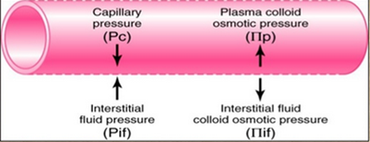
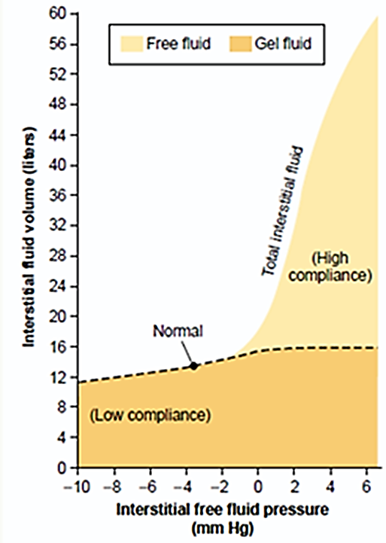
In the negative pressure range (less than 0 mmHg), the compliance of the tissues is low
In normal condition (small change in volume)
⬇
large increase in interstitial fluid hydrostatic (or interstitial free fluid pressure)
⬇
opposes further capillary filtration
In the positive pressure range (above 0 mmHg), the compliance of the tissues is high.
In pathological condition large change in volume
⬇
small increase in interstitial fluid hydrostatic (or interstitial free fluid pressure)
⬇
no further opposes capillary filtration
⬇
edema
Because the normal interstitial fluid hydrostatic pressure is –3 mm Hg, the interstitial fluid hydrostatic pressure must increase by about 3 mm Hg before large amounts of fluid will begin to accumulate in the tissues. Therefore, the safety factor against edema is a change of interstitial fluid pressure of about 3 mm Hg

Slide 9
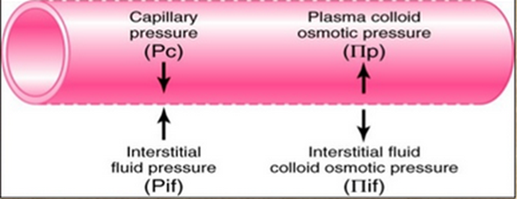
(2) Increased Lymph Flow as a Safety Factor against Edema
The lymphatics act as a safety factor against edema because lymph flow can increase 10- to 50-fold when fluid begins to accumulate in the tissues. This allows the lymphatics to carry away large amounts of fluid and proteins in response to increased capillary filtration, preventing the interstitial pressure from rising into the positive pressure range. The safety factor caused by increased lymph flow has been calculated to be about 7 mm Hg.
(3) “Wash down” of the Interstitial Fluid Protein as a Safety Factor against Edema
As↑ amounts of fluid are filtered into the interstitium,
⇩
↑ interstitial fluid pressure
⇩
↑ lymph flow.
⇩
↓ protein concentration of the interstitium
⇩
↓ Interstitial fluid colloid osmotic pressure
⇩
↓ net filtration pressure
⇩
↓ edema
The safety factor from this effect has been calculated to be about 7 mm Hg.

Slide 10
Importance of interstitial gel in preventing fluid accumulation in the interstitium
In normal tissues interstitial fluid pressure is negative,
In the negative fluid pressure range virtually all the fluid in the interstitium is in gel form.
A. in gel form, the fluid is bound in a proteoglycan mesh­work so that there are virtually no “free” fluid spaces larger than a few hundredths of a micrometer in diameter.
The importance of the gel is that it prevents fluid from flowing easily through the tissues because of impediment from the “brush pile” of trillions of proteoglycan fila­ments.
B. in gel form the gel does not contract greatly because the meshwork of proteoglycan filaments offers an elastic resistance to compression.

Slide 11
By contrast, when interstitial fluid pressure rises to the positive pressure range, there is a tremendous accumula­tion of free fluid in the tissues.
In this pressure range, the tissues are high compliance, allowing large amounts of fluid to accumulate with relatively small additional increases in interstitial fluid hydrostatic pressure.
Most of the extra fluid that accumulates is “free fluid” because it pushes the brush pile of proteoglycan filaments apart.
Therefore, the fluid can flow freely through the tissue spaces because it is not in gel form.
When this free flow of fluid occurs, the edema is said to be pitting edema (such as heart, renal, and liver failure) because one can press the thumb against the tissue area and push the fluid out of the area.
When the thumb is removed, a pit is left in the skin for a few seconds until the fluid flows back from the surrounding tissues.

Slide 12
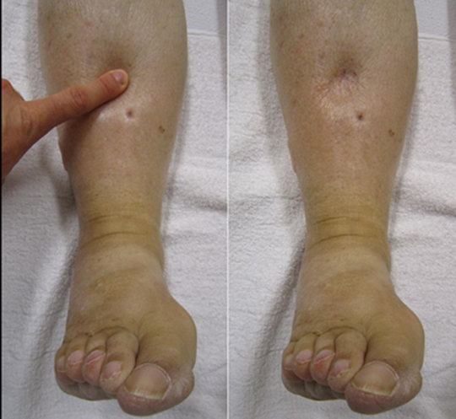
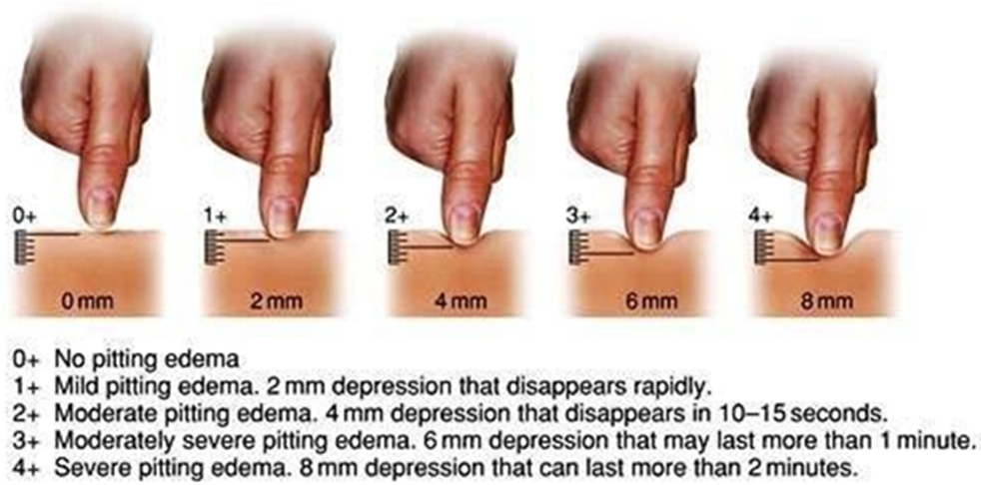

Slide 13
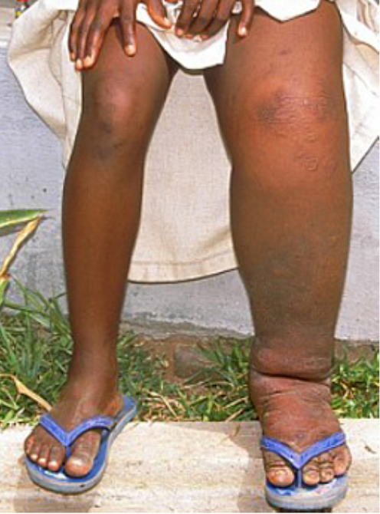
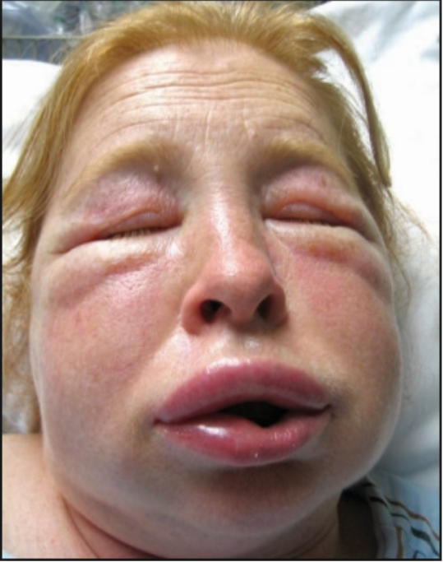
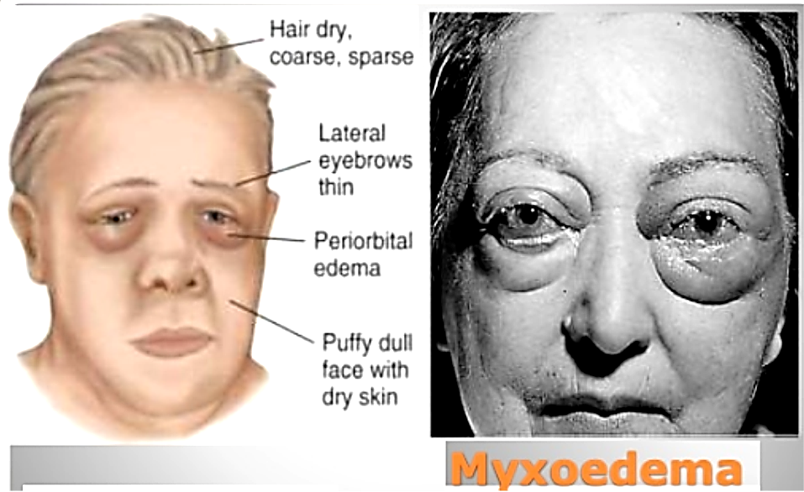
Non-pitting edema,
which occurs when the tissue cells swell instead of the interstitium or
when the fluid in the interstitium becomes clotted with fibrino­gen so that it cannot move freely within the tissue spaces.
Such as
elephantiasis, angioneurotic
Myxedema

Slide 14
Factors That Can Increase Capillary Filtration
To understand the causes of excessive capillary filtration, it is useful to review the determinants of capillary filtration Q_{w} = K . [(P_{c} – P_{i}) –σ (π_{c} – π_{i})]
From this equation, one can see that any one of the following changes can increase the capillary filtration rate:
Causes of increase interstitial fluid and edema:
1. Increase filtration pressure (due to increase capillary hydrostatic pressure):
a. Arterial dilation.
b. Venular constriction.
c. Increase venous pressure:
①heart failure
② incompetent venous valves
③ venous obstruction
④ increase total ECF volume
⑤ effect of gravity
2. Decrease osmotic pressure gradient across the capillary:
Decrease plasma protein level (decrease production of albumin as in liver failure or increase loss of albumin by kidney as in Glomerulonephritis)
Accumulation of osmotically active substances in interstitium (as albumin and Na)
3. Increase capillary permeability: by any substance cause vasodilatation like: substance P, histamine,
4. Inadequate lymphatic flow: like in elephantiasis

