Slide 1
Vascular physiology
Lecture 5
By Dr. Asem Alkhalaileh

Slide 2
Overview:
Concept 1:
Starling forces (Continue…)
Concept 2:
Lymphatic system

Slide 3
Concept 1:
Starling forces (Continue…)

Slide 4
Tissue (interstitial) oncotic pressure (π_{i})
Tends to cause osmosis of fluid outward through the capillary membrane to interstitium
Depends on :
The interstitial protein concentration
The reflection coefficient of the capillary wall … The more permeable the capillary barrier is to proteins, the higher the interstitial oncotic pressure
the amount of fluid filtrated into the interstitium “عكسية .. protein will be diluted with more fluid”
Increased capillary filtration will cause a decrease in interstitial protein concentration (because protein will be diluted with more fluid)
In a "typical" tissue, tissue oncotic pressure is about 5 mmHg (much lower than capillary plasma oncotic pressure) because only small amount of plasma protein do leak through the pores into the interstitial fluid so protein concentration in interstitium is 3gm/dL (about 40% of plasma)
There is no Gibbs-Donnan effect

Slide 5
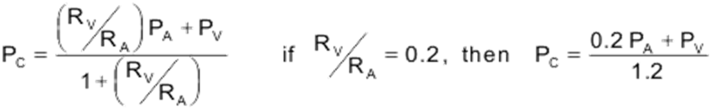
The capillary hydrostatic pressure (P_{c})
Tends to force fluid outward through the capillary membrane to the interstitium
Capillary hydrostatic pressure depending upon the organ
Capillary hydrostatic pressure is high in kidney (45mmHg)
Capillary hydrostatic pressure low in intestine (10mHg).
Capillary hydrostatic pressure in skeletal muscle is nearly 40 mmHg at arterial end and 12 mmHg at venous end.
Capillary hydrostatic pressure may drop along the length of the capillary by 15-30 mmHg (axial or longitudinal pressure gradient)
The axial gradient favors filtration at the arteriolar end (where P_{C} is greatest) and reabsorption at the venular end of the capillary (where P_{C} is the lowest)

Slide 6
Using this equation , we can develop the factors that affect the capillary hydrostatic pressure :
Arterial and venous pressures (PA and PV)
An increase in either arterial or venous pressure will increase capillary pressure
When (RV/RA)=0.2, a given change in arterial pressure is only about one-fifth as effective in changing capillary hydrostatic pressure as a comparable change in venous pressure
Therefore, P_{C} is much more influenced by changes in PV than by changes in PA
the ratio of postcapillary-to-precapillary resistances (Venous resistance /Arterial resistance)
When (RV/RA)=0.2; this means that the precapillary resistance (arteriolar) is about 5-times greater than post-capillary (venular) resistance.
Because venous resistance is relatively low, changes in P_{V} are readily transmitted back to the capillary. Conversely, because arterial resistance is relatively high, changes in P_{A} are poorly transmitted downstream to the capillary
Radius is inversely proportion to resistance
Increase ratio cause increase Capillary hydrostatic pressure
Arteriolar constriction ►↓radius ►↑ resistance ► ↓ ratio ►↓ Capillary hydrostatic pressure.
Venous constriction ►↓ radius ►↑ resistance ► ↑ ratio ►↑ Capillary hydrostatic pressure.

Slide 7
The tissue (interstitial) hydrostatic pressure (P_{i})
It depends on two factors :
The interstitial fluid volume
↑ fluid that filters into the interstitium >> ↑the volume of the interstitial space (Vi) and ↑ hydrostatic pressure within that space (Pi).
The compliance of the tissue interstitium
Compliance of the tissue interstitium is defined as the change in volume divided by the change in pressure, and there are two cases :
In some organs, the interstitial compliance is low
Which means that small increases in interstitial volume lead to large increases in pressure.
Examples of this include the brain and kidney
In some organs, the interstitial compliance is high
Which means that large increases in interstitial volume lead to small increases in pressure
Examples of this include the soft tissues such as skin, muscle and lung

Slide 8
↑ interstitial volume ►↑interstitial pressure ►↓filtration into the interstitium because this pressure opposes the capillary hydrostatic pressure.
Large increases in tissue interstitial pressure can lead to tissue damage and cellular death.
Normally, interstitial fluid hydrostatic pressure (Pi) is near zero.
In some tissues interstitial fluid hydrostatic pressure (Pi) is slightly sub-atmospheric (negative)
In some tissues interstitial fluid hydrostatic pressure (Pi) is slightly positive.
Interstitial fluid hydrostatic pressure (Pi) tends to force fluid inward when it is positive
Interstitial fluid hydrostatic pressure (Pi) tends to force fluid outward when it is negative.
Qw = K . [(Pc – Pi) –σ (πc – πi)]

Slide 9
The normal interstitial fluid pressure is usually several mmHg negative with respect to the pressure of the surrounds each tissue; for example, in the kidney the capsular pressure surround the kidney average about +13mmHg, whereas the interstitial fluid pressure is +6mmHg. The pressure exerted on the skin is atmospheric pressure, which is considered to be zero pressure, while the interstitial fluid pressure is sub-atmospheric.
In most natural cavities of the body where there is free fluid in dynamic equilibrium with the surrounding inter­stitial fluids, the pressures that have been measured have been negative. Some of these cavities and pressure mea­surements are as follows:
• Intra-pleural space: −8 mm Hg
• Joint synovial spaces: −4 to −6 mm Hg
• Epidural space: −4 to −6 mm Hg

Slide 10
Significance of negative interstitial fluid pressure as a means for holding the body tissues together
Traditionally, it has been assumed that the different tissues of the body are held together entirely by connec­tive tissue fibers.
However, connective tissue fibers are very weak or even absent at many places in the body, particularly at points where tissues slide over one another (e.g., skin sliding over the back of the hand or over the face).
Yet, even at these places, the tissues are held together by the negative interstitial fluid pressure, which is actually a partial vacuum.
When the tissues lose their negative pressure, fluid accumulates in the spaces and the condi­tion known as edema occurs.

Slide 11
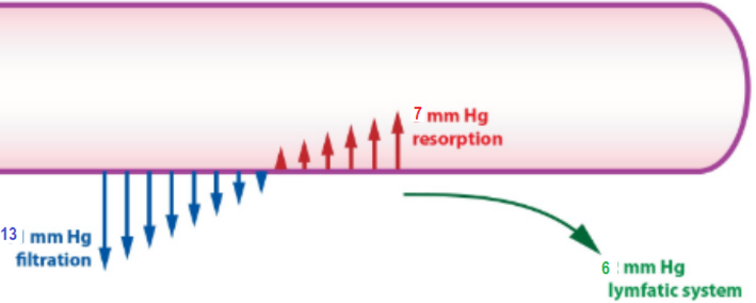
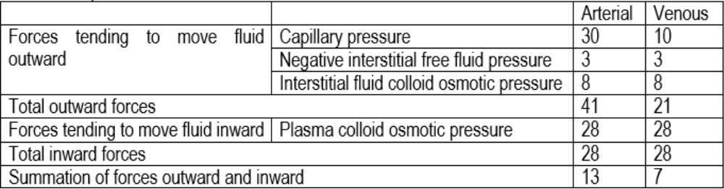
All of the above forces are seen at the arterial and venous side, but it tends to push fluid toward interstitium at the arterial side and toward the capillary at the venous side.
The best example is the skin:

Slide 12
Thus, the summation of forces at the arterial end of the capillary shows a net filtration pressure of 13 mmHg, tending to move in the outward direction through the capillary pores.
Thus, the summation of forces at the venous end of the capillary shows a net filtration pressure of 7 mmHg, is the (net re-absorption pressure) tending to move in the inward direction through the capillary pores.
The re-absorption pressure is considerably less than the filtration pressure at the capillary arterial ends, but remember that
◆ the venous capillary are more numerous and
the venous capillary more permeable than the arterial capillaries, so that less
pressure is required to cause the inward movement of fluid.
The re-absorption pressure causes about (9/10) of the fluid that has filtered out of the arterial of the capillaries to re-absorbed at the venous end. The remainder flows into the lymph vessels.

Slide 13
Concept 2:
Lymphatic system

Slide 14
Lymphatic system
Composition
Lymph contains lymph and lymphocytes
Lymph is a clear watery fluid, similar in composition to plasma, with less composition of plasma proteins; this why it is identical in composition to interstitial fluid.
Lymph is derived from interstitial fluid that flows into the lymphatics.
Therefore, lymph as it first enters the terminal lymphatics has almost the same composition as the inter­stitial fluid
Its daily production is dependent on the diet and daily dietary intake.
The protein concentration in the interstitial fluid of most tissues averages about 2 g/dl
Lymph formed in the liver has a protein concentra­tion as high as 6 g/dl, and lymph formed in the intestines has a protein concentration as high as 3 to 4 g/dl.

Slide 15
Lymphatic system
Composition
Because about two thirds of all lymph normally is derived from the liver and intestines, the thoracic duct lymph, which is a mixture of lymph from all areas of the body, usually has a protein concentration of 3 to 5 g/dl.
Lymph consist of fat 1-3% composed of Triglyceride (70% long chain), protein (3%), electrolytes content is the same as plasma except of lower calcium concentration and lymphocytes (T lymphocytes)
Lymphocytes circulate in the lymphatic system allowing them to patrol the different regions of the body.
.

Slide 16
Lymphatic system
Functions
Functions of the lymphatic system include:
1. Tissue drainage:
2. Absorption in the small intestine:
3. Immunity:
.

Slide 17
Lymphatic system
Functions: Tissue drainage
The lymphatic system is responsible for draining fluids and proteins and large particles from interstitial spaces
Every day, around 24 liters (about 0.3% of cardiac output) of fluid filtered from plasma, carrying dissolved substances and some plasma protein, escape from the arterial end of the capillaries into the tissues.
Most of this fluid is returned direct the blood stream via the capillary at its venous end, but 2 to 4 liters of fluid are drained away by the lymphatic vessels.
Fluid removed from the interstitium in order to maintain a gel state; without this, the tissues would rapidly become waterlogged, and the cardiovascular system would begin to fail as the blood volume falls.
.

Slide 18
Lymphatic system
Functions: Tissue drainage
The lymphatic system represents the only mechanism for returning albumin and other interstitial macro-molecules to the circulation system.
The lymphatic system recovers approximately 200gm of protein daily (which is equal to 25 to 50% of the total circulating plasma protein) that has been lost from the micro-circulation.
The fluid that returns to the circulation by way of the lymphatics is extremely important because substances of high molecular weight, such as proteins, cannot be absorbed from the tissues in any other way, although they can enter the lymphatic capillaries almost unimpeded.
The reason for this mechanism is a special structure of the lymphatic capillaries, the endothelial cells of the lymphatic capillary presumably at the junctions between the endothelial cells, and the proteins are returned to the bloodstream via the lymphatic
Lymph carries away larger particles, e.g., bacteria and cell debris from damaged tissues, which can then be filtered out and destroyed by the lymph nodes.
.

Slide 19
Lymphatic system
Functions: Tissue drainage
The lymphatic system plays a key role in controlling interstitial fluid protein concentration, volume, and pressure:
It is already clear that the lymphatic system functions as an “overflow mechanism” to return excess proteins and excess fluid volume from the tissue spaces to the circula­tion.
Therefore, the lymphatic system also plays a central role in controlling
(1) the concentration of proteins in the interstitial fluids,
(2) the volume of interstitial fluid
(3) the interstitial fluid pressure
Remember that small amounts of proteins leak continuously out of the blood capillaries into the intersti­tium.
Only minute amounts, if any, of the leaked proteins return to the circulation by way of the venous ends of the blood capillaries.
Therefore, these proteins tend to accu­mulate in the interstitial fluid, which in turn increases the colloid osmotic pressure of the interstitial fluids.
.

Slide 20
Lymphatic system
Functions: Tissue drainage
The increasing colloid osmotic pressure in the interstitial fluid shifts the balance of forces at the blood capillary membranes in favor of fluid filtration into the interstitium.
Therefore, in effect, fluid is trans-located outward through the capillary wall by the proteins and into the interstitium,
▼
↑both interstitial fluid volume and interstitial fluid pressure.
▼
↑interstitial fluid pressure greatly ►↑ the rate of lymph flow, which carries away the excess interstitial fluid volume and excess protein that has accumulated in the spaces
.

Slide 21
Lymphatic system
Functions: Tissue drainage
Thus, once the interstitial fluid protein concentration reaches a certain level and causes comparable increases in interstitial fluid volume and pressure, the return of protein and fluid by way of the lymphatic system becomes great enough to balance the rate of leakage of these into the interstitium from the blood capillaries.
Therefore, the quantitative values of all these factors reach a steady state, and they will remain balanced at these steady state levels
.

Slide 22
Lymphatic system
Functions: Absorption in the small intestines
The lymphatic system is one of the major routes for absorption of nutrients from the gastrointestinal tract, especially for absorption of all fat (long-chain fatty acids and cholesterol) and fat-soluble materials e.g., the fat-soluble vitamins in food, are absorbed into the central lacteals (lymphatic vessels) of the villi.
In the Lacteals of the small intestine, fats absorbed into the lymphatics give the lymph (now called chyle), a milky appearance.
Indeed, after a fatty meal, thoracic duct lymph sometimes contains as much as 1 to 2 percent fat.
The thoracic duct is the conduit قناةfor lymph and dietary fat to reach venous blood stream
.

Slide 23
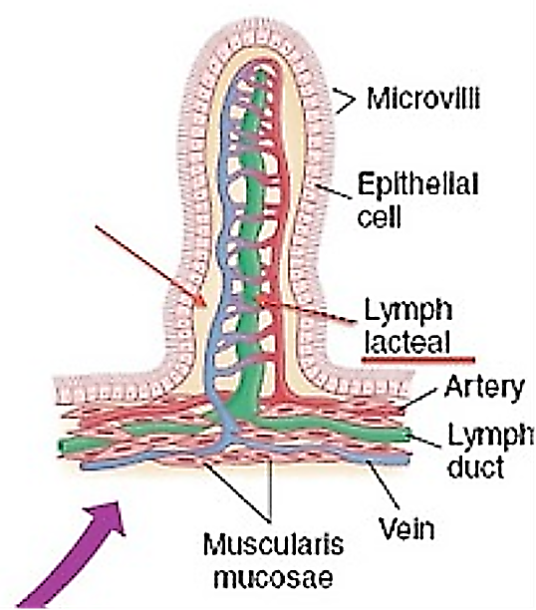

Slide 24
Lymphatic system
Functions: Immunity
The lymphatic organs are concerned with the production and maturation of lymphocytes, the white blood cells responsible for immunity.
Bone marrow is therefore considered to be lymphatic tissue, since lymphocytes are produced there.
.

Slide 25
Lymphatic system
Rate of lymph flow
About 100 milliliters per hour of lymph flows through the thoracic duct of a resting human, and approximately another 20 milliliters flows into the circulation each hour through other channels, making a total estimated lymph flow of about 120 ml/hr or 2 to 3 liters per day.
.

Slide 26
Lymphatic system
Structure of lymphatic vessels
Lymphatic vessels can be dividing into two types: ❶initial lymphatic ❷collecting lymphatic.
The endothelium of terminal (initial) lymphatics are anchored by anchoring filaments that attaches the vessel with surrounding connective tissue.
At the junctions of adjacent endothelial cells, the edge of one endothelial cell overlaps the edge of the adjacent cell in such a way that the overlapping edge is free to flap inward, thus forming a minute valve that opens to the interior of the lymphatic capillary.
Interstitial fluid, along with its suspended particles, can push the valve open and flow directly into the lymphatic capillary.
However, this fluid has difficulty leaving the capillary once it has entered because any backflow closes the flap valve.
Thus, the lymphatics have valves at the very tips of the terminal lymphatic capillaries, as well as valves along their larger vessels up to the point where they empty into the blood circulation
.

Slide 27
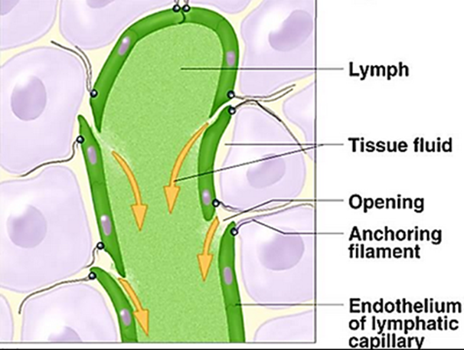
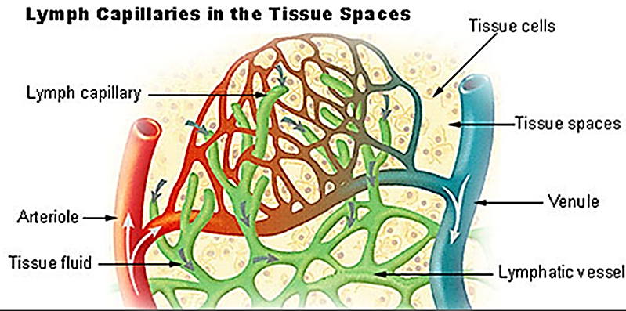
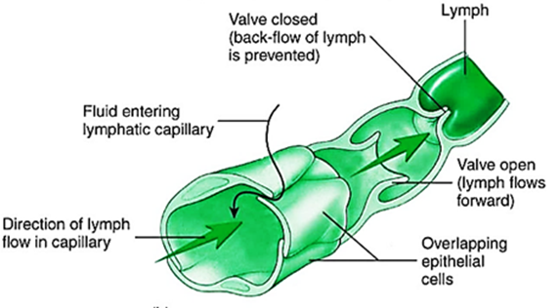

Slide 28
Lymphatic system
Effect of interstitial fluid pressure on lymph flow
Note that normal lymph flow is very little at interstitial fluid pressures more negative than the normal value of −6 mm Hg. Then, as the pressure rises to 0 mm Hg (atmospheric pressure), flow increases more than 20-fold.
Therefore, any factor that ↑ intersti­tial fluid pressure →↑increase the formation (lymphagogues) +↑ flow of lymph
Such factors include the following:
◆ Elevated capillary hydrostatic pressure
❖ Decreased plasma colloid osmotic pressure
⬥ Increased interstitial fluid colloid osmotic pressure
 Increased permeability of the capillaries
 Compression of lymphatic vessels
Q_{w} = K . [(P_{c} – P_{i}) –σ (π_{c} – π_{i})]
All of these factors causes a balance of fluid exchange at the blood capillary membrane to ↑ fluid movement into the interstitium, ↑ interstitial fluid volume ↑ interstitial fluid pressure ↑ lymph flow all at the same time.
.

Slide 29
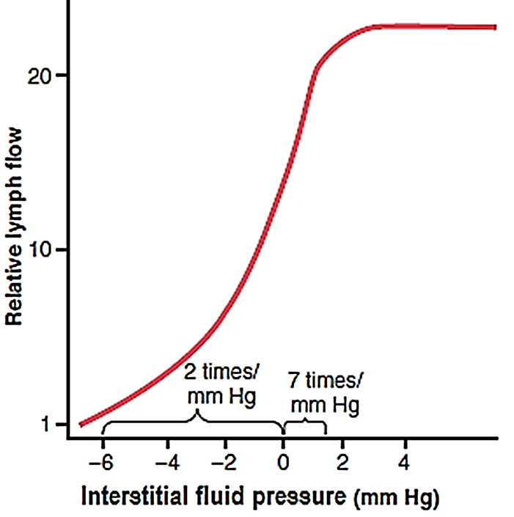

Slide 30
Lymphatic system
Effect of interstitial fluid pressure on lymph flow
When the intersti­tial fluid pressure becomes 1 or 2 mm Hg greater than atmospheric pressure (>0 mm Hg), lymph flow fails to rise any further at still higher pressures.
This results from the fact that the increasing tissue pressure not only increases entry of fluid into the lymphatic capillaries but also compresses the outside surfaces of the larger lymphatics, thus impeding lymph flow.
At the higher pressures, these two factors balance each other almost exactly, so lymph flow reaches a maximum flow rate.
This maximum flow rate is illustrated by the upper level plateau
.

Slide 31
Lymphatic system
The terminal lymphatic capillary pump
The walls of the lymphatic capillaries are tightly adherent to the surrounding tissue cells by means of their anchoring filaments. Therefore,
When the tissue swollen
each time excess fluid enters the tissue and causes the tissue to swell,
▼
the anchoring filaments pull on the wall of the lymphatic capillary and
▼
fluid flows into the terminal lymphatic capillary through the junctions between the endothelial cells.
Then, when the tissue is compressed,
the pressure inside the capillary increases
▼
causes the overlapping edges of the endothelial cells to close like valves.
▼
Therefore, the pressure pushes the lymph forward into the collecting lymphatic instead of backward through the cell junctions
.

Slide 32
Lymphatic system
The terminal lymphatic capillary pump
The lymphatic capillary endothelial cells also contain a few contractile actomyosin filaments.
In some animal tissues (e.g., the bat’s wing), these filaments have been observed to cause rhythmical contraction of the lym­phatic capillaries in the same rhythmic way that many of the small blood vessels and larger lymphatic vessels con­tract.
Therefore, it is probable that at least part of lymph pumping results from lymph capillary endothelial cell contraction in addition to contraction of the larger mus­cular lymphatics.
The larger lymphatic capillary is also capable of pumping lymph, in addition to the pumping by the terminal lymph vessels.
.

Slide 33
Lymphatic system
The terminal lymphatic capillary pump
Valves exist in all lymph channels
When a collecting lymphatic or larger lymph vessel becomes stretched with fluid, the smooth muscle in the wall of the vessel automatically contracts.
Furthermore, each segment of the lymph vessel between successive valves functions as a separate auto­matic pump.
That is, even slight filling of a segment causes it to contract, and the fluid is pumped through the next valve into the next lymphatic segment.
This fluid fills subsequent segment and a few seconds later it, too, con­tracts, the process continuing all along the lymph vessel until the fluid is finally emptied into the blood circulation.
In a very large lymph vessel such as the thoracic duct, this lymphatic pump can generate pressures as great as 50 to 100 mm Hg.
.

Slide 34
Lymphatic system
The terminal lymphatic capillary pump
In addition to the pumping caused by intrinsic intermittent contraction of the lymph vessel walls, any external factor that intermittently com­presses the lymph vessel also can cause pumping.
In order of their importance, such factors are as follows:
Contraction of surrounding skeletal muscles
❖ Movement of the parts of the body
Pulsations of arteries adjacent to the lymphatics
 Compression of the tissues by objects outside the body
The lymphatic pump becomes very active during exercise, often increasing lymph flow 10- to 30-fold.
Conversely, during periods of rest, lymph flow is sluggish (almost zero).
.

Slide 35
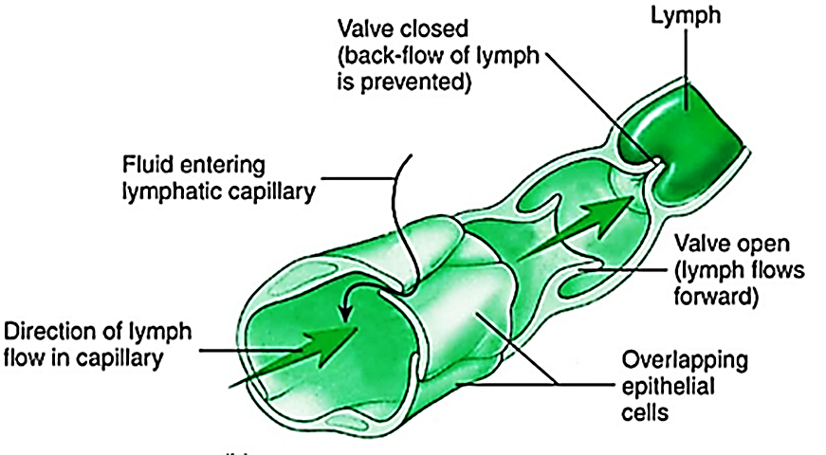

Slide 36
Thank you!
As you shine on your medical journey, remember that the pursuit of knowledge and the practice of compassion are intertwined.
Never lose sight of the fact that medicine is not just a profession, it is a lifelong commitment to the well-being of others, but don’t lose yourself while doing that!
وتذكروا قوله تعالى: «فَأَمَّا الزَّبَدُ فَيَذْهَبُ جُفَاءً ۖ وَأَمَّا مَا يَنفَعُ النَّاسَ فَيَمْكُثُ فِي الْأَرْضِ»

