Slide 1
Introduction to Physiology
(31501100 ) 2hrs
Al-balqa Applied University
Faculty of Medicine
Department of Basic Medical Sciences
Dr. Ensaf Almomani
Textbooks:
Medical Physiology, by Guyton and Hall
Review of Medical Physiology, by William F. Ganong
Principles of Anatomy and Physiology, by Gerard Tortora and Bryan Derrickson
Human Physiology, by Stuart Fox

Slide 2
What is Physiology?
Physiology: The science that is concerned with the normal functions of the living organism and its parts, and of the physical and chemical processes involved.
Human Physiology: the science of how the human body functions in health
Pathophysiology: The study of disordered body function (i.e., disease)
The basis for clinical medicine

Slide 3
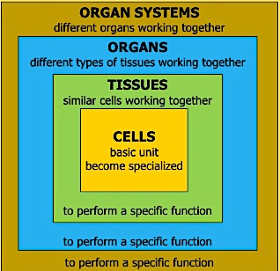
Structural Organization
Adapted from the internet

Slide 4
Structural Organization
Levels of organization
Cells: the basic structural and functional unit (~ 100 trillion)
Tissues: e.g., muscles, epithelial, nervous
Organs: e.g. heart, blood vessels
Organ systems: e.g., cardiovascular system

Slide 5
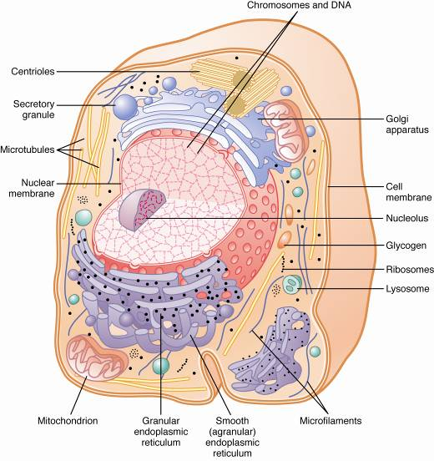
Cellular composition

Slide 6
Introduction ( L1 & L2)
Learning Objectives
Explain the course general objectives
Understand the calculations: Molarity, Equivalents, Molality, Molarity vs. equivalent, pH
Review cellular composition
Discuss ‘Homeostasis’ meaning, properties, control systems
Explain Positive and Negative Feedback

Slide 7
Moles, Molarity, and Molality
Moles
  A mole of a compound can be measured as its molecular weight in grams.
  1M = molecular weight in grams / 1000ml of water
  The number of atoms in 1 mole is always the same no matter the substance:
    6.02 X 10²³ particles (Avogadro’s number)

Slide 8
Molarity – moles solute/Liter solution
Glucose has a molecular weight of 180. To make a 1 molar solution of glucose, dissolve 180 g glucose in water to make 1 L solution.
NaCl has a molecular weight of 58.5. To make a 1 molar solution of NaCl, dissolve 58.5 g NaCl in water to make 1 L solution.

Slide 9
Molality – moles solute/Kg solvent
1 molal solutions take the molecular weight in grams dissolved in exactly 1Kg of water ( Equal 1L at 4.8C)
The amount of water never changes, so you can compare solute concentrations to predict the direction of osmosis.
Does not depend on the chemistry of the solute, but on how many particles are present in the solution

Slide 10
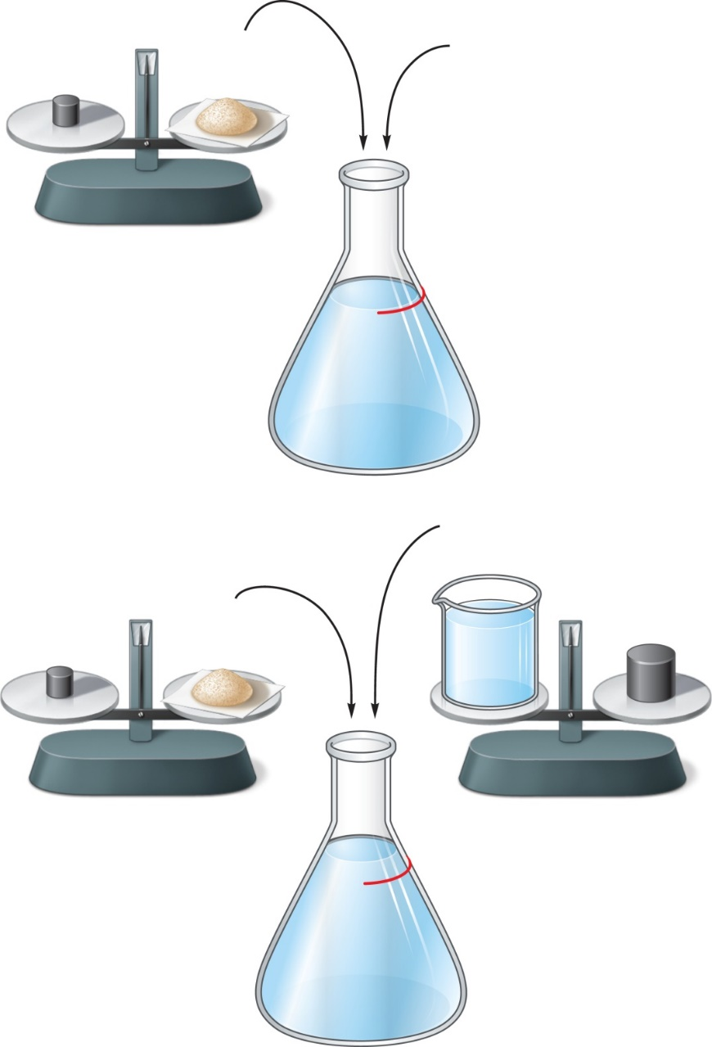
Molar & Molal Solutions
1 mole of
glucose (180 g)
180 g
H₂O
Scale
1.0–liter mark
on flask
1.0 mole per liter
solution ─ one molar
1.0 m
glucose
(a)
1.0 Kg of
H₂O (liter)
1 mole of
glucose (180 g)
180 g
1.0 Kg
Scale
Scale
1.0–liter mark
on flask
1.0 mole per kilogram
water ─ one molal
1.0 m
glucose
(b)
Copyright © The McGraw-Hill Companies, Inc. Permission required for reproduction or display.

Slide 11
Equivalents (Eq)
Eq: The amount of a substance that reacts with (or is equivalent to) an arbitrary amount of another substance in a given chemical reaction
Divide the molecular weight by the number of hydrogen protons (H) it donates as acid or the number of hydroxide (OH¯) anions it produces as a base
The equivalent weight of acid is equal to the gram-molecular weight (or molar mass) divided by number of replaced hydrogen (H).
1 molecule of HCl and HNO3 is 'equivalent' to adding 1 ion, but adding 1 molecule of H₂SO₄ is 'equivalent' to adding 2 ions, H₃PO4 is 'equivalent' to adding 3 ions
Ex. EW (HCl) = MW/n = 36.5/1 = 36.5 g
EW (HNO₃) = 63/1 = 63g
EW (H₂SO₃) = MW/n = 82/2 = 41g
Notes:
EW: Equivalent Weight

Slide 12
Equivalents (Eq) …….
The equivalent weight of base is equal to the gram-molecular weight (or molar mass) divided by the number of replaced hydroxyl (OH)
EW (LiOH) = MW/n = 24/1 = 24g
1 mol Ca(OH)₂ = 2 equivalents Ca(OH)₂
EW Ca(OH)2= MW/n=74/2=37 gm
EW Al(OH)3= MW/n= 78/3=26 gm
The equivalent weight of the SALT is equal to the gram-molecular weight (or molar mass) divided by the valence (number of charged particles).
Equivalent weight, (Eq)=Atomic weight/ Valence
mEq = mmol /valence
One mole of NaCl will dissociate into two ions (Valence =2)
CaCl2 will dissociate into three ions (Valence =3)

Slide 13
Molarity vs Equivalent
To Convert from mole to equivalent = divide the mole by the number of equivalents
Ex. 1 mol Ca(OH)₂ = 74 g Ca(OH)₂ → 1 Eq Ca(OH)₂ = 37 g Ca(OH)
→ 1 mol Ca(OH)₂ =2 Eq Ca(OH)₂ ; 1/2 mol Ca(OH)₂ =1 Eq Ca(OH)₂
Ex. 1 mol Al(OH)₃ = 78 g Al(OH)₃ → 1 Eq Al(OH)₃ = 26 grams Al(OH)
1 mol Al(OH)₃ =3 Eq Al(OH)₃ → 1/3 mol Al(OH)₃ =1 Eq Al(OH)₃
Ex.1 mol H₃PO₄ = 96 g H₃PO₄; 1 Eq H₃PO₄ = 32 g H₃PO₄
→ 1 mol H₃PO₄ = 3 Eq H₃PO₄ → 1/3 mol H₃PO₄ = 1 Eq H₃PO₄

Slide 14
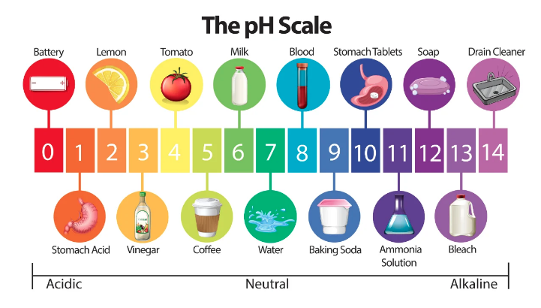
The hydrogen ion concentration of a solution (pH)
[H+]: H+ concentration in mol/L or eq/L.
pH: pH = log (1/[H+]) = −log [H+]
pH scale used to describe the acidity or basicity of an aqueous solution with regard to water ([H] in water is 1 X 10⁻⁷ M)
Normal [H+] in plasma 4x10ˉ⁸ mol/L → pH = − log (4x10ˉ⁸) = 7.4 (which is the normal pH of blood)
Adapted from the internet

Slide 15
Introduction ( L1 & L2)
Learning Objectives
Explain the course general objectives
Understand the calculations: Molarity, Equivalents, Molality, Molarity vs. equivalent, pH
Review cellular composition
Discuss ‘Homeostasis’ meaning, properties, control systems
Explain Positive and Negative Feedback

Slide 16

Homeostasis
Homeostasis: is the maintenance of constant internal environment (a condition of equilibrium)
The main purpose of our physiological mechanisms is to maintain homeostasis
Deviation from homeostasis indicates disease
Examples:
The regulation of body temperature around 37 ºC (blood, glands)
The regulation of blood glucose (70-110 mg/dL) (liver, pancreas)
The control of the internal environment of the cell

Slide 17
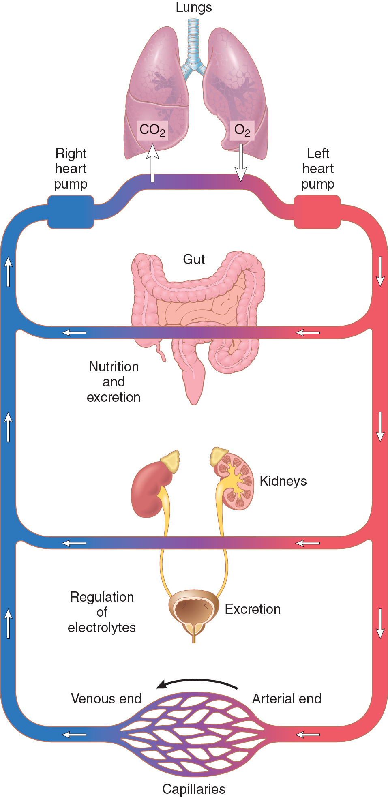
General Organization of the Circulatory System
Each organ or tissue contribute to homeostasis
For Example:
Respiratory system
Lungs provide oxygen to all body cells to work
Digestive system
Gastrointestinal tract provide nutrients that are absorbed into the blood
Renal system
Kidneys maintain constant ion concentration
Blood circulation: Rest: 1 / min
Active 6 /min
Figure 1-1

Slide 18
How does the body system maintain homeostasis?
Pathway
  1. Sensors: detect change in the internal environment and send information to the:
  2. Integrating center (Brain, CNS, endocrine glands): Assess change around a set point, then sends instructions to:
  3. Effector (muscle or gland): make the appropriate adjustments (increase or decrease) to counter the change from the set-point

Slide 19
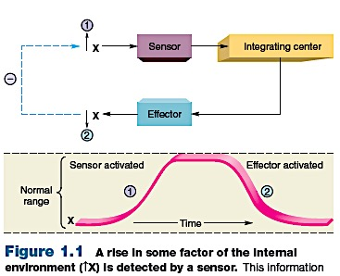
Maintenance of Homeostasis
Negative feedback
Human physiology, by S. Fox

Slide 20
Introduction ( L1 & L2)
Learning Objectives
Explain the course general objectives
Understand the calculations: Molarity, Equivalents, Molality, Molarity vs. equivalent, pH
Review cellular composition
Discuss ‘Homeostasis’ meaning, properties, control systems
Explain Positive and Negative Feedback

Slide 21
How does the body system maintain homeostasis?
Feedback Control
Negative feedback: The response is negative to the initial stimulus
→ Series of changes that return the factor toward a certain mean value
promotes stability
maintain homeostasis
Examples:
1. The regulation of body temperature
2. the regulation of blood pressure
3. the regulation of blood pH
4. the regulation of blood glucose

Slide 22
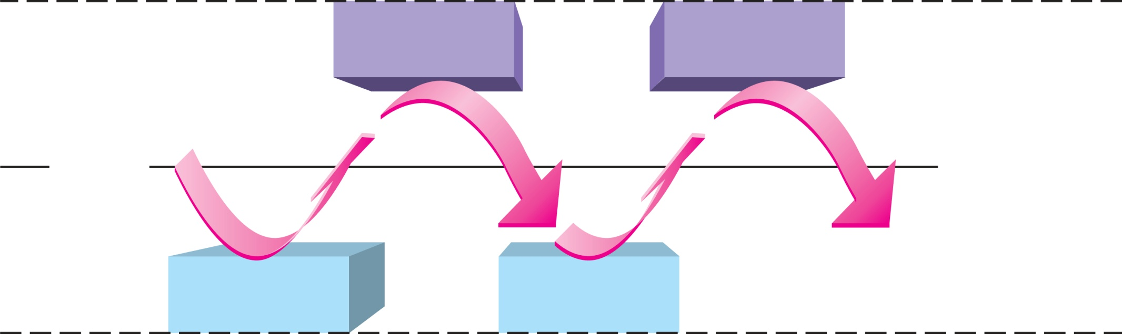
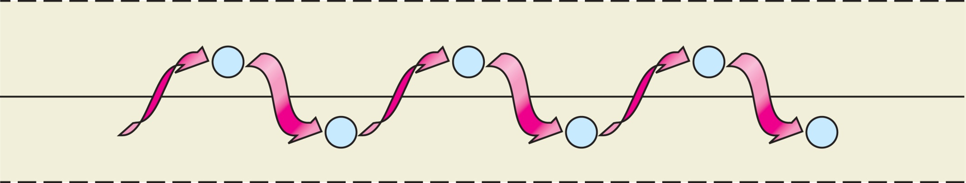
1. The regulation of body temperature
Sweat
Sweat
37° C
Normal
range
Shiver
Shiver
–
–
–
Set point
(average)
Normal
range
–
–
–
Copyright © The McGraw-Hill Companies, Inc. Permission required for reproduction or display.

Slide 23
2. The Control of Arterial Pressure
Sympathetic
Activity
Arterial Pressure
Heart Rate
Vasoconstriction
Arterial pressure
Problem is fixed

Slide 24

The Control of Arterial Pressure
Stimuli
Blood pressure
Sensor
Baroreceptors
Integrating center
Effector
Sensory neurons
Medulla oblongata
Sympathetic
Parasympathetic
Vasoconstriction
of arterioles
Cardiac
rate
Negative feedback
response
Blood pressure
Copyright © The McGraw-Hill Companies, Inc. Permission required for reproduction or display.

Slide 25
Feedback Gain
A measure of the effectiveness of a feedback system in maintaining constant conditions (Homeostasis efficiency)
Correction
Gain =
Error
Example:
Normal Blood Pressure (BP) = 100mmHg
Disturbance: Increase in BP = 175mmHg
Baroreceptors mechanism brings BP = 125mmHg
Correction = 125-175= -50mmHg
Error = 125-100 = 25 mmHg
Gain = -50/25 = -2

Slide 26
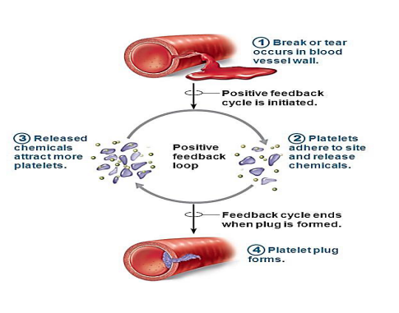
Positive Feedback
The end product in a process stimulates the process
promotes a change in one direction
The action of effectors amplifies the changes
Examples:
Blood clotting
Child birth
Action potential
Adapted from the internet

Slide 27
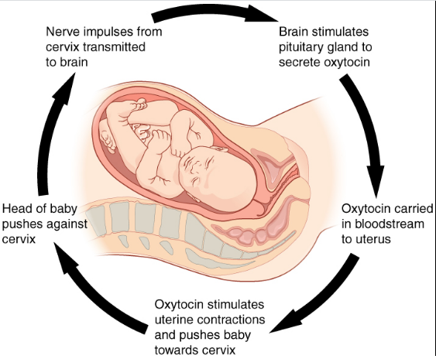
Child birth
Adapted from the internet

