Slide 1

Introduction To Pathology
Dr. Raya D. Marji, M.D. Email: r.marji@bau.edu.jo Office: O-301

Slide 2
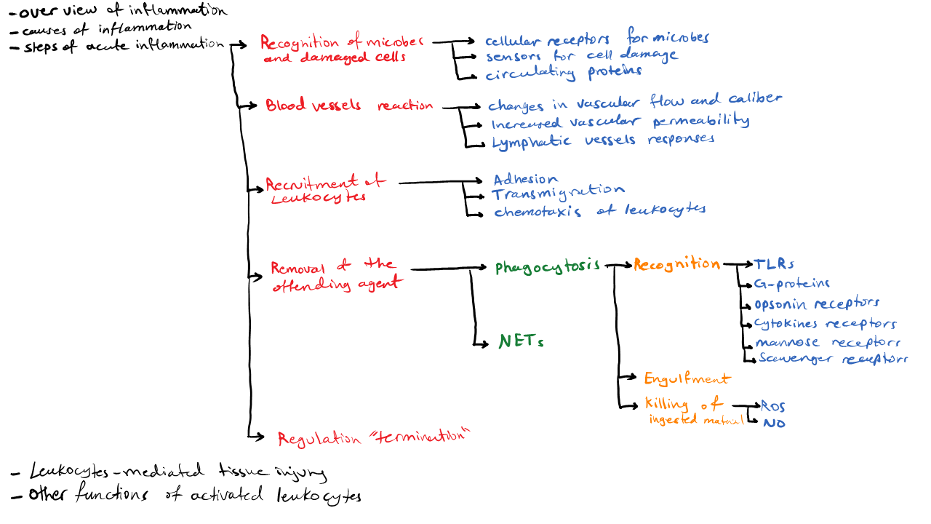

Slide 3
Leukocyte Recruitment to Sites of Inflammation
Neutrophils: use cytoskeletal rearrangements and enzyme assembly to mount rapid, transient responses.
Macrophages, being long-lived, make slower but more prolonged responses that often rely on new gene transcription.
These leukocytes ingest and destroy bacteria and other microbes, as well as necrotic tissue and foreign substances.
Macrophages also produce growth factors that aid in repair.

Slide 4
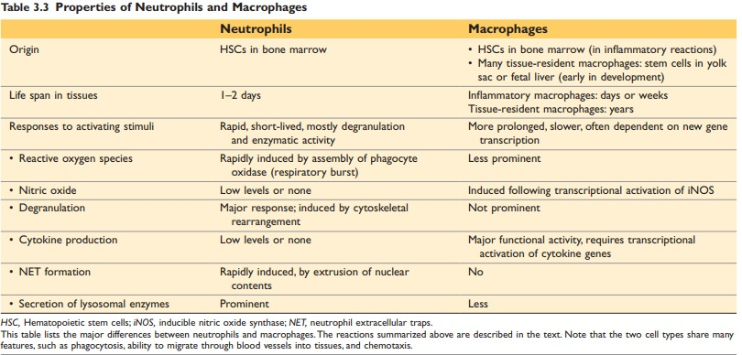

Slide 5
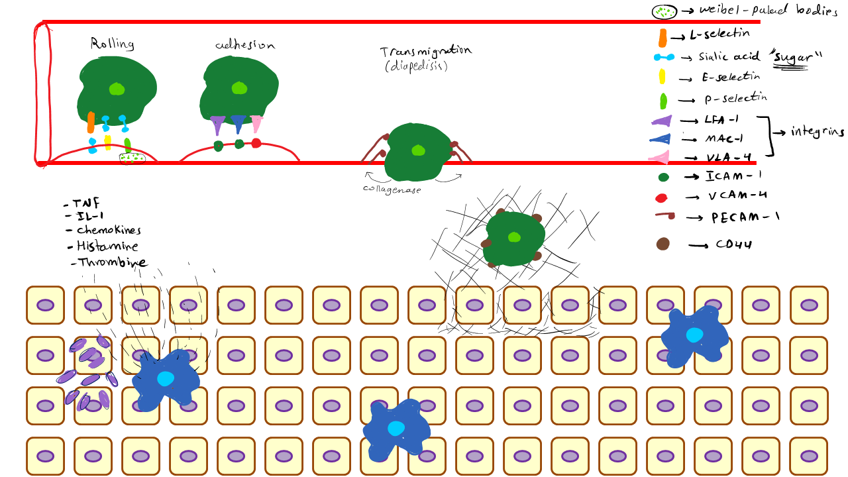

Slide 6
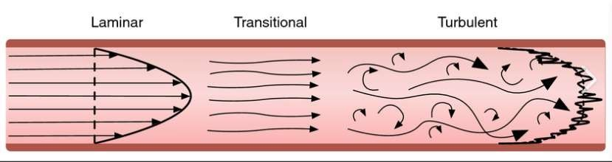
Leukocyte Adhesion to Endothelium
Leukocyte margination: stasis>>> hemodynamic changes>>> leukocytes redistribution toward peripheral position along the endothelial surface.
They express adhesion molecules to which the leukocytes attach loosely.

Slide 7
The attachment of leukocytes to endothelial cells is mediated by complementary adhesion molecules.
The two major families of molecules involved in leukocyte adhesion and migration are the selectins and integrins.

Slide 8
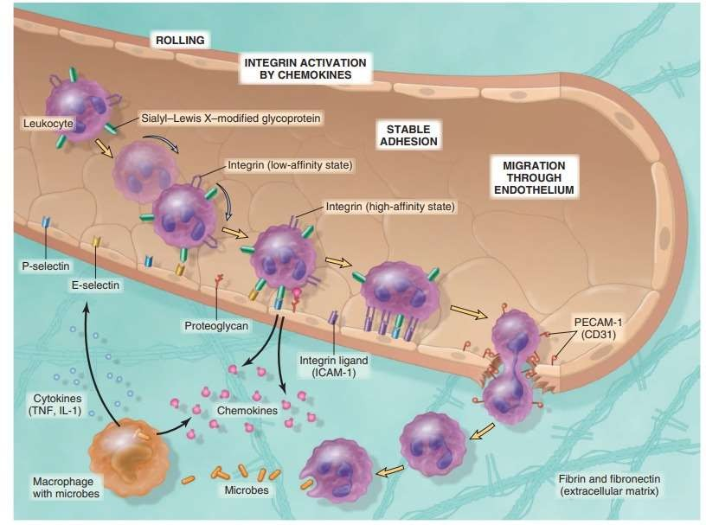

Slide 9
Selectins:
Mediate the initial weak interactions between leukocytes and endothelium.
Selectins are receptors expressed on leukocytes and endothelium that contain an extracellular domain that binds sugars.
The three members of this family are E-selectin (also called CD62E), expressed on endothelial cells; P-selectin (CD62P), present on platelets and endothelium; and L-selectin (CD62L), found on the surface of most leukocytes.
The ligands for selectins are sialic acid-containing oligosaccharides bound to glycoprotein backbones.

Slide 10
Selectins:
Low-affinity interactions with a fast off rate.
Upregulated after stimulation by cytokines and mediators (histamine, thrombin) .
In unactivated endothelial cells, P-selectin is found in intracellular Weibel- Palade bodies.
E-selectin and the ligand for L-selectin are expressed on endothelium only
after stimulation by IL-1 and tumor necrosis factor (TNF), cytokines that
are produced by tissue macrophages, dendritic cells, mast cells, and endothelial cells.
Leukocytes express L-selectin at the tips of their microvilli and bind to the complementary molecules on the endothelial cells.
As a result, the bound leukocytes bind, detach, and bind again, and thus begin to roll along the endothelial surface.

Slide 11
Integrins:
High-affinity, firm adhesion of leukocytes to endothelium.
Transmembrane two-chain glycoproteins that mediate the adhesion of leukocytes to endothelium and of various cells to the extracellular matrix.
Adhere to their specific ligands until the leukocytes are activated by chemokines.
TNF and IL-1, activate endothelial cells to increase their expression of ligands for integrins.
These ligands include intercellular adhesion molecule-1 (ICAM-1), which
binds to the integrins leukocyte function–associated antigen-1 (LFA-1) (also
called CD11aCD18) and macrophage-1 antigen (Mac-1) (CD11bCD18), and
vascular cell adhesion molecule-1 (VCAM-1), which binds to the integrin very late antigen-4 (VLA-4).

Slide 12
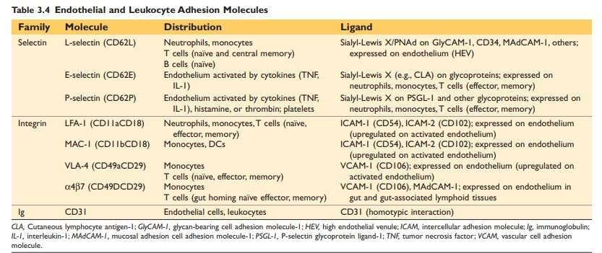

Slide 13
Leukocyte Migration Through Endothelium
Squeezing between cells at intercellular junctions (transmigration).
Platelet endothelial cell adhesion molecule-1 (PECAM-1) (also called CD31), an adhesion molecule of the immunoglobulin (Ig) superfamily expressed on leukocytes and endothelial cells.
Leukocytes pierce the basement membrane, probably by secreting collagenases, and they enter the extravascular tissue.

Slide 14
Chemotaxis of Leukocytes
Locomotion along a chemical gradient.
Both exogenous and endogenous substances:
Bacterial products, particularly peptides with Nformylmethionine termini
Cytokines, especially those of the chemokine family
Components of the complement system, particularly C5a
Products of the lipoxygenase pathway of arachidonic acid (AA) metabolism, leukotriene B4 (LTB4).
Binding to seven transmembrane G protein-coupled receptors on the surface of leukocytes.
Activate second messengers that induce polymerization of actin, resulting in increased amounts at the leading edge of the cell and localization of myosin filaments at the back.

Slide 15
Leukocyte infiltrate varies with the age of the inflammatory response and the type of stimulus.
Acute inflammation: neutrophils predominate (first 6 to 24 hours), more numerous in the blood, they respond more rapidly to chemokines, and they may attach more firmly to the adhesion molecules.
After entering tissues, neutrophils are short-lived; they undergo apoptosis and disappear
within 24 to 48 hours.
Macrophages survive and may proliferate in the tissues.
Exceptions:
Pseudomonas bacteria: neutrophils for several days.
Viral infections: lymphocytes.
Hypersensitivity reactions: lymphocytes, macrophages, and plasma cells.
Allergic reactions: eosinophils.

Slide 16
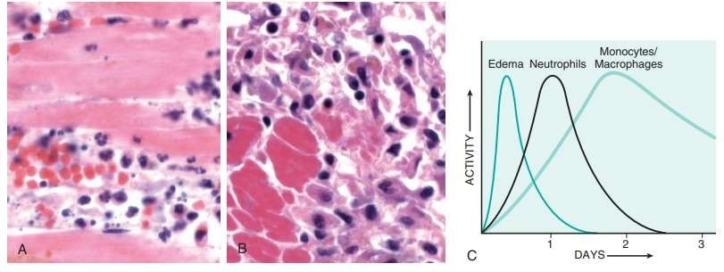

Slide 17
Phagocytosis and Clearance of the Offending Agent
Recognition of microbes or dead cells induces several responses in leukocytes called leukocyte activation.
Phagocytosis and intracellular killing.

Slide 18
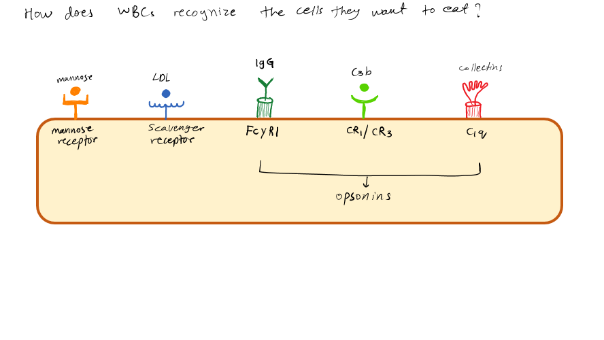

Slide 19
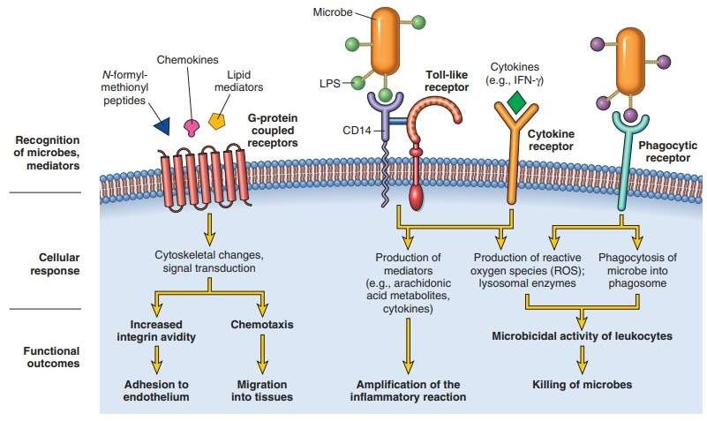

Slide 20
Phagocytosis
Recognition by Phagocytic Receptors: Mannose receptors, scavenger receptors, and receptors for various opsonins bind and ingest microbes.
Mannose receptor recognizes microbes and not host cells.
The major opsonins are immunoglobulin (Ig)G antibodies, the C3b breakdown product of complement activation, and certain plasma lectins.
Engulfment: Extensions of the cytoplasm (pseudopods) flow around it, and the plasma membrane pinches off to form a cytosolic vesicle (phagosome) that encloses the particle.
Killing or degradation of the ingested material.

Slide 21
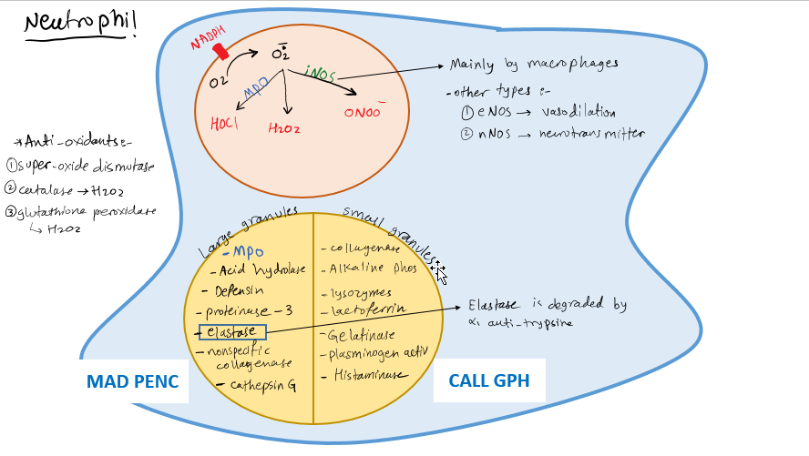

Slide 22
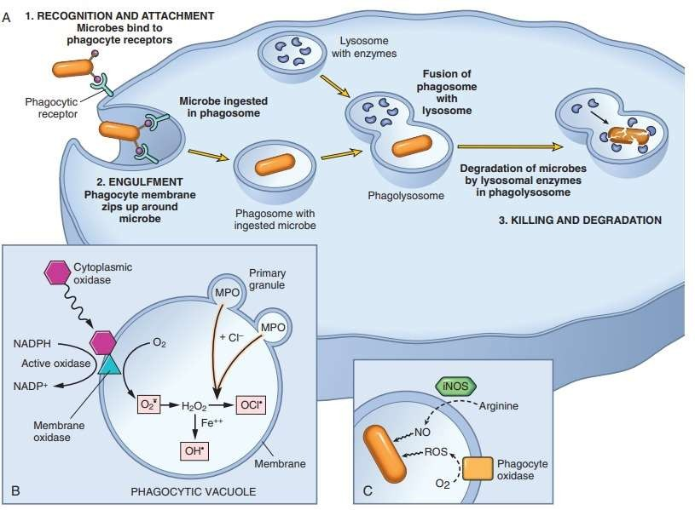

Slide 23
Intracellular Destruction of Microbes and Debris
Reactive oxygen species (ROS) and lysosomal enzymes.
Reactive Oxygen Species: ROS are produced by assembly and activation of a multicomponent enzyme, phagocyte oxidase (also called NADPH oxidase), which oxidizes NADPH and, in the process, reduces oxygen to the superoxide anion (O2 • ).
O2 then converted into hydrogen peroxide (H2O2).
The azurophilic granules of neutrophils contain the enzyme myeloperoxidase (MPO), which, in the presence
of a halide such as Cl− , converts H2O2 to hypochlorite (OCl2)
The H2O2-MPO-halide system is the most efficient bactericidal system of neutrophils.
H2O2 also is converted to hydroxyl radical (OH•), another powerful destructive agent.

Slide 24
Oxygen-derived radicals may be released extracellularly.
Serum, tissue fluids, and host cells possess anti-oxidant mechanisms:
the enzyme superoxide dismutase, which is found in or can be activated in a variety of cell types.
Catalase, which detoxifies H2O2.
Glutathione peroxidase, another powerful H2O2 detoxifier.

Slide 25
Nitric Oxide. NO, a soluble gas produced from arginine by the action of nitric oxide synthase (NOS), also participates in microbial killing.
There are three different types of NOS: endothelial (eNOS), neuronal (nNOS), and inducible (iNOS).
eNOS and nNOS are constitutively expressed at low levels, and the NO they generate acts to maintain vascular tone and as a neurotransmitter, respectively.
iNOS, is involved in microbial killing, is expressed when macrophages are activated and induces the production of NO.
In macrophages, NO reacts with superoxide (O2 • ) to generate the highly reactive free radical peroxynitrite (ONOO•).

Slide 26
Granule Enzymes and Other Proteins: Neutrophils and monocytes contain granules packed with enzymes and anti-microbial proteins that degrade microbes and dead tissues and may contribute to tissue damage.
Actively secretory and distinct from classical lysosomes.
Neutrophils have two main types of granules:
The smaller specific (or secondary) granules contain lysozyme, collagenase, gelatinase, lactoferrin, plasminogen activator, histaminase, and alkaline phosphatase.
The larger azurophil (or primary) granules contain MPO, bactericidal factors (such as defensins), acid hydrolases, and a variety of neutral proteases (elastase, cathepsin G, nonspecific collagenases, proteinase 3).

Slide 27
Neutrophil Extracellular Traps (NETs): are extracellular fibrillar networks that concentrate anti-microbial substances at sites of infection and prevent the spread of the microbes by trapping them in the fibrils.
They are produced by neutrophils in response to infectious pathogens (mainly bacteria and fungi) and inflammatory mediators (e.g., chemokines, cytokines, and complement proteins).
Consist of a viscous meshwork of nuclear chromatin that binds and concentrates granule proteins such as anti-microbial peptides and enzymes.

Slide 28
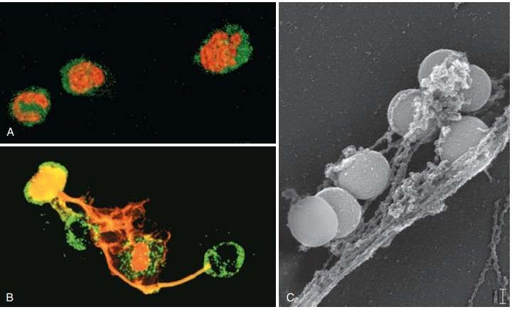

Slide 29
Leukocyte-Mediated Tissue Injury
As part of a normal defense reaction against infectious microbes, when tissues at or near the site of infection suffer collateral damage.
When the inflammatory response is inappropriately directed against host tissues, as in certain autoimmune diseases.
When the host “hyper-reacts” against usually harmless environmental substances.

Slide 30
Leukocytes damage tissues by releasing injurious molecules:
If phagocytes encounter materials that cannot be easily ingested, such as immune complexes deposited on immovable flat surfaces (e.g., glomerular basement membrane), the inability of the leukocytes to surround and ingest these substances (“frustrated phagocytosis”) triggers strong activation and the release of large amounts of granule enzymes into the extracellular environment.
Some phagocytosed substances, such as urate and silica crystals, may damage the membrane of the phagolysosome and lead to the release of damaging contents.

Slide 31
Termination of the Acute Inflammatory Response
Inflammation declines after the offending agents are removed.
Active termination mechanisms include a switch in the type of arachidonic acid metabolite produced, from proinflammatory leukotrienes to anti-inflammatory lipoxins, and the liberation of anti- inflammatory cytokines, including transforming growth factor-β (TGF- β) and IL-10, from macrophages and other cells.

