Slide 1

Introduction To Pathology
Dr. Raya D. Marji, M.D.
Email: r.marji@bau.edu.jo
Office: O-301

Slide 2
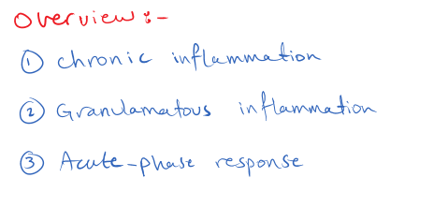

Slide 3
CHRONIC INFLAMMATION
A response of prolonged duration (weeks or months) in which inflammation, tissue injury, and attempts at repair coexist, in varying combinations.
It may follow acute inflammation or may begin de novo.

Slide 4
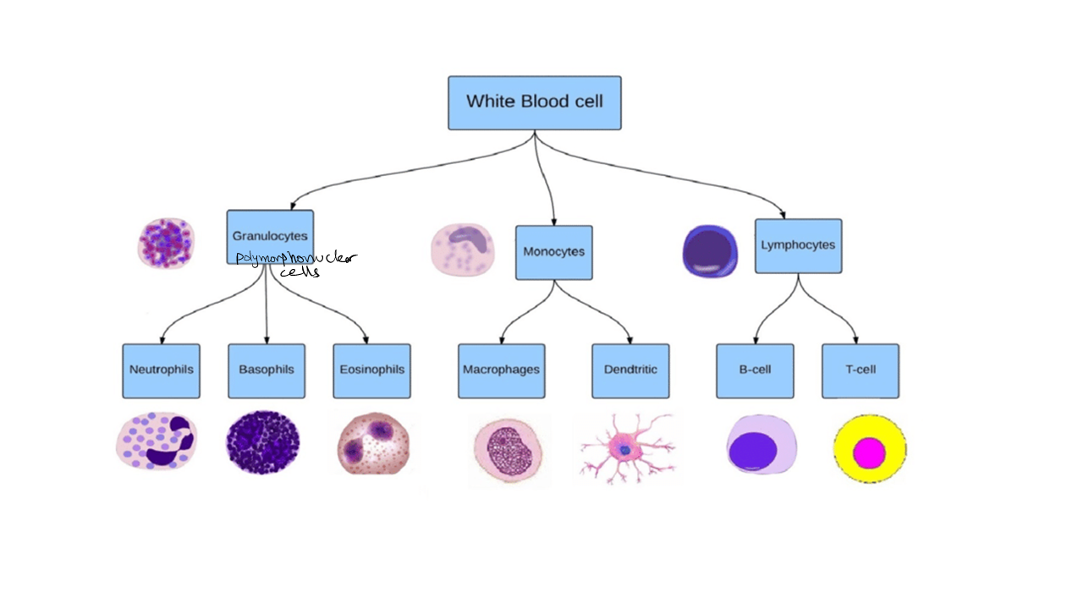

Slide 5
Causes of Chronic Inflammation
1- Persistent infections by microorganisms that are difficult to eradicate.
Ex. granulomatous inflammation, chronic lung abscess.
2- Hypersensitivity diseases: excessive and inappropriate activation of the immune system.
Ex. autoimmune diseases, allergic diseases.
3- Prolonged exposure to potentially toxic agents, either exogenous or endogenous.
Ex. Silica produce silicosis, Atherosclerosis.

Slide 6
Morphologic Features
Infiltration with mononuclear cells, which include macrophages, lymphocytes, and plasma cells.
Tissue destruction, induced by the persistent offending agent or by the inflammatory cells.
Attempts at healing by connective tissue replacement of damaged tissue.

Slide 7
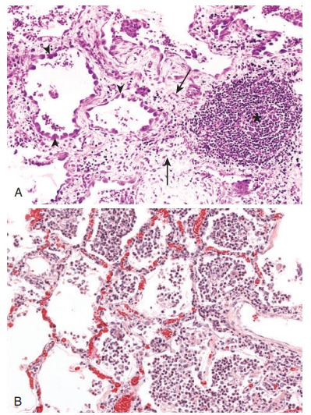

Slide 8
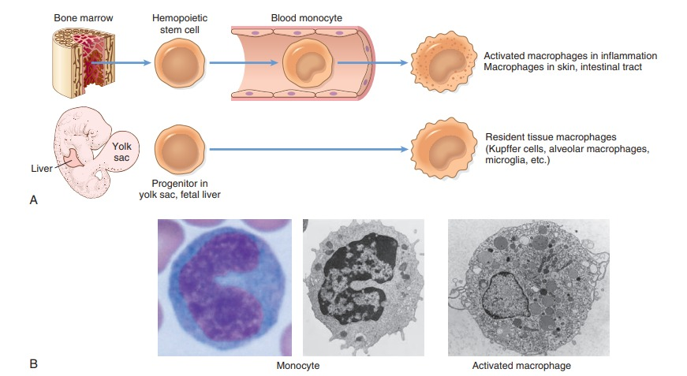

Slide 9
Cells and Mediators of Chronic Inflammation
Local activation of several cell types and the production of mediators.
The dominant cells are macrophages, which contribute to the reaction by secreting cytokines and growth factors.
Progenitors in the bone marrow give rise to monocytes, which enter the blood, migrate into various tissues, and differentiate into macrophages.
Macrophages become the dominant cell population in inflammatory reactions within 48 hours of onset.

Slide 10
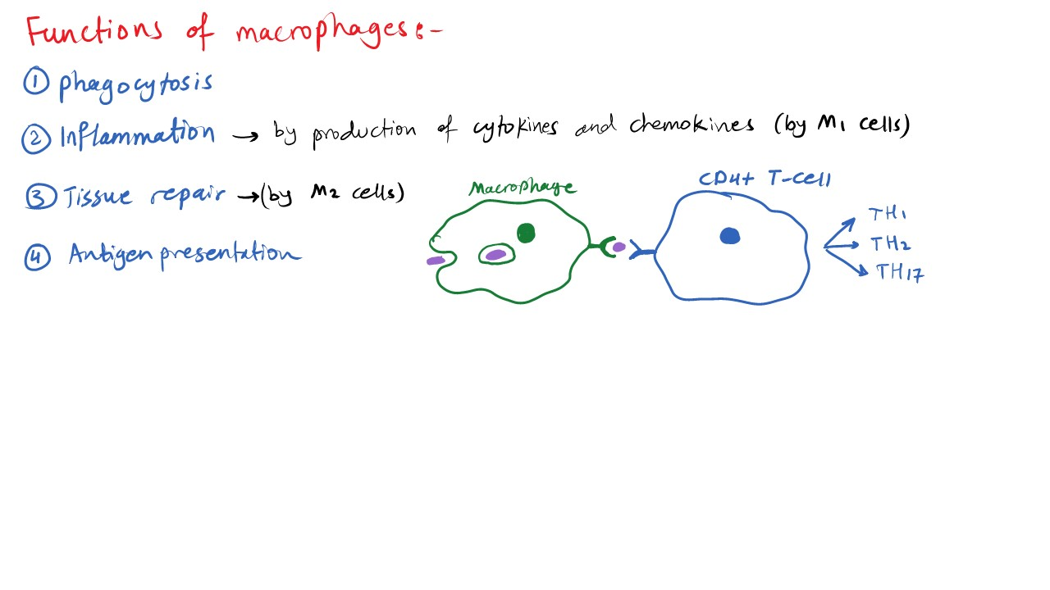

Slide 11
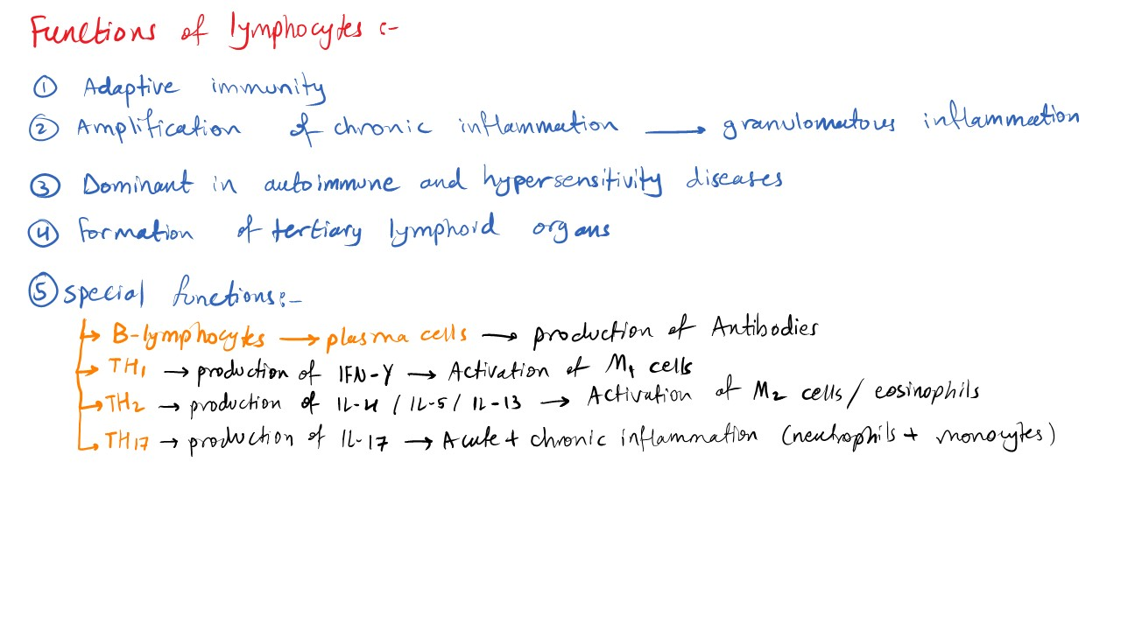

Slide 12
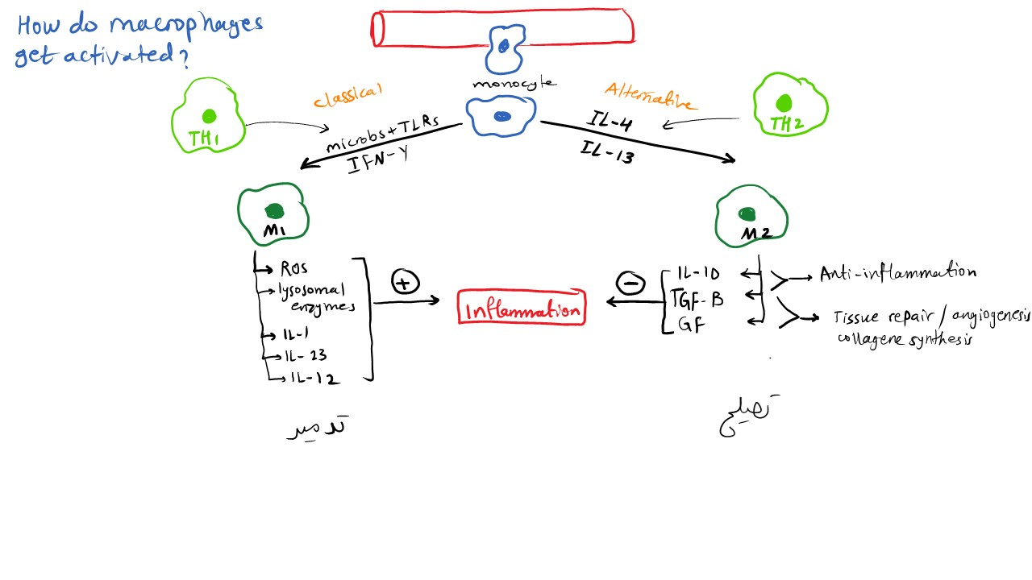

Slide 13
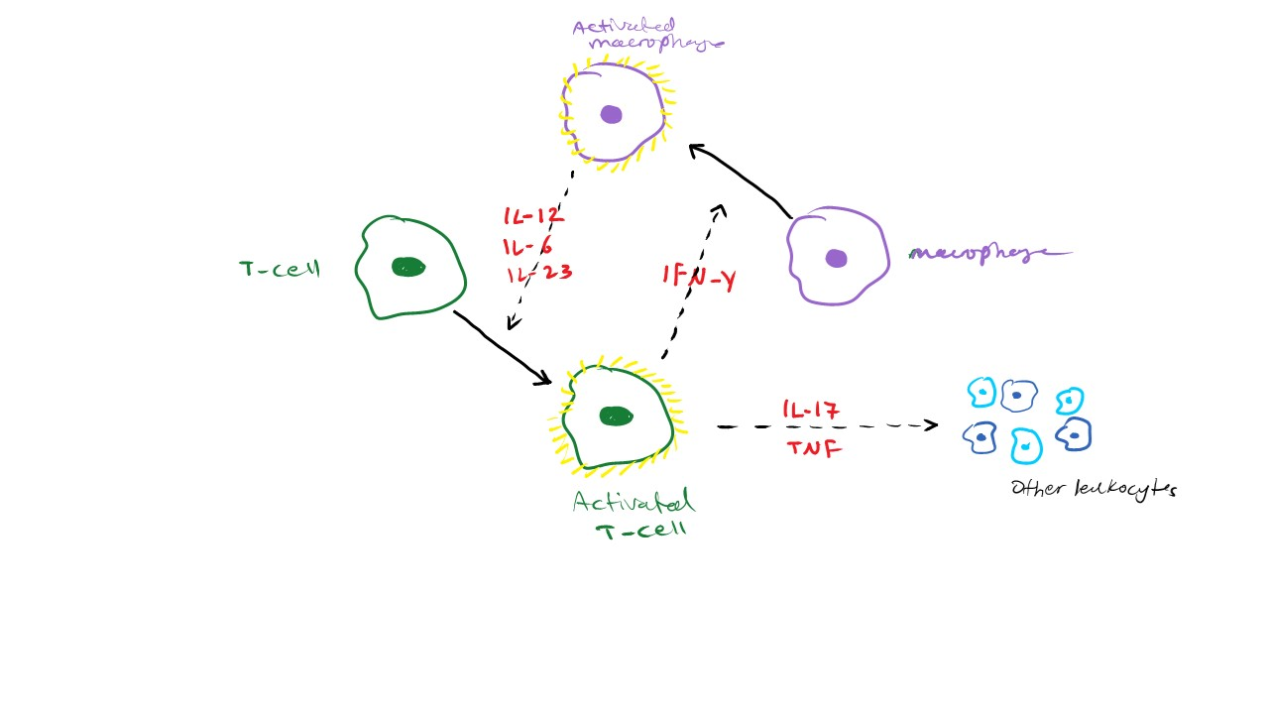

Slide 14
Macrophage Activation
Two major pathways: classical and alternative.
Depends on the nature of the activating signals.
Classical macrophage activation: induced by microbial products such as endotoxin, which engage TLRs and other sensors, and by T cell–derived signals, importantly the cytokine IFN-γ, in immune responses. Classically activated (also called M1) macrophages produce NO and ROS and upregulate lysosomal enzymes.
Alternative macrophage activation: the principal function of alternatively activated (M2) macrophages is in tissue repair. They secrete growth factors that promote angiogenesis, activate fibroblasts, and stimulate collagen synthesis.

Slide 15
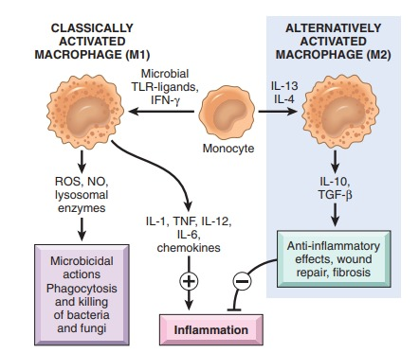

Slide 16
Other functions of Macrophages:
Macrophages secrete mediators of inflammation, such as cytokines (TNF, IL-1, chemokines, and others).
Macrophages display antigens to T lymphocytes and respond to signals from T cells (cell-mediated immunity).
Can also induce considerable tissue destruction when macrophages are inappropriately or excessively activated.

Slide 17
Role of Lymphocytes
Microbes and other environmental antigens activate T and B lymphocytes.
Ability to secrete cytokines (CD4+ T lymphocytes).
Three subsets of CD4+ T cells that secrete different cytokines and elicit different types of inflammation:
TH1 cells produce the cytokine IFN-γ, which activates macrophages by the classical pathway.
TH2 cells secrete IL-4, IL-5, and IL-13, which recruit and activate eosinophils and are responsible for the alternative pathway of macrophage activation.
TH17 cells secrete IL-17 and other cytokines, which induce the secretion of chemokines responsible for recruiting neutrophils into the reaction.

Slide 18
Macrophages display antigens to T cells, express membrane molecules (called costimulators) that activate T cells, and produce cytokines (IL-12 and others) that also stimulate T cell responses.
Activated T lymphocytes produce cytokines which recruit and activate macrophages.
Activated B lymphocytes and antibody-producing plasma cells.
Ex. in the synovium of patients with longstanding rheumatoid arthritis.
in the thyroid in Hashimoto thyroiditis.
in the gastric mucosa in the setting of Helicobacter pylori infection.

Slide 19
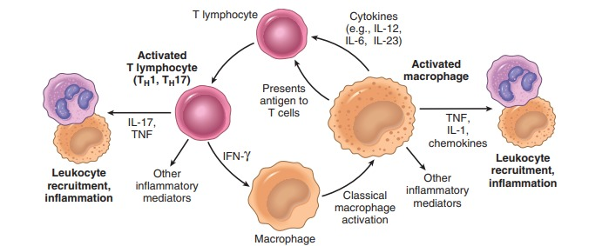

Slide 20
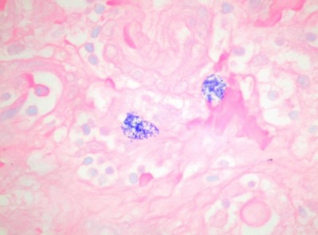
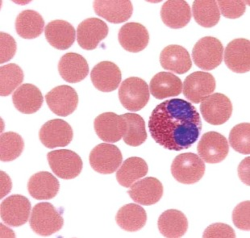
Other Cells in Chronic Inflammation
1- Eosinophils: abundant in immune reactions mediated by IgE and in parasitic infections.
2- Mast cells: in acute and chronic inflammatory reactions.
Ex. allergic reactions to foods, insect venom, or drugs, sometimes with catastrophic results (e.g., anaphylactic shock).

Slide 21
3- Neutrophils: acute on chronic
many forms of chronic inflammation, lasting for months, continue to show large numbers of neutrophils.
Ex. Chronic bacterial infection of bone (osteomyelitis).

Slide 22
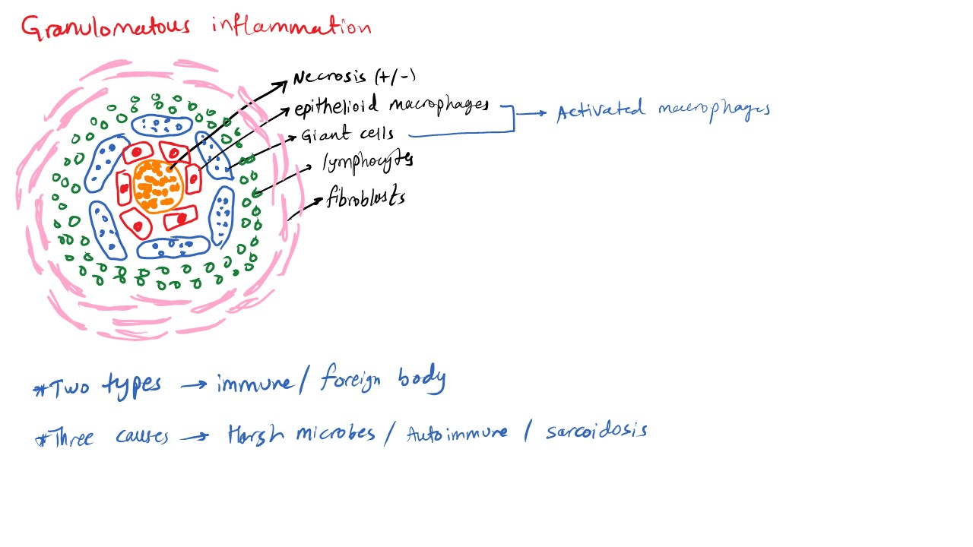

Slide 23
Granulomatous Inflammation
Collections of activated macrophages (epithelioid), T lymphocytes, +/- central necrosis.
Activated macrophages may fuse: called multinucleate giant cells.
Two types of granulomas, which differ in their pathogenesis:
1- Immune granulomas: inducing a persistent T cell–mediated immune response.
2- Foreign body granulomas: in the absence of T cell– mediated immune responses.

Slide 24
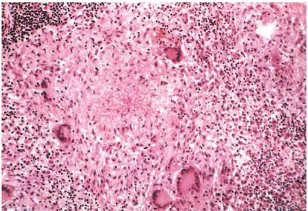
Granulomas:
Pink granular cytoplasm with indistinct cell boundaries and are called epithelioid cells.
A collar of lymphocytes surrounds the aggregates of epithelioid macrophages.
Multinucleated giant cells 40 to 50 µm in diameter.

Slide 25
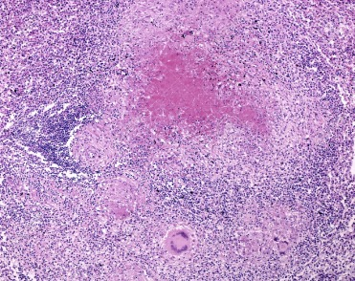
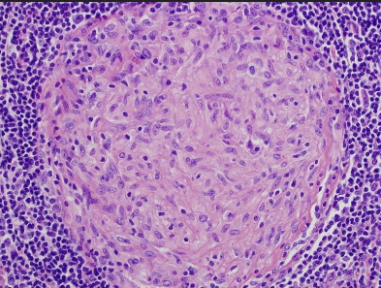
Caseous necrosis
Non-caseating granulomas

Slide 26
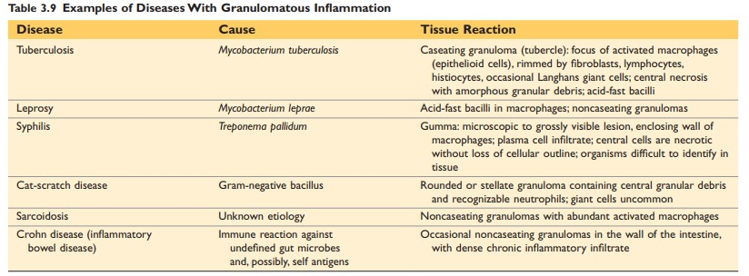

Slide 27
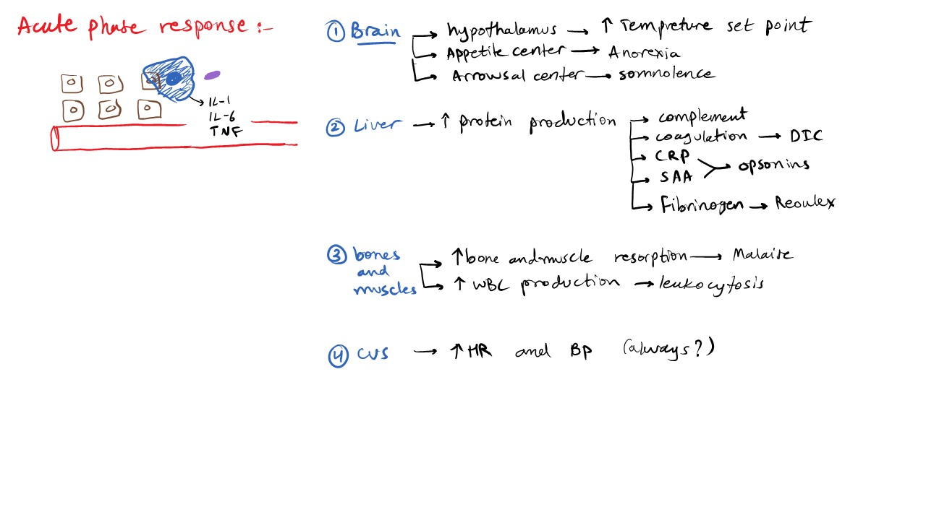

Slide 28
The acute-phase response:
Fever: elevation of body temperature by pyrogens.
Bacterial products, such as LPS (called exogenous pyrogens), stimulate leukocytes to release cytokines such as IL-1 and TNF (called endogenous pyrogens) that increase the enzymes (cyclooxygenases) that convert arachadonic acid into prostaglandins.
In the hypothalamus, the prostaglandins, especially PGE2, stimulate the production of neurotransmitters that reset the temperature set point at a higher level.

Slide 29
Acute-phase proteins:
Plasma proteins, mostly synthesized in the liver.
C-reactive protein (CRP), fibrinogen, and serum amyloid A (SAA) protein.
CRP and SAA, bind to microbial cell walls, and they may act as opsonins and fix complement.
Fibrinogen binds to red cells and causes them to form stacks (rouleaux) and shows high ESR test.
Prolonged production of these proteins (especially SAA): cause secondary amyloidosis.
iron-regulating peptide hepcidin: responsible for the anemia.

Slide 30
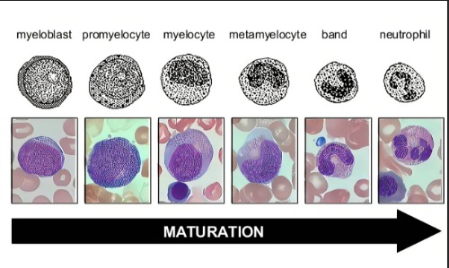
Leukocytosis:
Elevated WBCs.
Leukemoid reactions.
Due to accelerated release of cells from the bone marrow and associated with a rise in the number of more immature neutrophils in the blood (shift to the left).
Most bacterial infections: neutrophilia.
Viral infections: lymphocytosis.
Allergies and parasitic infestations: eosinophilia.

Slide 31
Other manifestations of the acute-phase response:
Increased heart rate and blood pressure; decreased sweating; rigors (shivering), chills (search for warmth), anorexia, somnolence, and malaise.
Sepsis: the large amounts of bacteria and their products in the blood stimulate the production of enormous quantities of several cytokines, notably TNF and IL-1. High blood levels of cytokines cause widespread clinical and pathologic abnormalities such as disseminated intravascular coagulation, hypotensive shock, and metabolic disturbances including insulin resistance and hyperglycemia= septic shock.
Systemic inflammatory response syndrome (SIRS): a complication of noninfectious disorders, such as severe burns, trauma, pancreatitis, and other serious conditions.

