Slide 1

Introduction To Pathology
Dr. Raya D. Marji, M.D.
Email: r.marji@bau.edu.jo
Office: O-505

Slide 2
Plasma-derived mediators

Slide 3
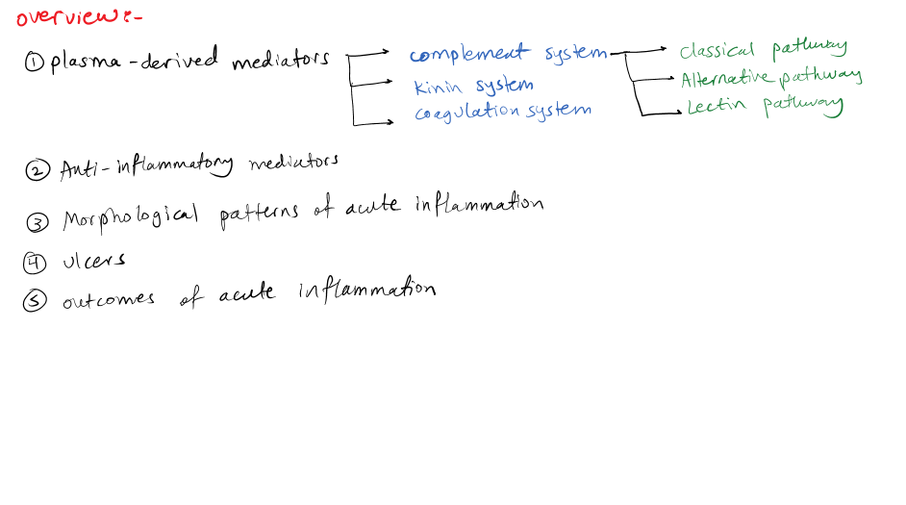

Slide 4
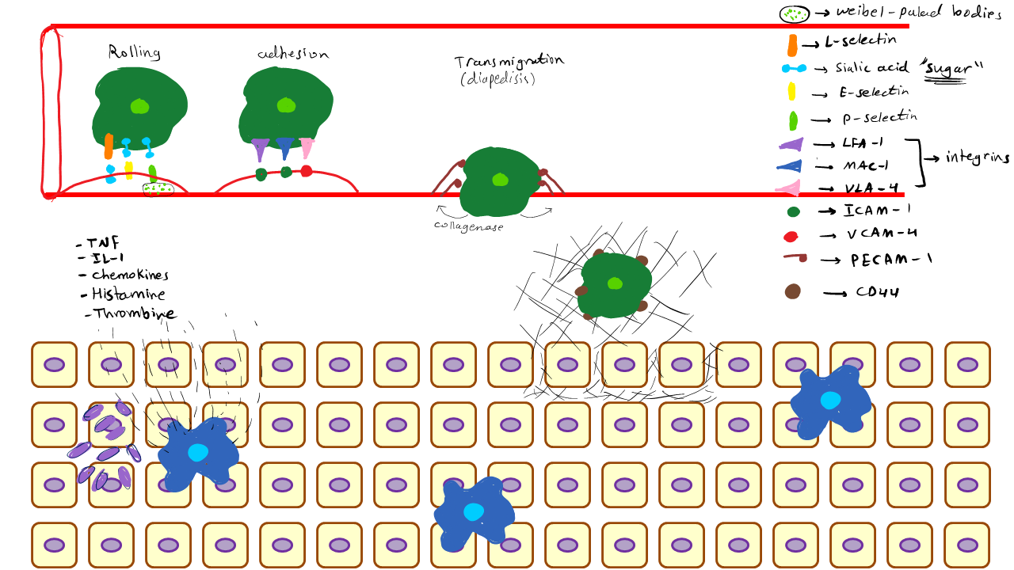

Slide 5
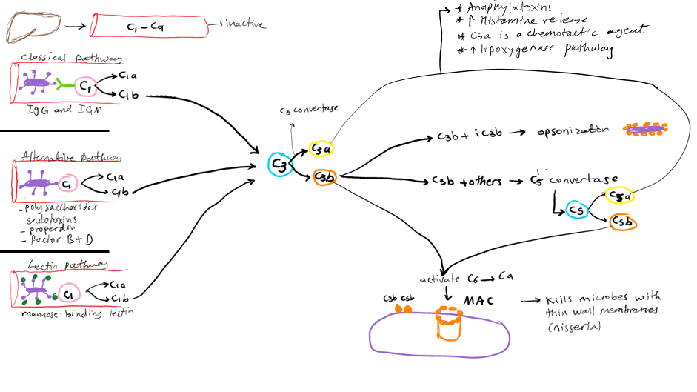

Slide 6
Complement System
A collection of soluble proteins and their membrane receptors.
More than 20 complement proteins, some numbered C1 through C9.
Function in both innate and adaptive immunity for defense against microbial pathogens.
Complement proteins are present in inactive forms in the plasma, and many of them are activated to become proteolytic enzymes that degrade other complement proteins, thus forming an enzymatic cascade capable of tremendous amplification.
The critical step in complement activation is the proteolysis of the third (and most abundant) component, C3.
Cleavage of C3 can occur by one of three pathways:
The classical pathway.
The alternative pathway.
The lectin pathway.

Slide 7
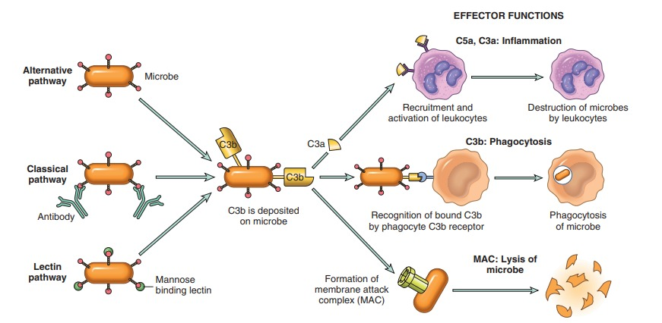
Complement Activation:

Slide 8
Complement activation: lead to the formation of an enzyme called the C3 convertase, which splits C3 into two functionally distinct fragments, C3a and C3b.
C3a is released, and C3b becomes covalently attached to the cell or molecule where the complement is being activated.
C3b then binds to the previously generated fragments to form C5 convertase, which cleaves C5 to release C5a and leave C5b attached to the cell surface. C5b binds the late components (C6–C9), culminating in the formation of the membrane attack complex (MAC, composed of multiple C9 molecules).

Slide 9
Functions of Complement System:
Inflammation: C5a, and, to a lesser extent, C4a and C3a, are cleavage products of the corresponding complement components that stimulate histamine release from mast cells and thereby increase vascular permeability and cause vasodilation. They are called anaphylatoxins because they have effects similar to those of mast cell mediators that are involved in the reaction called anaphylaxis. C5a also is a chemotactic agent for neutrophils, monocytes, eosinophils, and basophils. C5a activates the lipoxygenase pathway of arachidonic acid metabolism in neutrophils and monocytes, causing release of more inflammatory mediators.
Opsonization and phagocytosis: C3b and its cleavage product iC3b (inactive C3b), when fixed to a microbial cell wall, act as opsonins and promote phagocytosis by neutrophils and macrophages, which bear cell surface receptors for these complement fragments.
Cell lysis: The deposition of the MAC on cells drills holes in the cell membrane, making the cells permeable to water and ions and resulting in their osmotic death (lysis). This function of complement is important mainly for the killing of microbes with thin cell walls, such as Neisseria bacteria.

Slide 10
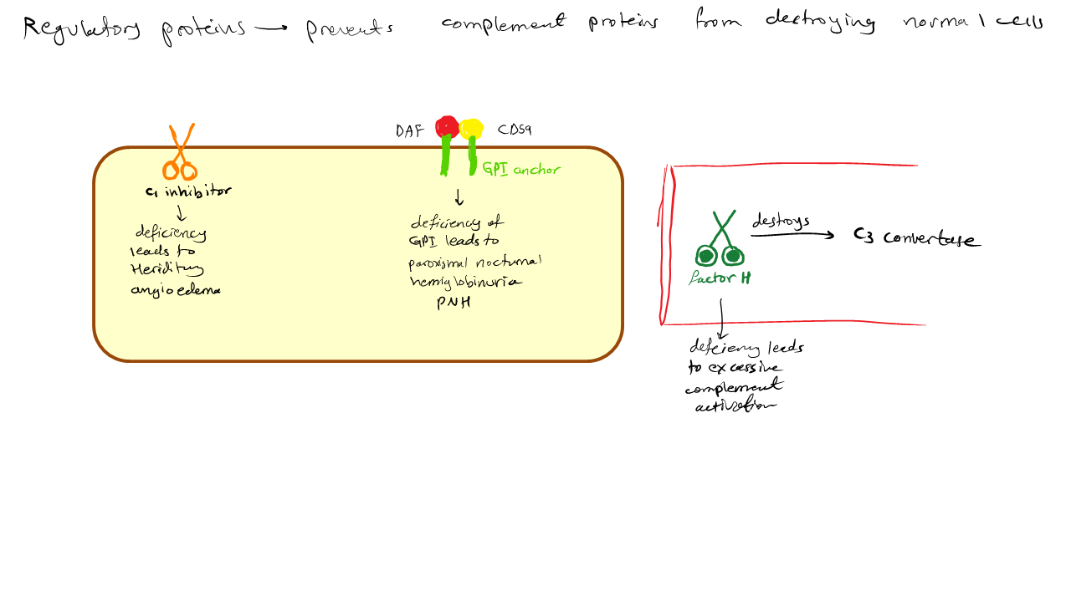

Slide 11
Cell-associated and circulating regulatory proteins:
The activation of complement is controlled by cell-associated and circulating regulatory proteins.
Inhibit the production of active complement fragments or remove fragments that deposit on cells.
C1 inhibitor blocks the activation of C1, the first protein of the classical complement pathway.
Decay accelerating factor (DAF) and CD59 are two proteins that are linked to plasma membranes by a glycophosphatidyl (GPI) anchor. DAF prevents formation of C3 convertases and CD59 inhibits formation of the MAC.
Other complement regulatory proteins proteolytically cleave active complement components.

Slide 12
Other Mediators of Inflammation
Platelet-Activating Factor PAF.
Products of Coagulation.
Kinins.

Slide 13
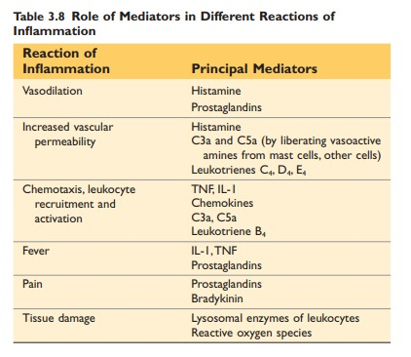

Slide 14
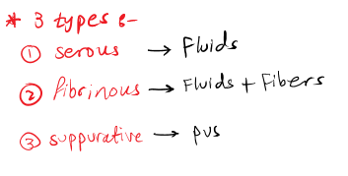
MORPHOLOGIC PATTERNS OF ACUTE INFLAMMATION
The morphologic hallmarks of acute inflammatory reactions are dilation of small blood vessels and accumulation of leukocytes and fluid in the extravascular tissue.

Slide 15
Serous Inflammation
Exudation of cell-poor fluid into spaces created by injury to surface epithelia or into body cavities.
Not infected by destructive organisms and does not contain large numbers of leukocytes.
Derived from the plasma, or from the secretions of mesothelial cells; accumulation of fluid in these cavities is called an effusion.
Effusions consisting of transudates also occur in noninflammatory conditions, such as reduced blood outflow in heart failure, or reduced plasma protein levels in some kidney and liver diseases.

Slide 16
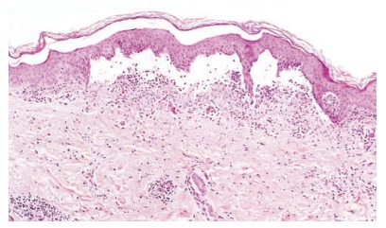

Slide 17
Fibrinous Inflammation
The vascular leaks are large or there is a local procoagulant stimulus.
Higher-molecular weight proteins such as fibrinogen pass out of the blood, and fibrin is formed and deposited in the extracellular space.
Fibrin appears as an eosinophilic meshwork of threads or sometimes as an amorphous coagulum.
Fibrinous exudates may be dissolved by fibrinolysis and cleared by macrophages.
If the fibrin is not removed, with time, it may stimulate the ingrowth of fibroblasts and blood vessels and thus lead to scarring.

Slide 18
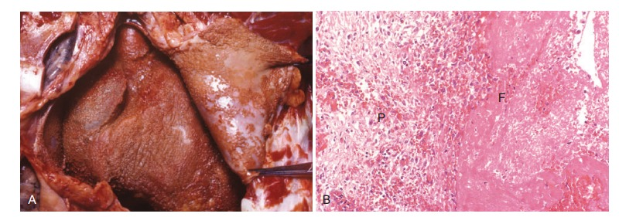

Slide 19
Purulent (Suppurative) Inflammation, Abscess
The production of pus, an exudate consisting of neutrophils, the liquefied debris of necrotic cells, and edema fluid.
The most frequent cause of purulent inflammation is infection with bacteria that cause liquefactive tissue necrosis, such as staphylococci; these pathogens are referred to as pyogenic (pus-producing) bacteria.
Abscesses are localized collections of pus caused by suppuration buried in a tissue, an organ, or a confined space.
Abscesses have a central region that appears as a mass of necrotic leukocytes and tissue cells. There is usually a zone of preserved neutrophils around this necrotic focus, and outside this region there may be vascular dilation and parenchymal and fibroblastic proliferation, indicating chronic inflammation and repair.
In time the abscess may become walled off and ultimately replaced by connective tissue. When persistent or at critical locations (such as the brain), abscesses may have to be drained surgically.

Slide 20
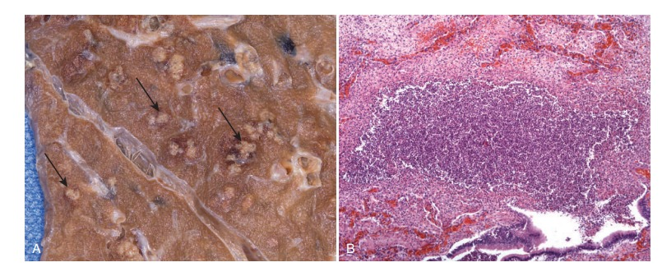

Slide 21
Ulcers
Local defect, or excavation, of the surface of an organ or tissue that is produced by the sloughing (shedding) of inflamed necrotic tissue.
Ulceration can occur only when tissue necrosis and resultant inflammation exist on or near a surface.
It is most commonly encountered in
The mucosa of the mouth, stomach, intestines, or genitourinary tract.
The skin and subcutaneous tissue of the lower extremities in older persons who have circulatory disturbances that predispose to extensive ischemic necrosis.

Slide 22
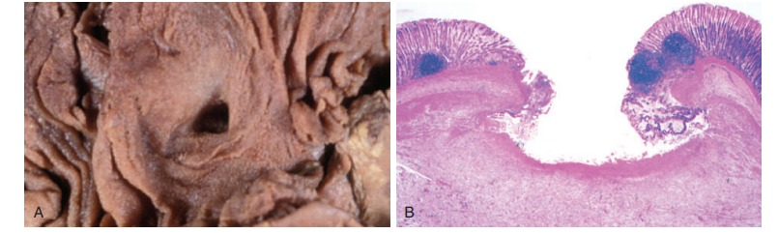

Slide 23
OUTCOMES OF ACUTE INFLAMMATION
1- Complete resolution: restoration of the site of acute inflammation to normal.
The usual outcome when the injury is limited or short-lived or when there has been little tissue destruction and the damaged parenchymal cells can regenerate.
Resolution involves removal of cellular debris and microbes by macrophages, and resorption of edema fluid by lymphatics

Slide 24
2- Healing by connective tissue replacement (scarring, or fibrosis): after substantial tissue destruction, when the inflammatory injury involves tissues that are incapable of regeneration, or when there is abundant fibrin exudation in tissue or in serous cavities (pleura, peritoneum) that cannot be adequately cleared.
3- Progression of the response to chronic inflammation: Acute to chronic transition occurs when the acute inflammatory response cannot be resolved, as a result of either the persistence of the injurious agent or some interference with the normal process of healing.

Slide 25
