Slide 1

Introduction To Pathology
Dr. Raya D. Marji, M.D.
Email: r.marji@bau.edu.jo
Office: O-301

Slide 2
Mediators of Inflammation/ Cell-derived mediators

Slide 3
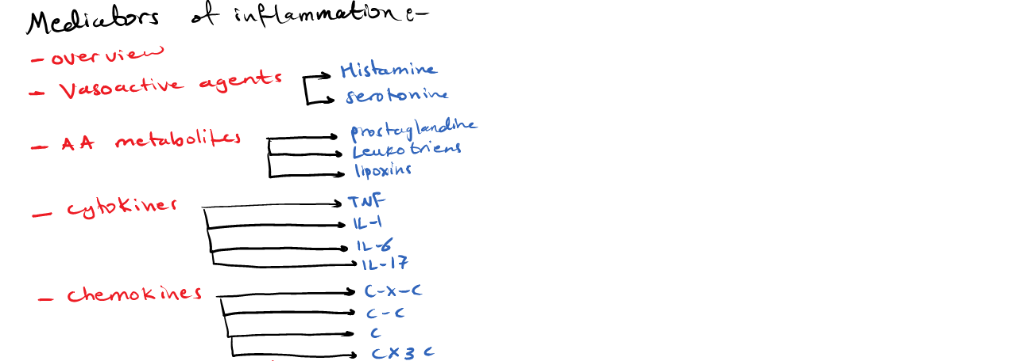

Slide 4
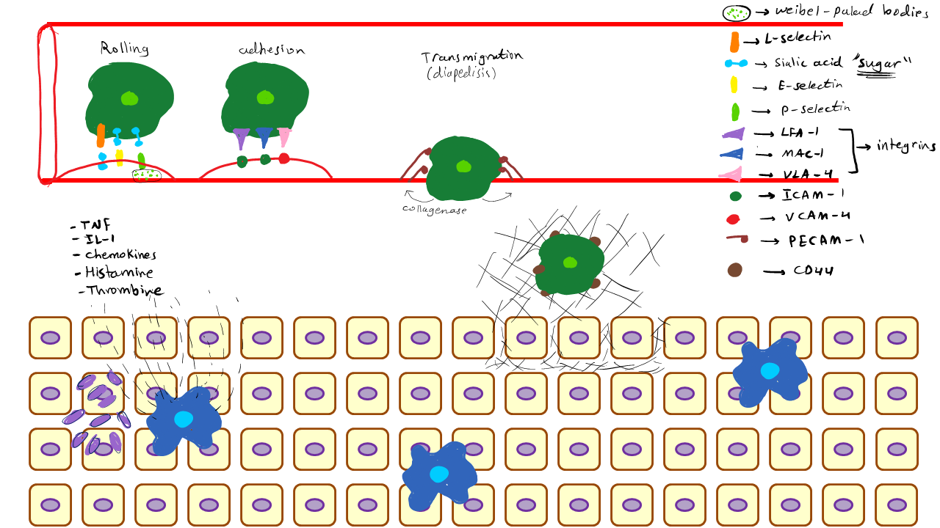

Slide 5
Cell-derived mediators:
Rapidly released from intracellular granules (e.g., amines) or are synthesized de novo (e.g., prostaglandins, leukotrienes, cytokines) in response to a stimulus.
The major cell types that produce mediators of acute inflammation are tissue macrophages, dendritic cells, and mast cells. (platelets, neutrophils, endothelial cells, and most epithelia for lesser extent).
Plasma-derived mediators (e.g., complement proteins):
In the circulation as inactive precursors that must be activated, usually by a series of proteolytic cleavages.
Produced mainly in the liver, are effective against circulating microbes, and also can be recruited into tissues.

Slide 6
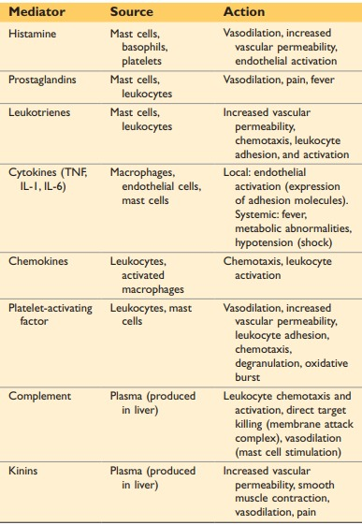
MEDIATORS OF INFLAMMATION

Slide 7
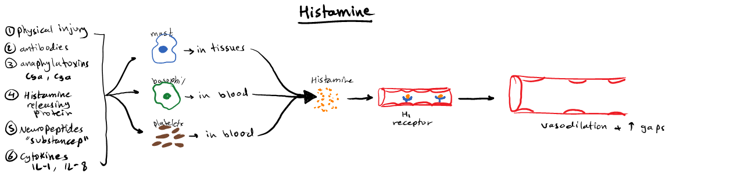

Slide 8
Vasoactive Amines: Histamine
Stored as preformed molecules in cells, among the first mediators to be released during inflammation.
The richest sources of histamine are mast cells, blood basophils and platelets.
It is stored in mast cell granules and is released by degranulation in response to a variety of stimuli, including (1) physical injury, such as trauma, cold, or heat, by unknown mechanisms; (2) binding of antibodies to mast cells, which underlies immediate hypersensitivity (allergic) reactions; and (3) products of complement called anaphylatoxins (C3a and C5a).
Neuropeptides (e.g., substance P) and cytokines (IL-1, IL-8) also may trigger release of histamine.

Slide 9
Histamine:
Histamine causes dilation of arterioles and increases the permeability of venules and contraction of smooth muscles.
Binding to H1 receptors, on microvascular endothelial cells.
The antihistamine drugs: H1 receptor antagonists that bind to and block the receptor.
Other vasoactive mediators: Serotonin.

Slide 10
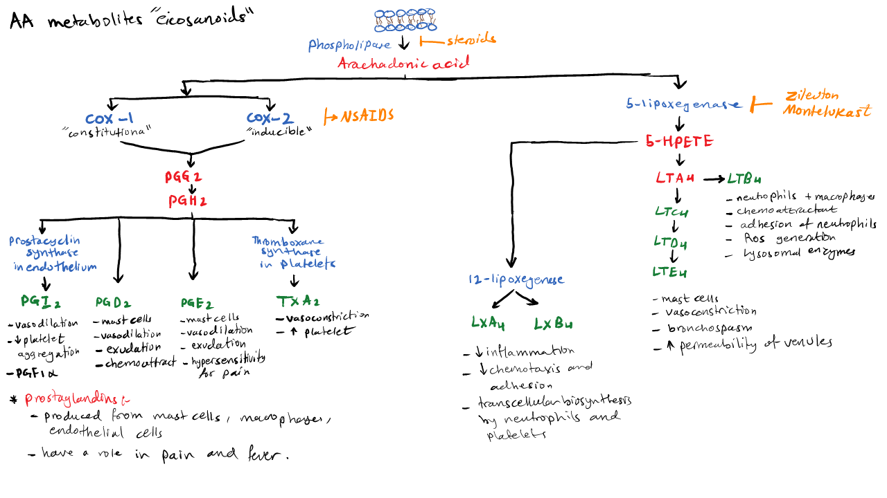

Slide 11
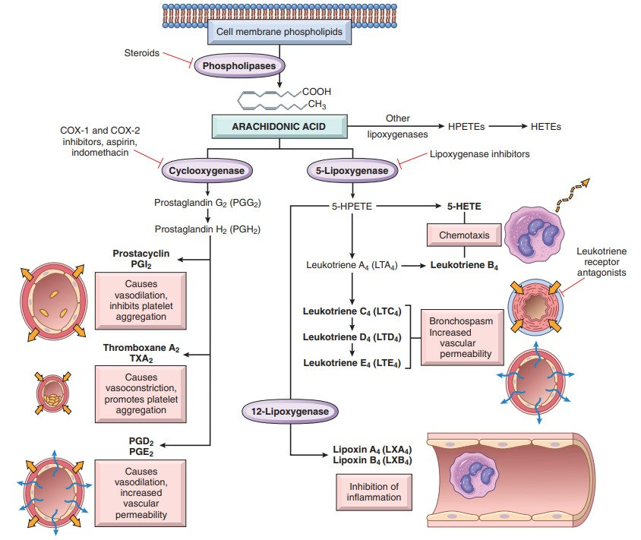
Arachidonic Acid Metabolites
Notes:
The lipid mediators prostaglandins and leukotrienes are produced from arachidonic acid present in membrane phospholipids, and they stimulate vascular and cellular reactions in acute inflammation.
Arachidonic acid is a 20-carbon polyunsaturated fatty acid that is derived from dietary sources or by conversion from the essential fatty acid linoleic acid.
Most cellular arachidonic acid is esterified and incorporated into membrane phospholipids.
Mechanical, chemical, and physical stimuli or other mediators (e.g., C5a) trigger the release of arachidonic acid from membranes by activating cellular phospholipases, mainly phospholipase A2.
Once freed from the membrane, arachidonic acid is rapidly converted to bioactive mediators. These mediators, also called eicosanoids (because they are derived from 20-carbon fatty acids; Greek eicosa = 20), are synthesized by two major classes of enzymes: cyclooxygenases (which generate prostaglandins) and lipoxygenases (which produce leukotrienes and lipoxins) (Fig. 3.9). Eicosanoids bind to G protein-coupled receptors on many cell types and can mediate virtually every step of inflammation.

Slide 12
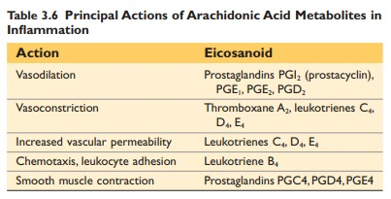

Slide 13
Prostaglandins:
Prostaglandins: produced by mast cells, macrophages, endothelial cells.
Involved in the vascular and systemic reactions of inflammation.
Generated by the actions of two cyclooxygenases called COX-1 and COX-2.
COX-1 is produced in response to inflammatory stimuli and is constitutively expressed in most tissues, where it may serve a homeostatic function (e.g., fluid and electrolyte balance in the kidneys, cytoprotection in the gastrointestinal tract).
COX-2 is induced by inflammatory stimuli and thus generates the PGs that are involved in inflammatory reactions, but it is low or absent in most normal tissues.
The most important prostaglandins in inflammation are PGE2, PGD2, PGF2a, PGI2 (prostacyclin), and TXA2 (thromboxane A2).

Slide 14
Prostacyclin:
Vascular endothelium contains prostacyclin synthase, which is responsible for the formation of prostacyclin (PGI2) and its stable end product PGF1a.
Prostacyclin is a vasodilator and a potent inhibitor of platelet aggregation.
Prostaglandins are involved in the pathogenesis of pain and fever.
PGE2 makes the skin hypersensitive to painful stimuli, and causes fever during infections.

Slide 15
Leukotrienes:
Leukotrienes: produced in leukocytes and mast cells by the action of lipoxygenase and are involved in vascular and smooth muscle reactions and leukocyte recruitment.
The synthesis: generates leukotriene A4 (LTA4), which in turn gives rise to LTB4 or LTC4.
LTB4 is produced by neutrophils and some macrophages, and is a potent chemotactic agent and activator of neutrophils, causing aggregation and adhesion of the cells to venular endothelium, generation of ROS, and release of lysosomal enzymes.
The cysteinyl-containing leukotriene LTC4 and its metabolites, LTD4 and LTE4, are produced mainly in mast cells and cause intense vasoconstriction, bronchospasm, and increased permeability of venules.

Slide 16
Lipoxins:
Generated from arachidonic acid by the lipoxygenase pathway.
Suppress inflammation by inhibiting the recruitment of leukocytes.
Inhibit neutrophil chemotaxis and adhesion to endothelium.
Leukocytes, particularly neutrophils, produce intermediates in lipoxin synthesis, and these are converted to lipoxins by platelets interacting with the leukocytes.

Slide 17
Pharmacologic Inhibitors of Prostaglandins and Leukotrienes:
Cyclooxygenase inhibitors include aspirin and other nonsteroidal anti-inflammatory drugs (NSAIDs), such as ibuprofen.
They inhibit both COX-1 and COX-2 and thus block all prostaglandin synthesis.
Selective COX-2 inhibitors are a newer class of these drugs that are 200- to 300-fold more potent in blocking COX-2 than COX-1.

Slide 18
Pharmacologic agents that inhibit leukotriene production (e.g., zileuton) are useful in the treatment of asthma.
Corticosteroids are broad-spectrum anti-inflammatory agents that reduce the transcription of genes encoding COX-2, phospholipase A2, proinflammatory cytokines (e.g., IL-1 and TNF), and iNOS.
Leukotriene receptor antagonists block leukotriene receptors and prevent the actions of the leukotrienes. These drugs (e.g., Montelukast) are useful in the treatment of asthma.

Slide 19
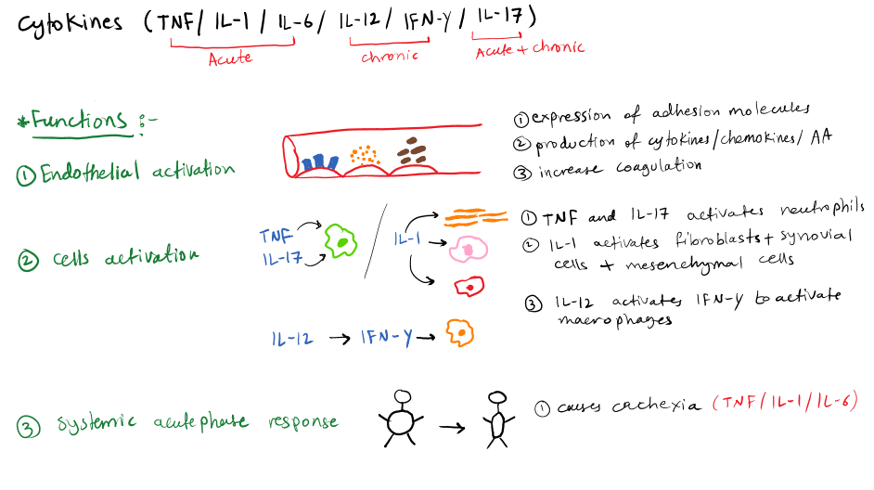
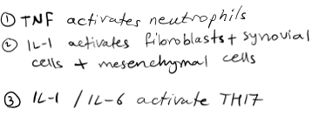




Slide 20
Cytokines and Chemokines
Cytokines are proteins secreted by many cell types (principally activated lymphocytes, macrophages, and dendritic cells, but also endothelial, epithelial, and connective tissue cells).
Mediate and regulate immune and inflammatory reactions.

Slide 21
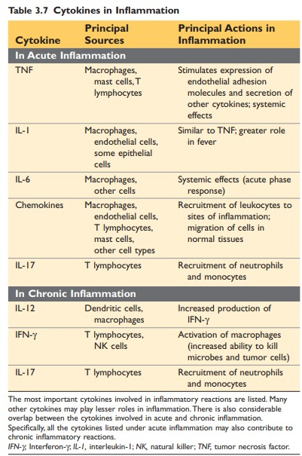

Slide 22
Tumor Necrosis Factor and Interleukin-1:
Leukocyte recruitment by promoting adhesion of leukocytes to endothelium and their migration through vessels.
Activated macrophages and dendritic cells mainly produce these cytokines; TNF also is produced by T lymphocytes and mast cells, and some epithelial cells produce IL-1 as well.
Microbial products, foreign bodies, necrotic cells, and a variety of other inflammatory stimuli can stimulate the secretion of TNF and IL-1.

Slide 23
The most important roles of these cytokines in inflammation are the following:
Endothelial activation: Both TNF and IL-1: increased expression of endothelial adhesion molecules, mostly E- and P-selectins and ligands for leukocyte integrins; increased production of various mediators, including other cytokines and chemokines, and eicosanoids; and increased procoagulant activity of the endothelium.
Activation of leukocytes and other cells: TNF augments responses of neutrophils to other stimuli such as bacterial endotoxin and stimulates the microbicidal activity of macrophages. IL-1 activates fibroblasts to synthesize collagen and stimulates proliferation of synovial cells and other mesenchymal cells. IL-1 and IL-6 also stimulate the generation of a subset of CD4+ helper T cells called TH17 cells.
Systemic acute-phase response: IL-1 and TNF (as well as IL-6) induce the systemic acute-phase responses associated with infection or injury, including fever. They also are implicated in the pathogenesis of the systemic inflammatory response syndrome (SIRS), resulting from disseminated bacterial infection (sepsis) and other serious conditions.
TNF regulates energy balance by promoting lipid and protein catabolism and by suppressing appetite.

Slide 24
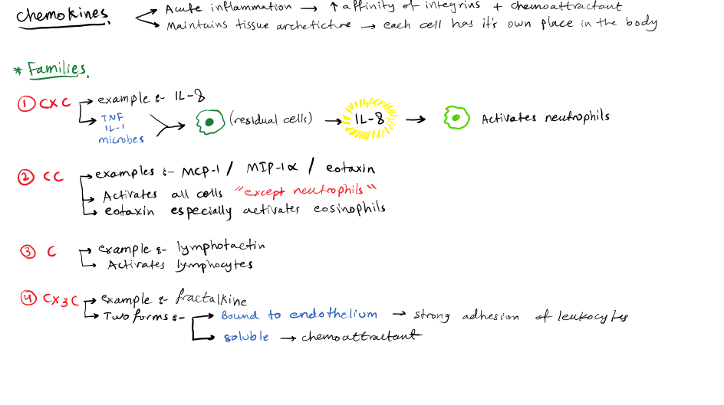


Slide 25
Chemokines
A family of small (8–10 kD) proteins that act primarily as chemo-attractants for specific types of leukocytes.
Four major groups:
C-X-C chemokines: act on neutrophils. IL-8 (now called CXCL8) is typical of this group.
C-C chemokines: include monocyte chemoattractant protein (MCP-1, CCL2), eotaxin (CCL11), and macrophage inflammatory protein1α (MIP-1α, CCL3), mainly serve as chemoattractants for monocytes, eosinophils, basophils, and lymphocytes.
C chemokines: specific for lymphocytes (e.g., lymphotactin, XCL1).
CX3C chemokines: The only known member of this class is called fractalkine (CX3CL1). This chemokine exists in two forms: a cell surface-bound protein and a soluble form.

Slide 26
Chemokines mediate their activities by binding to seven-transmembrane G protein–coupled receptors.
Certain chemokine receptors (CXCR4, CCR5) act as coreceptors for a viral envelope glycoprotein of human immunodeficiency virus (HIV), the cause of AIDS, and are thus involved in binding and entry of the virus into cells.
Chemokines bind to proteoglycans and are displayed at high concentrations on the surface of endothelial cells and in the extracellular matrix.
They have two main functions:
Acute inflammation.
Maintenance of tissue architecture.

Slide 27
Other Cytokines in Acute Inflammation:
IL-6: made by macrophages and other cells, which is involved in local and systemic reactions.
IL-17: produced mainly by T lymphocytes, which promotes neutrophil recruitment.

Slide 28
