Slide 1

Introduction To Pathology
Dr. Raya D. Marji, M.D.
Email: r.marji@bau.edu.jo
Office: O-505

Slide 2
Tissue Repair

Slide 3
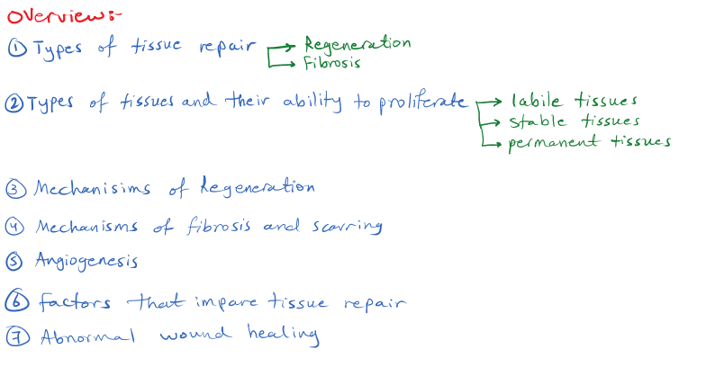

Slide 4
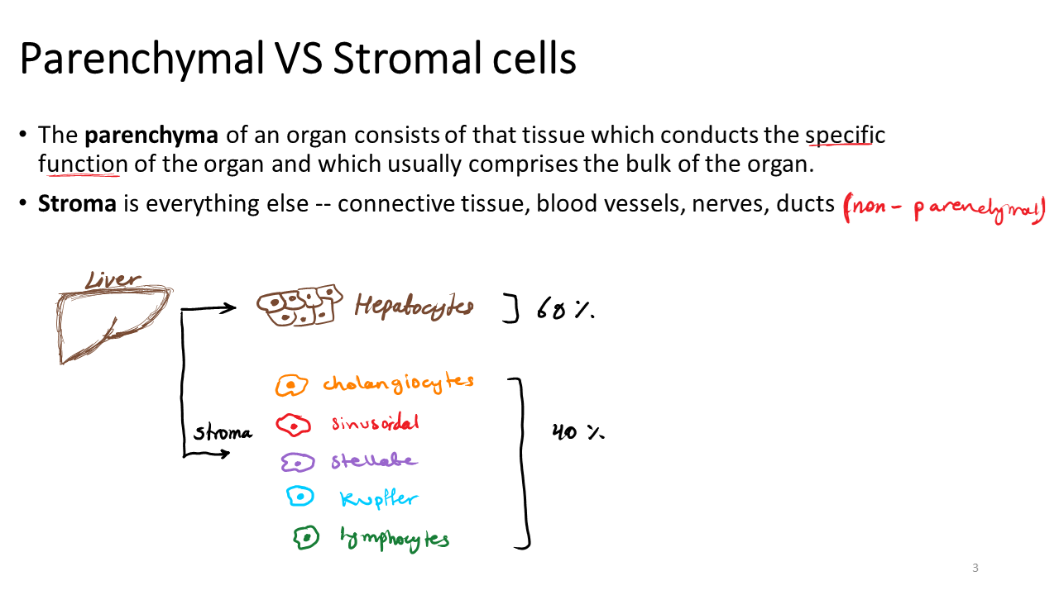

Slide 5
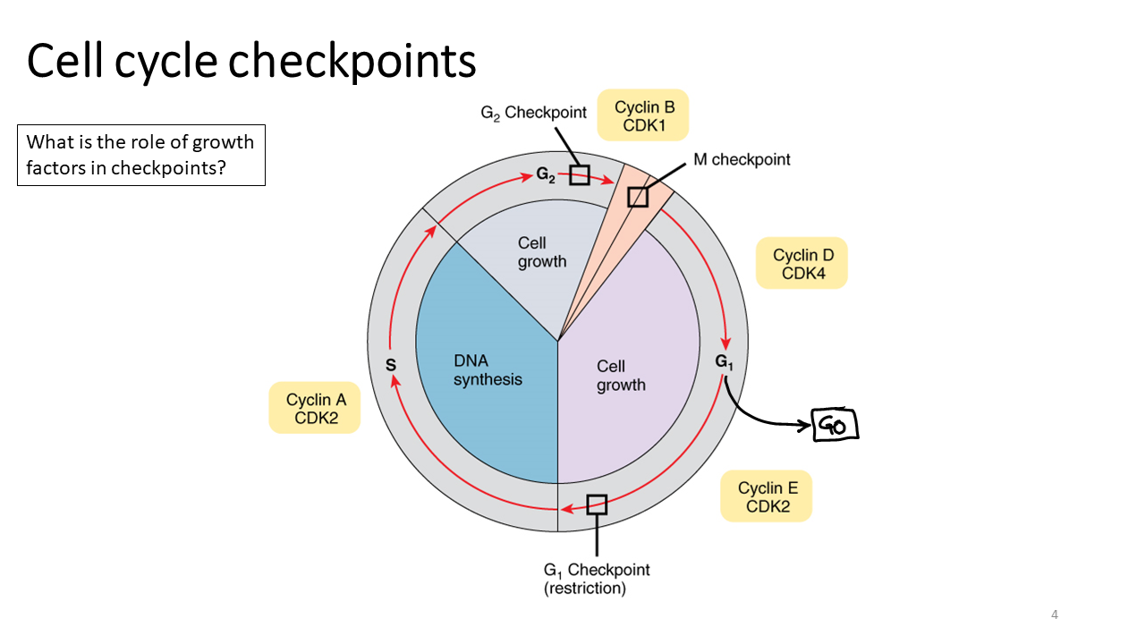

Slide 6
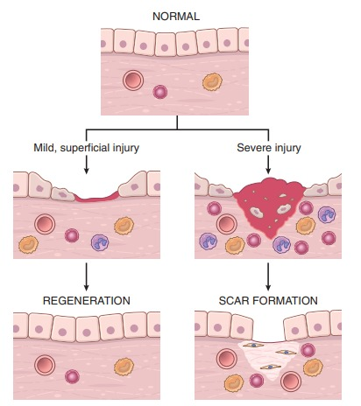
TISSUE REPAIR
The ability to repair the damage.
Two types of reactions:
Regeneration: Proliferation of cells that survive the injury and retain the capacity to proliferate.
Maturation of tissue stem cells, and the deposition of connective tissue to form a scar.

Slide 7
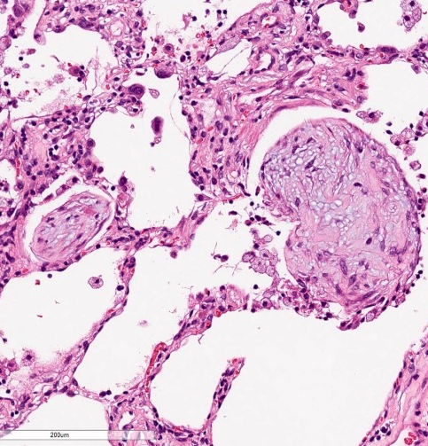
Fibrosis: extensive deposition of collagen.
Organization: fibrosis develops in a tissue space occupied by an inflammatory exudate, as in organizing pneumonia affecting the lung.

Slide 8
Cell Proliferation: Signals and Control Mechanisms
Several cell types proliferate during tissue repair.
Labile tissues: Intrinsic proliferative capacity.
Hematopoietic cells in the bone marrow and many surface epithelia, such as the basal layers of the squamous epithelia of the skin, oral cavity, vagina, and cervix; the cuboidal epithelia of the ducts draining exocrine organs (e.g., salivary glands, pancreas, biliary tract); the columnar epithelium of the gastrointestinal tract, uterus, and fallopian tubes; and the transitional epithelium of the urinary tract.

Slide 9
2- Stable tissues: in the G0 stage of the cell cycle and hence not proliferating, but they are capable of dividing in response to injury or loss of tissue mass.
These tissues include the parenchyma of most solid organs, such as liver, kidney, and pancreas. Endothelial cells, fibroblasts, and smooth muscle cells.
3- Permanent tissues: terminally differentiated nonproliferative cells, such as the majority of neurons and cardiac muscle cells.
Skeletal muscle cells are usually considered nondividing, but satellite cells attached to the endomysial sheath provide some regenerative capacity for muscle.

Slide 10
Cell proliferation:
Driven by signals provided by growth factors and from the extracellular matrix.
Growth factors: multiple cell types or cell-type specific, produced by cells near the site of damage; Sources: macrophages, epithelial and stromal cells.
Several growth factors bind to ECM proteins and are displayed at the site of tissue injury at high concentrations>>> activate signaling pathways and induce changes in gene expression>>> drive cells through the cell cycle and support the biosynthesis of molecules and organelles needed for cell division.
Cells use integrins to bind to ECM proteins.

Slide 11
Mechanisms of Tissue Regeneration
Epithelia: injured cells replaced by proliferation of residual cells and differentiation of cells derived from tissue stem cells, providing the underlying basement membrane is intact >> growth factors involved in these processes.
Parenchymal organs whose cells are capable of proliferation: a limited process.
EX: Liver (Exceptional), Kidney (hypertrophy and hyperplasia).

Slide 12
Liver Regeneration
Remarkable capacity to regenerate.
Growth after partial hepatectomy.
By two major mechanisms:
Proliferation of hepatocytes following partial hepatectomy: Process is driven by cytokines such as IL-6 produced by Kupffer cells, and by growth factors such as hepatocyte growth factor (HGF).
Liver regeneration from progenitor cells: if proliferative capacity of hepatocytes is impaired>>> progenitor cells in the liver contribute to repopulation.

Slide 13
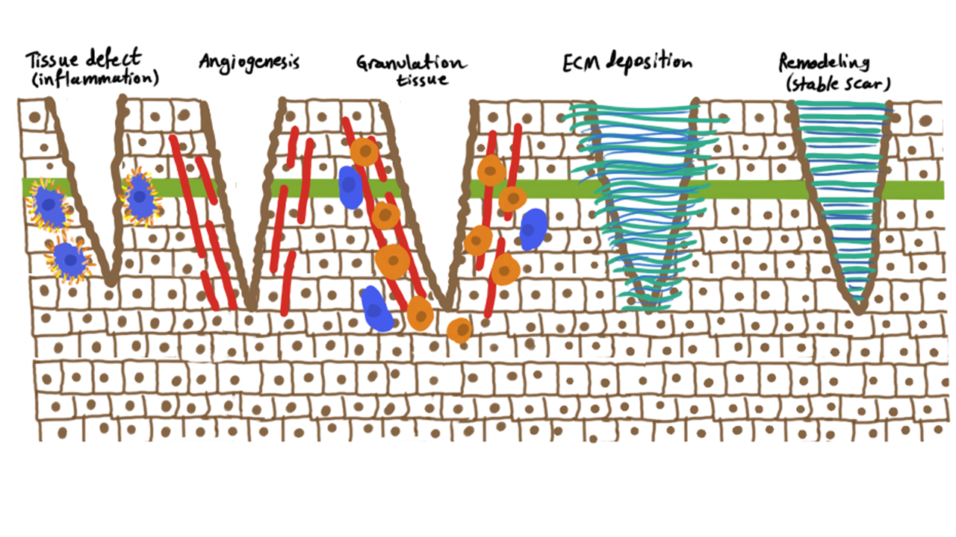
Repair by Scarring
Replacement of the injured cells with connective tissue.
If the tissue injury is severe or chronic or if nondividing cells are injured.
Ex. Skin, heart.

Slide 14
Steps in Scar Formation
Hemostatic plug formation.
Inflammation: Breakdown products of complement activation, chemokines released from activated platelets, and other mediators produced at the site of injury function as chemotactic agents to recruit neutrophils and then monocytes during the next 6 to 48 hours.
Macrophages are the central cellular players in the repair process:
M1 macrophages clear microbes and necrotic tissue and promote inflammation.
M2 macrophages produce growth factors.

Slide 15
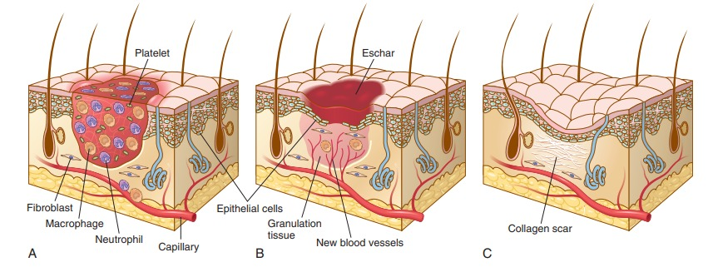

Slide 16
Cell proliferation:
Takes up to 10 days.
Epithelial cells: respond to locally produced growth factors and migrate over the wound to cover it.
Endothelial and other vascular cells proliferate to form new blood vessels (angiogenesis).
Fibroblasts proliferate and migrate into the site of injury and lay down collagen fibers that form the scar.
Granulation tissue: Proliferating fibroblasts, loose connective tissue, new blood vessels and scattered chronic inflammatory cells.
Remodeling: Produce the stable fibrous scar. This process begins 2 to 3 weeks after injury and may continue for months or years.

Slide 17
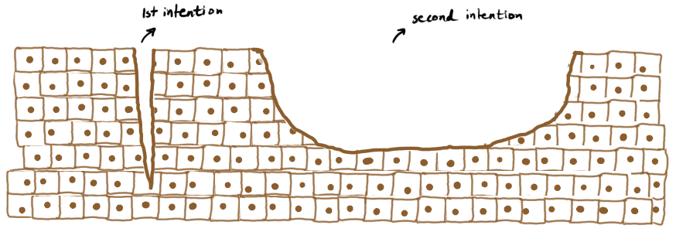

Slide 18
Healing of skin wounds:
First intention (primary union): epithelial regeneration with minimal scarring.
Second intention (secondary union): larger wounds that heal by a combination of regeneration and scarring.

Slide 19
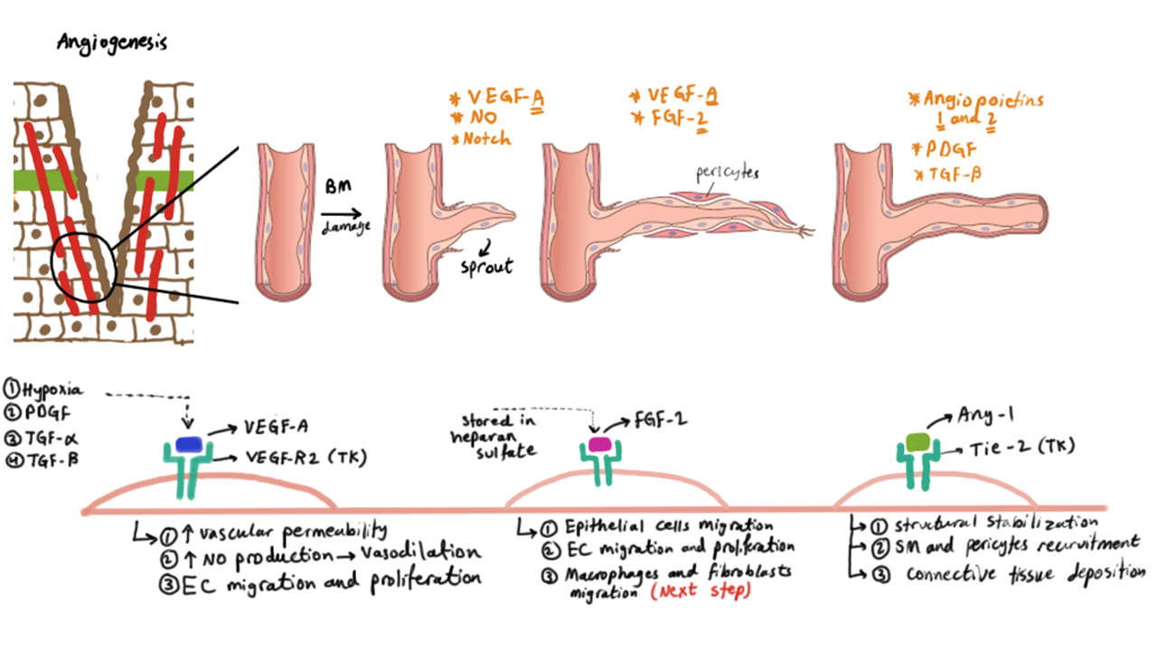
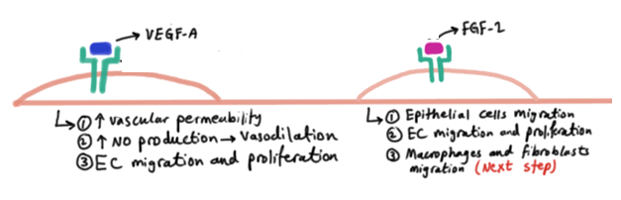
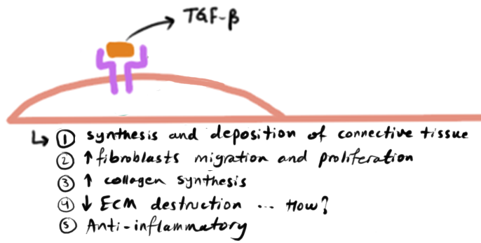

Slide 20
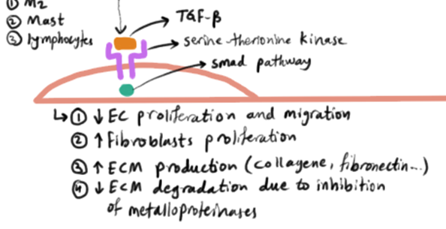

Slide 21
Angiogenesis
New blood vessel development from existing vessels.
It is critical in healing at sites of injury, in the development of collateral circulations at sites of ischemia, and in allowing tumors to increase in size beyond the constraints of their original blood supply.

Slide 22
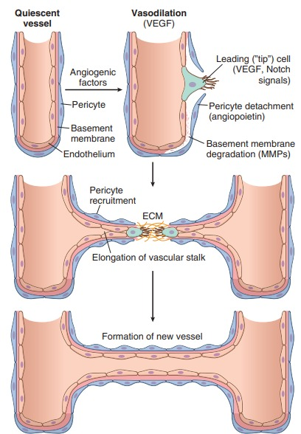
Angiogenesis:
Vasodilation in response to NO and increased permeability induced by VEGF.
Separation of pericytes from the abluminal surface and breakdown of the basement membrane to allow formation of a vessel sprout
Migration of endothelial cells toward the area of tissue injury.
Proliferation of endothelial cells.
Remodeling into capillary tubes.
Recruitment of periendothelial cells.
Suppression of endothelial proliferation and migration and deposition of the basement membrane.

Slide 23
Signaling pathways in angiogenesis:
1- Growth factors:
VEGFs, mainly VEGF-A, stimulates both migration and proliferation of endothelial cells, promotes vasodilation by stimulating the production of NO and contributes to the formation of the vascular lumen.
Fibroblast growth factors (FGFs):, mainly FGF-2, stimulate the proliferation of endothelial cells, migration of macrophages and fibroblasts to the damaged area, and stimulate epithelial cell migration to cover epidermal wounds.
Stabilization: recruitment of pericytes and smooth muscle cells and deposition of connective tissue.
PDGF recruits smooth muscle cells.
TGF-β suppresses endothelial proliferation and migration and enhances the production of ECM proteins.

Slide 24
2- Notch signaling: regulates the branching of new vessels.
3- ECM: through interactions with integrin receptors of endothelial cells for vessel growth.
Fibroblasts enter the wound from the edges and migrate toward the center.
Collagen synthesis by fibroblasts begins early in wound healing (days 3–5) and continues for several weeks, depending on the size of the wound.

Slide 25
TGF-β:
The most important cytokine for the synthesis and deposition of connective tissue proteins.
TGF-β stimulates fibroblast migration and proliferation, increases the synthesis of collagen and fibronectin, and decreases the degradation of ECM by inhibiting metalloproteinases.
Anti-inflammatory effects.

Slide 26
Remodeling of Connective Tissue
Scar is remodeled to increase its strength and contract it.
Wound strength increases because of cross-linking of collagen and increased size of collagen fibers.
Shift of the type of collagen deposited, from type III collagen early in repair to more resilient type I collagen.
Strength may recover to 70% to 80% of normal skin by 3 months.
The degradation of collagens and other ECM components is accomplished by a family of matrix metalloproteinases (MMPs).

Slide 27
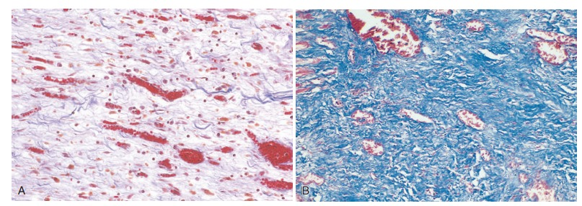
The use of special stains to identify different proteins: trichrome stain detects collagen fibers, and the elastin stain identifies delicate fibers of elastin, reticulin stain, which detects reticulin that is composed of type III collagen.

Slide 28
Factors That Impair Tissue Repair
Extrinsic (e.g., infection) or intrinsic.
Systemic or local.
Infection.
Diabetes is a metabolic disease.
Nutritional status.
Glucocorticoids (steroids).
Mechanical factors.
Poor perfusion.
Foreign bodies.

Slide 29
Clinical Examples of Abnormal Wound Healing and Scarring

Slide 30
Defects in Healing: Chronic Wounds
A result of local and systemic factors.
Venous leg ulcers: in elderly people as a result of chronic venous hypertension. Deposits of iron pigment (hemosiderin) are common, ulcers fail to heal because of poor delivery of oxygen.
Arterial ulcers: individuals with atherosclerosis of peripheral arteries, especially associated with diabetes. These lesions can be quite painful.
Pressure sores: areas of skin ulceration and necrosis of underlying tissues caused by prolonged compression of tissues against a bone.
Diabetic ulcers: affect the lower extremities, particularly the feet. Tissue necrosis and failure to heal are the result of small vessel disease causing ischemia, neuropathy, systemic metabolic abnormalities, and secondary infections.

Slide 31
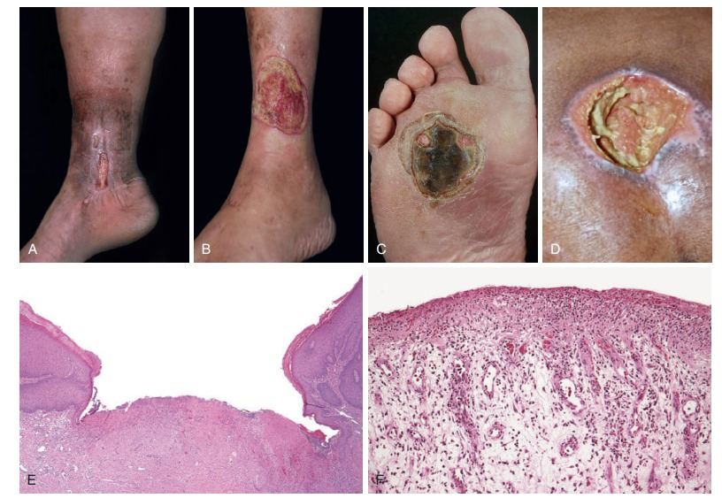

Slide 32
Excessive Scarring
Hypertrophic scars and keloids.
Hypertrophic scar: grow rapidly and contain abundant myofibroblasts, but they tend to regress over several months.
Develop after thermal or traumatic injury that involves the deep layers of the dermis.
If the scar tissue grows beyond the boundaries of the original wound and does not regress, it is called a keloid.

Slide 33
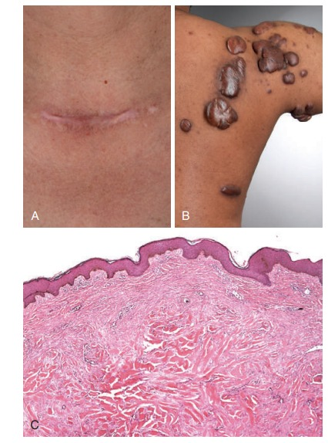

Slide 34
Exuberant granulation: formation of excessive amounts of granulation tissue, which protrudes above the level of the surrounding skin and blocks reepithelialization.
Desmoids, or aggressive fibromatoses.
Wound contraction: develop on the palms, the soles, and the anterior aspect of the thorax.

Slide 35
Fibrosis in Parenchymal Organs
Excessive deposition of collagen and other ECM components in a tissue.
A pathologic process induced by persistent injurious stimuli.
Substantial organ dysfunction and organ failure.

Slide 36
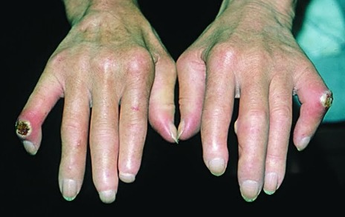
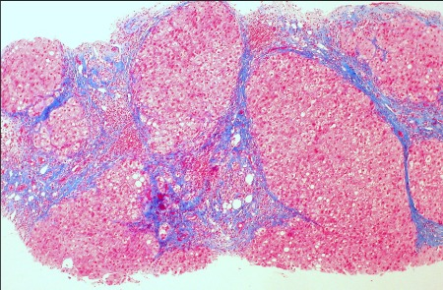
Fibrotic disorders:
Liver cirrhosis, systemic sclerosis (scleroderma), fibrosing diseases of the lung (idiopathic pulmonary fibrosis, pneumoconioses, and drug- or radiation-induced pulmonary fibrosis), end-stage kidney disease, and constrictive pericarditis.
Anti-fibrotic drugs.

Slide 37
