Slide 1

Introduction To Pathology
Dr. Raya D. Marji, M.D.
Email: r.marji@bau.edu.jo
Office: O-301

Slide 2
Inflammation

Slide 3
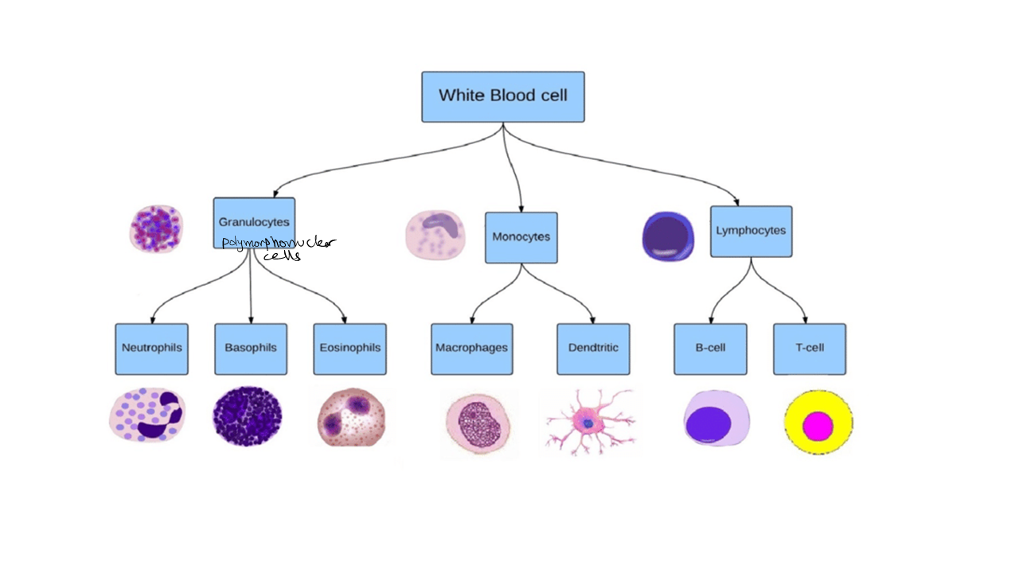

Slide 4
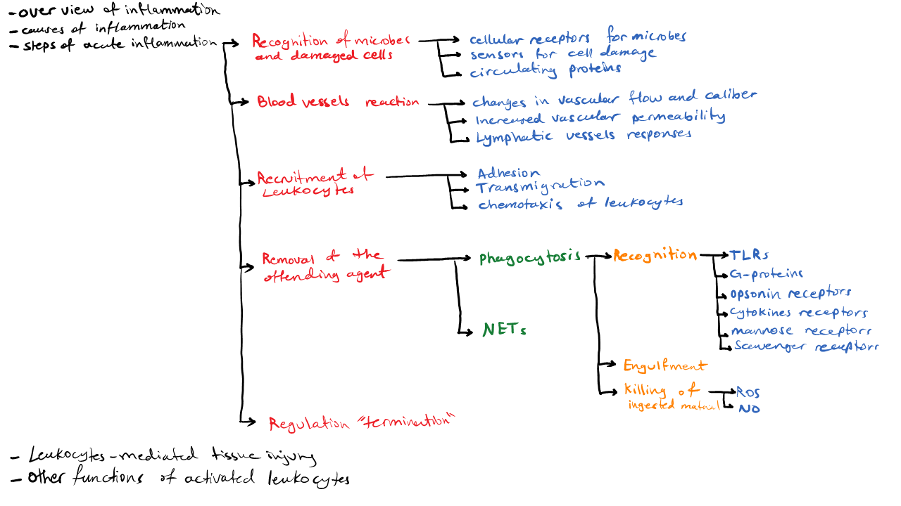

Slide 5
OVERVIEW OF INFLAMMATION
Protective response essential for survival.
Response of vascularized tissues to tissue damage; eliminate the offending agents.
Initial cause of cell injury vs. consequences of such injury.
The mediators of defense include phagocytic leukocytes, antibodies, and complement proteins.

Slide 6
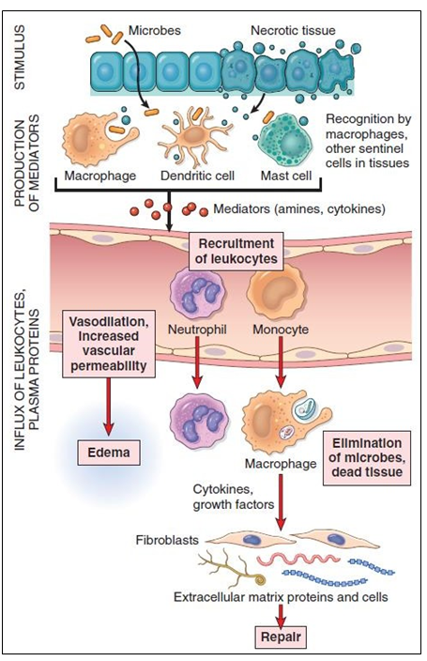
The typical inflammatory reaction develops through a series of sequential steps:
1-The offending agent, which is located in extravascular tissues, is recognized by host cells and molecules.
2-Leukocytes and plasma proteins are recruited from the circulation to the site where the offending agent is located.
3-The leukocytes and proteins are activated and work together to destroy and eliminate the offending substance.
4-The reaction is controlled and terminated.
5-The damaged tissue is repaired.

Slide 7
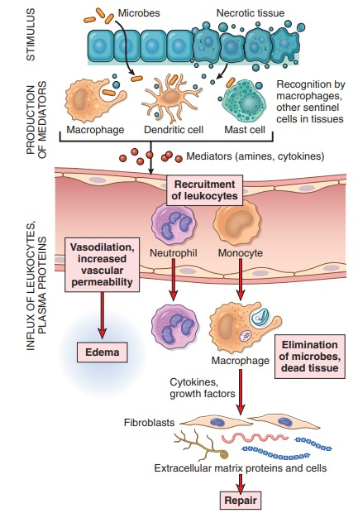

Slide 8
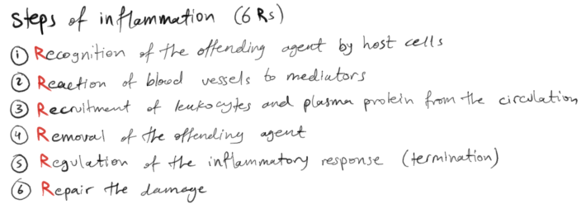
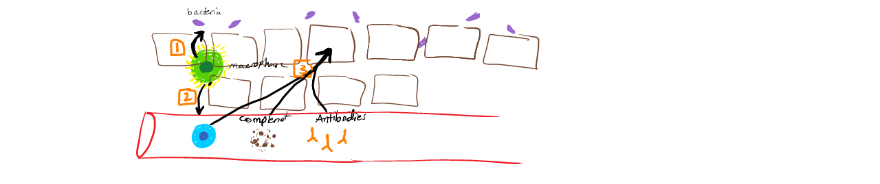

Slide 9
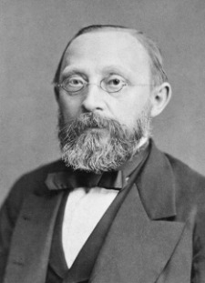
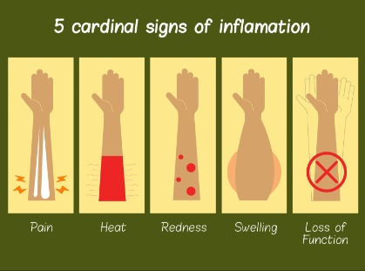
External Manifestations of Inflammation

Slide 10
CAUSES OF INFLAMMATION
Infections and microbial toxins.
Tissue necrosis (ischemia, trauma, and physical and chemical injury).
Foreign bodies (splinters, dirt, sutures, urate crystals and cholesterol crystals).
Immune reactions (also called hypersensitivity): directed against self antigens, causing autoimmune diseases, or may be inappropriate reactions against environmental substances, as in allergies, or against microbes.

Slide 11
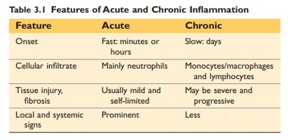
Two types of inflammation:
Acute: initial, rapid response to infections and tissue damage.
Chronic inflammation: may follow acute inflammation or arise de novo.

Slide 12
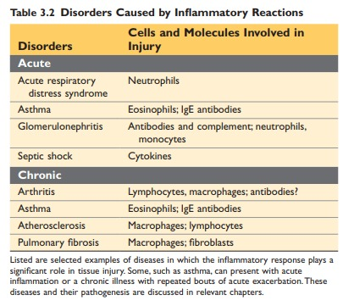

Slide 13
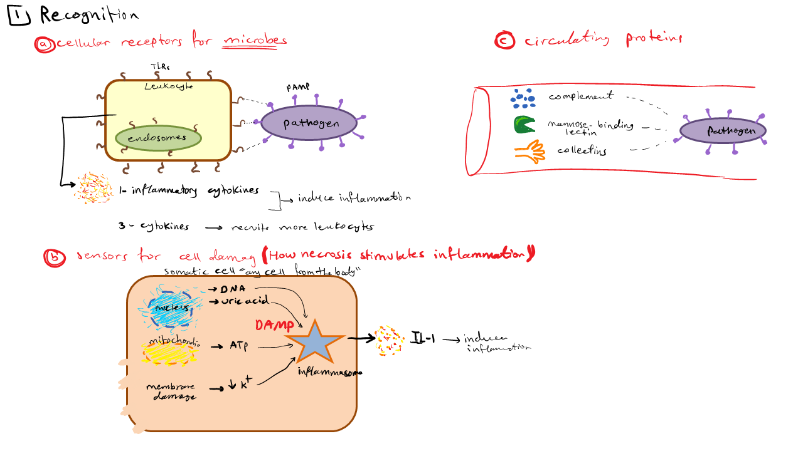

Slide 14
RECOGNITION OF MICROBES AND DAMAGED CELLS
By cellular receptors and circulating proteins.
Cellular receptors for microbes: Phagocytes, dendritic cells and many other cells have (Toll-like receptors (TLRs)). TLRs: detect extracellular and ingested microbes (pathogen-associated molecular patterns (PAMPs)).
Sensors of cell damage: damage-associated molecular patterns (DAMPs). Ex. uric acid, ATP, reduced intracellular K+ concentrations, DNA…

Slide 15
The receptors activate a multiprotein cytosolic complex called the inflammasome, which induces the production of the cytokine interleukin-1 (IL-1).
Circulating proteins: Mannose-binding lectin recognizes microbial sugars and promotes ingestion of microbes and activation of the complement system. Collectins also bind to microbes and promote their phagocytosis.

Slide 16
Reaction of blood vessels in ACUTE INFLAMMATION
Three major components:
Dilation of small vessels.
Increased permeability of the microvasculature.
Emigration of the leukocytes from the microcirculation.

Slide 17
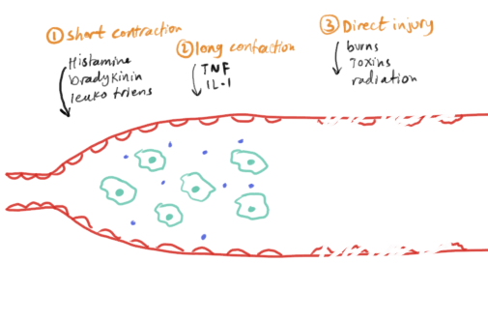

Slide 18
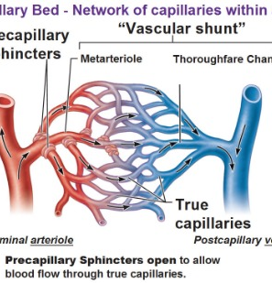
Increased Vascular Permeability:
1- Immediate transient response: Retraction of endothelial cells.
Elicited by histamine, bradykinin, leukotrienes, and other chemical mediators. It occurs rapidly after exposure to the mediator (within 15 to 30 minutes) and is usually short-lived, mainly seen in postcapillary venules.
2- Endothelial injury: induced by the actions of microbes and microbial toxins that target endothelial cells. Leakage starts immediately after injury and is sustained for several hours until the damaged vessels are thrombosed or repaired.
(ex. in burns)

Slide 19
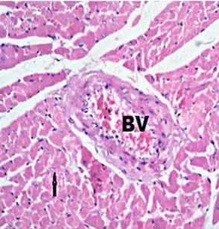
Changes in Vascular Flow and Caliber:
Vasodilation is induced by the action of several mediators (histamine) on vascular smooth muscle.
Followed by increased permeability of the microvasculature, with the outpouring of protein-rich fluid into the extravascular tissues/ body cavities.
The loss of fluid and increased vessel diameter lead to slower blood flow.
Stasis develops: blood leukocytes, principally neutrophils, accumulate along the vascular endothelium.
Endothelial cells are activated by mediators produced at sites of infection and tissue damage, and express increased levels of adhesion molecules. Leukocytes then adhere to the endothelium, and soon afterward they migrate through the vascular wall into the interstitial tissue.

Slide 20
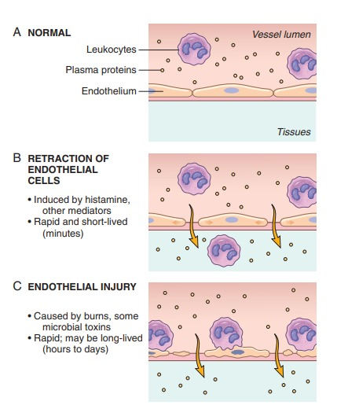

Slide 21
Reactions of Blood Vessels in Acute Inflammation
The escape of fluid, proteins, and blood cells from the vascular system into interstitial tissues or body cavities is known as exudation.
An exudate is an extravascular fluid that has a high protein concentration and contains cellular debris. Its presence implies that there is an increase in the permeability of small blood vessels, typically during an inflammatory reaction.
A transudate is a fluid with low protein content, little or no cellular material, and low specific gravity. It is essentially an ultrafiltrate of blood plasma that is produced as a result of osmotic or hydrostatic imbalance across vessels with normal vascular permeability.
Edema denotes an excess of fluid in the interstitial tissue or serous cavities; it can be either an exudate or a transudate.
Pus, a purulent exudate, is an inflammatory exudate rich in leukocytes (mostly neutrophils), the debris of dead cells, and, in many cases, microbes.

Slide 22
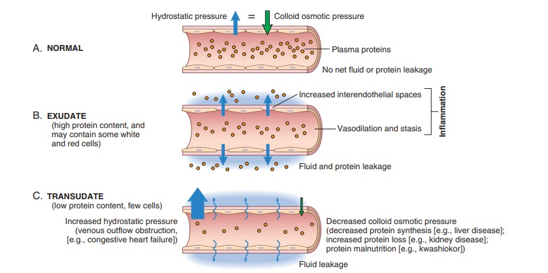

Slide 23
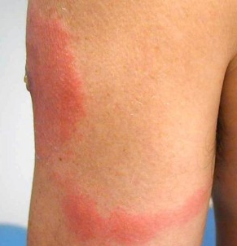
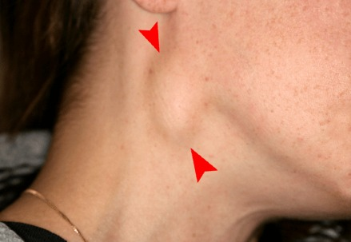
Responses of Lymphatic Vessels and Lymph Nodes:
Lymphatics drain the small amount of extravascular fluid that seeps out of capillaries under normal circumstances.
In inflammation, lymph flow is increased to help drain edema fluid (leukocytes, cell debris, and microbes, too) that accumulates because of increased vascular permeability.
The lymphatics may become secondarily inflamed (lymphangitis), as may the draining lymph nodes (lymphadenitis). This constellation of pathologic changes is termed reactive, or inflammatory, lymphadenitis.

Slide 24
Leukocyte Recruitment to Sites of Inflammation
Neutrophils: use cytoskeletal rearrangements and enzyme assembly to mount rapid, transient responses.
Macrophages, being long-lived, make slower but more prolonged responses that often rely on new gene transcription.
These leukocytes ingest and destroy bacteria and other microbes, as well as necrotic tissue and foreign substances.
Macrophages also produce growth factors that aid in repair.

Slide 25
